Slide 1
Oak Park
Stormwater Management & Flood Mitigation Project
Oak Park
Stormwater Management and Flood Mitigation Project
City of New Orleans – Hazard Mitigation Grant Program
Draft 90% Design Report
Community Meeting – January 8, 2018

Slide 2
AGENDA
PROJECT OVERVIEW AND PURPOSE
EXISTING CONDITIONS
PROPOSED DESIGN
PROJECT BENEFITS
NEXT STEPS
CONCLUSION

Slide 3
PROJECT OVERVIEW AND PURPOSE

Slide 4
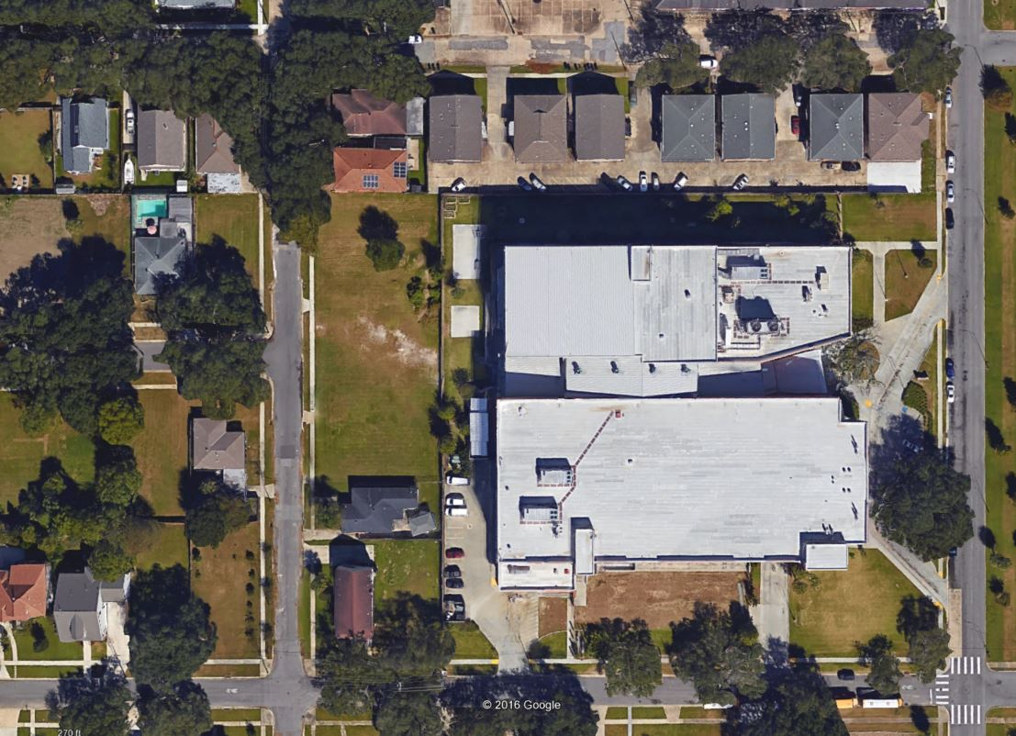
PROJECT OVERVIEW: LOCATION, PURPOSE, STATUS
Transforms five vacant NORA-owned parcels on Perlita Street, and nearby planting strips along the street, into a stormwater management feature that reduces flood risk
Location: Perlita Street, adjacent to Lake Area H.S.
Status: 90% design under Benefit-Cost Analysis review
Lake Area High School
Perlita Street
Project Site : 27,720 square feet or .64 acres

Slide 5
PROJECT SITE
Five contiguous vacant parcels behind Lake Area High School

Slide 6
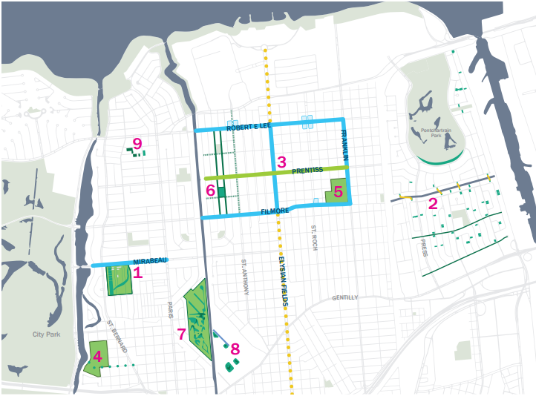
PROJECT CONTEXT
The Oak Park project is part of the City’s work to create the Gentilly Resilience District. Other projects the City is undertaking in Gentilly can be seen on the map to the left. Oak Park is #9 on the map.
Source: New Orleans Office of Resilience and Sustainability

Slide 7
EXISTING CONDITIONS

Slide 8
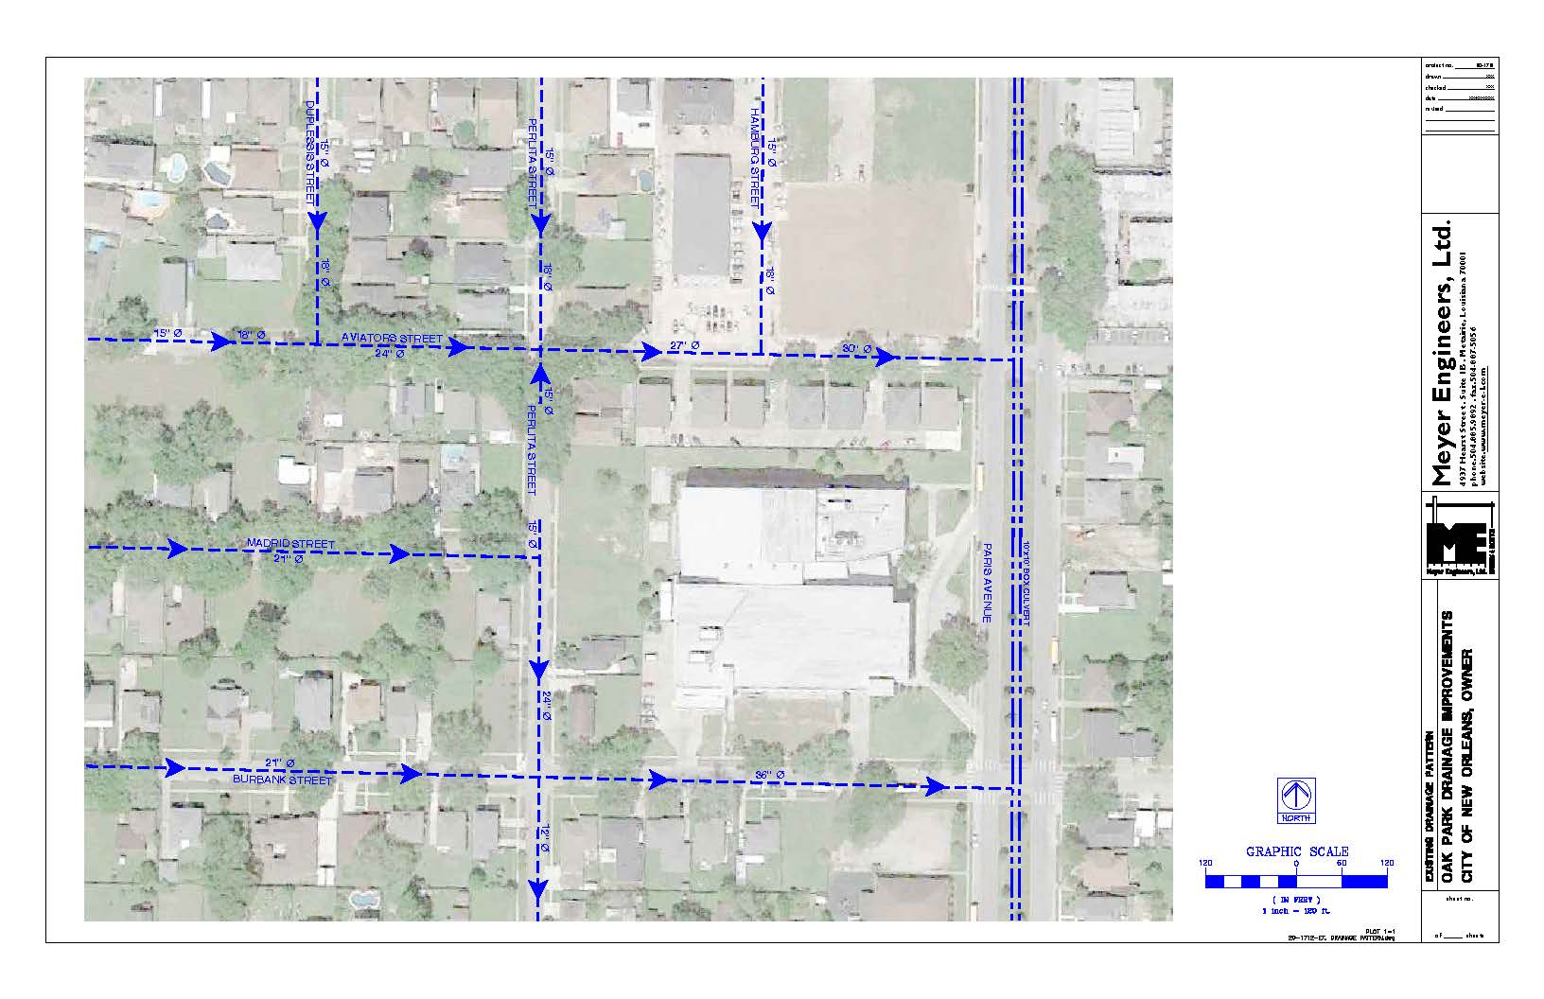
EXISTING DRAINAGE
Currently, the entire project area drains toward a large culvert under Paris Avenue (circled).
We found that the existing system can only accommodate the 100% annual chance (1 year) flood. This means that even normal rainfall events that happen every year will overflow the stormwater system and flood the streets.
Our goal with this project is to decrease neighborhood flooding during a much more severe 10-year, 24-hour storm event (8.5 inches of rain).
Lake Area High School
Existing Drainage
Project site
Paris Ave culvert

Slide 9
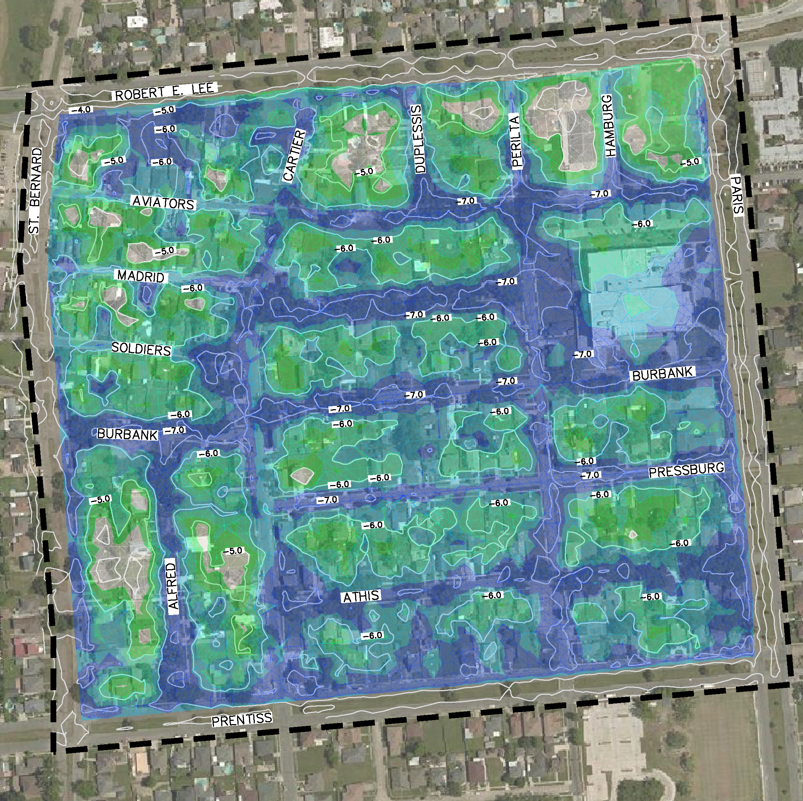
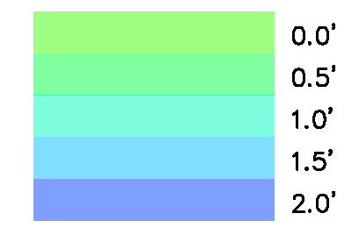
EXISTING FLOODING CHALLENGES
The team modeled street flooding under current conditions for a 2 year, 5 year, and 10 year storm.
2 year Storm Conditions: Flooding encroaches past the street onto surrounding properties in certain areas
10 year Storm Conditions: Most of the neighborhood experiences more severe flooding that encroaches onto properties and the high school
Depth of Inundation
Project site
10 Year Storm Inundation Map – Existing Conditions

Slide 10
PROPOSED DESIGN

Slide 11
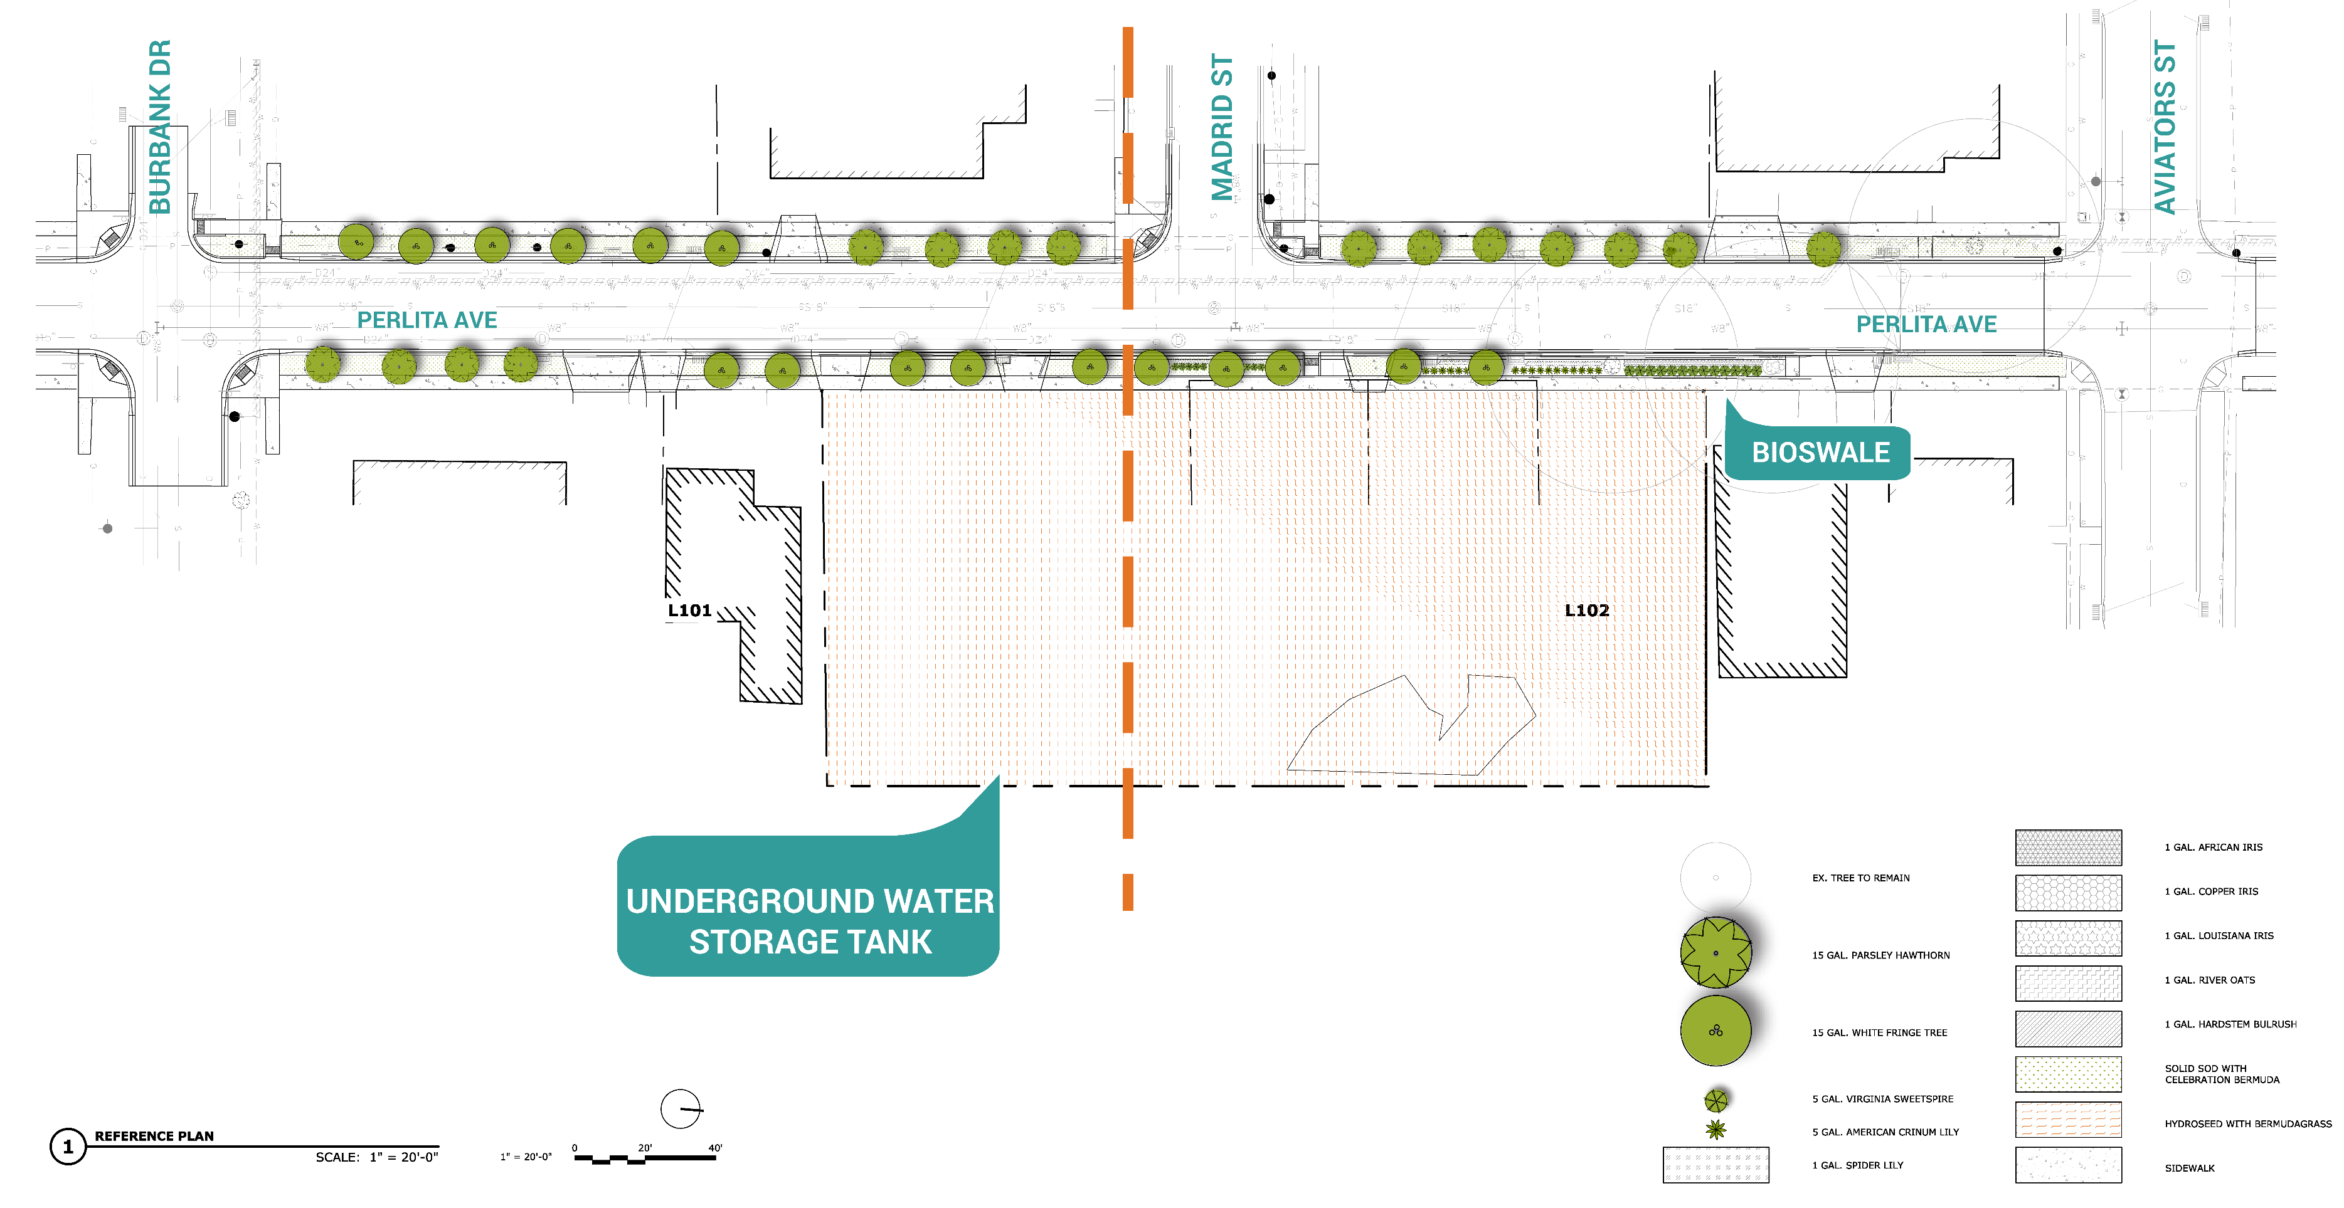
PROPOSED DESIGN

Slide 12
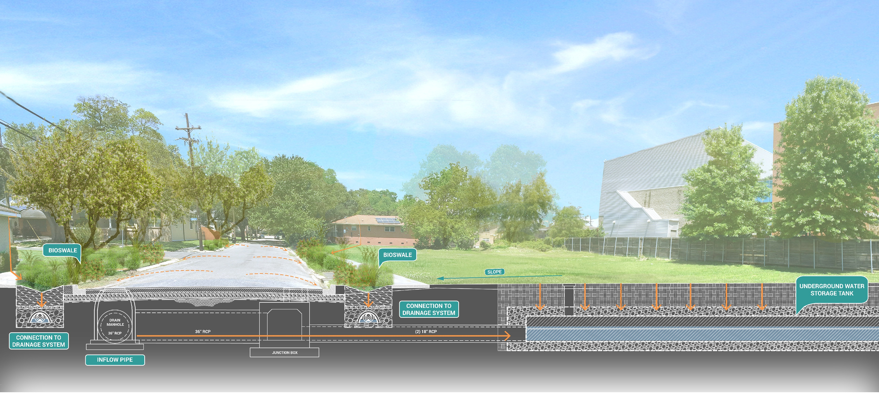
PROPOSED DESIGN

Slide 13
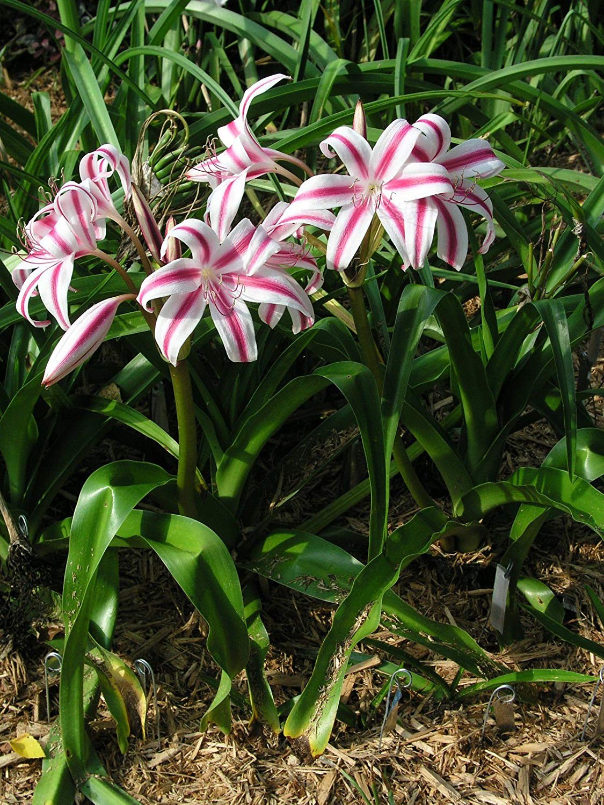
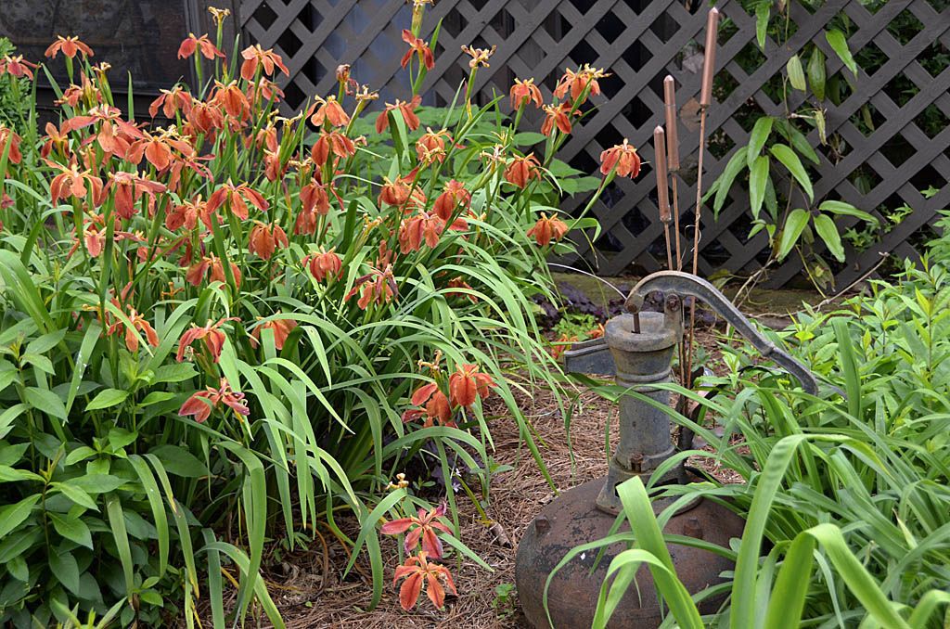
NORA LOT PLANTINGS
Additional plantings were included along the perimeter of the NORA lots. Plant roots will help water infiltrate the soils and slow and filter stormwater.
Flowering plants will help enhance the beauty of the landscape and define the site’s boundaries.
Project Site: Vacant Lots
American Crinum Lily
Copper Iris

Slide 14
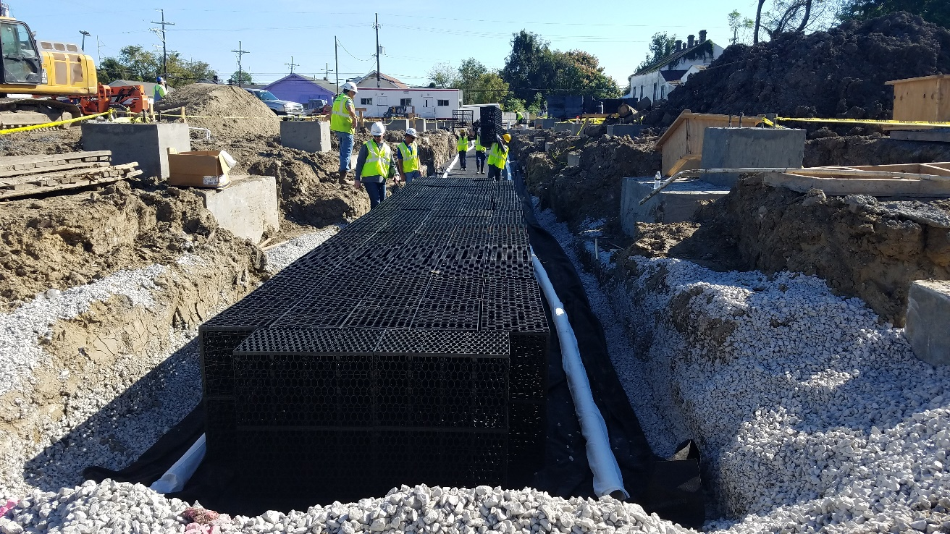
UNDERGROUND WATER STORAGE TANK
RTank: Large, permeable storage tank
The RTank system is constructed using “Double Module” units, each measuring 15.75” wide x 28.15” long x 33.86” deep and having an individual storage volume of 8.24 CF.
The 225’-2.40” x 95’-9.75” RTank system is composed of 7008 of these units giving it a total storage volume of 57,748 CF.
The RTank system is estimated to have a 40-year useful life by its manufacturer.

Slide 15
UNDERGROUND WATER STORAGE TANK
Surface of NORA Lots
Connections to Drainage System
Outfall Pipe
This image shows the R-Tank buried under the NORA lots. The pipes at the bottom of the tank connect it to the drainage system. There is a pipe on the right side that will drain the tank back into the drainage system once the storm has passed or when the tank gets full.

Slide 16
BIOSWALES
Bioswales are proposed to go in the planting strip between the sidewalk and the road. These swales will extend along Perlita Street on both sides of the street, between Aviators and Burbank.
The new total water management capacity will be 5,492 CF
Existing driveways and pedestrian connections will be preserved.
Project Site: Vacant Lots

Slide 17
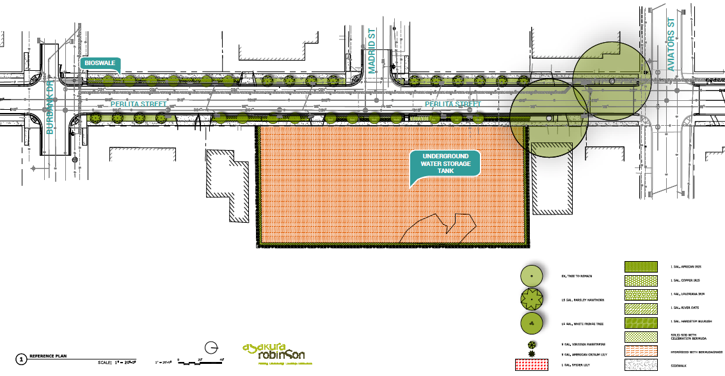

Slide 18
PROJECT BENEFITS

Slide 19
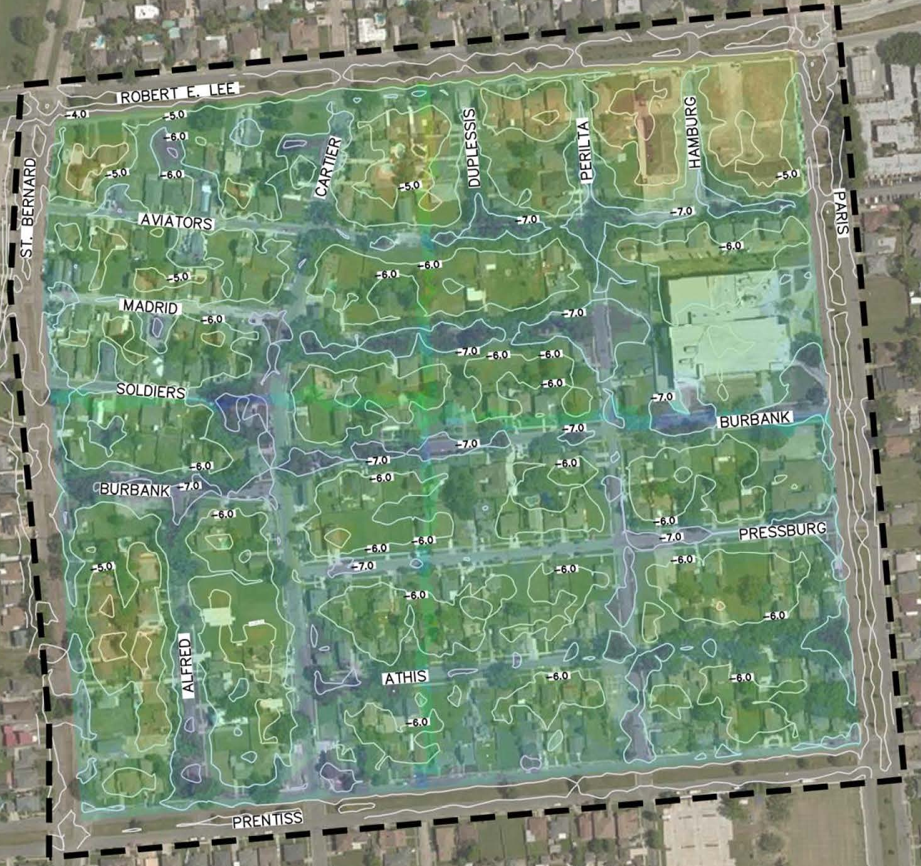
FLOODING REDUCTION: 10 YEAR STORM
The Benefit Area of the project includes 209 structures: among these are single-family homes, Lake Area High School, and commercial properties along Robert E. Lee Boulevard.
Project reduces average flooding in Benefit Area by 5.28 inches
Project reduces average flood duration by 1.34 hours: Average flood duration is reduced by over an hour, so streets are safe to drive sooner.
10 Year Storm: Preferred Option
Project site

Slide 20
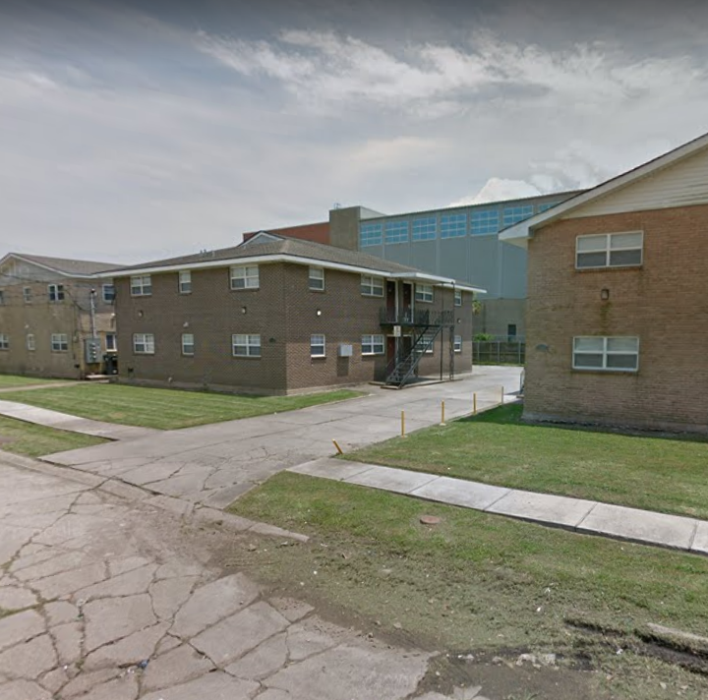
ADDITIONAL PROJECT BENEFITS
1. Reduce repetitive losses: A repetitive loss multifamily property on Aviators Street will see one foot of reduction in street flooding.
2. Reduce losses at other properties: 94 properties in the Benefit Area are estimated to be less than 0.5 feet above grade and may benefit.
3. Increase access to the neighborhood, services, and jobs for residents by reducing impassable streets: The reduction of flooding depth and duration will allow residents the ability to get to work and access services.
4. Increase access to Lake Area High School: Flooding around the school will decrease by 9.36 inches, allowing increased access to the school for teachers and students.
Multifamily repetitive loss property on Aviators

Slide 21
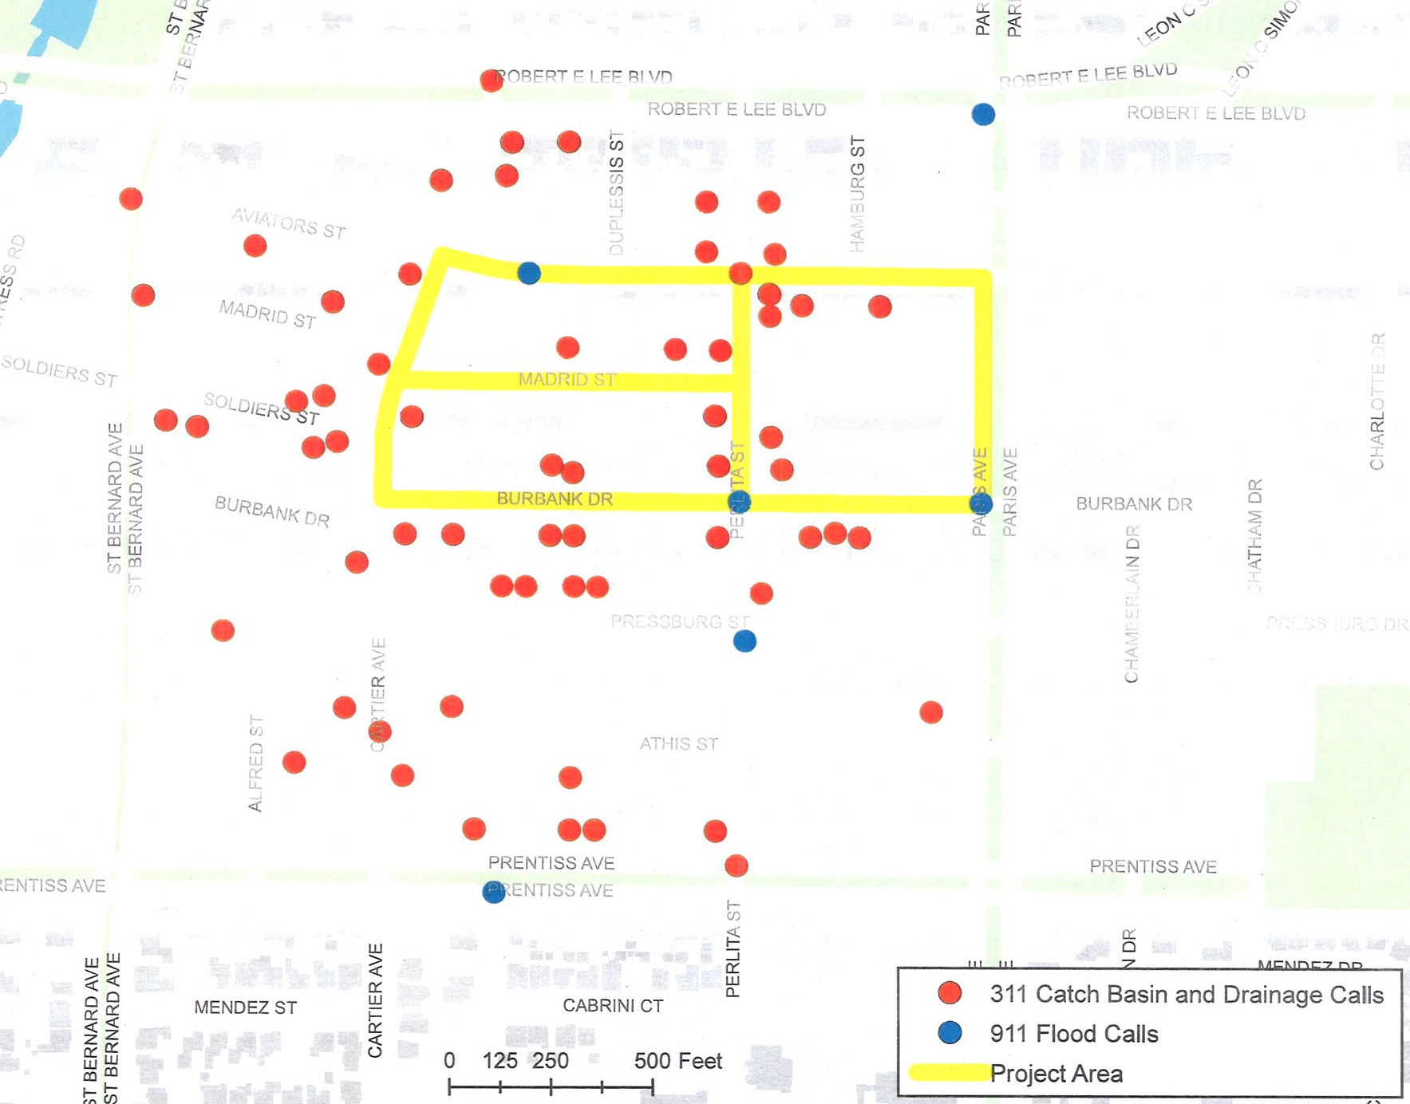
ADDITIONAL PROJECT BENEFITS
5. Reduce car flooding losses: 84 cars are estimated to be saved from flooding; a conservative estimate of $5,000 value per car means avoiding approximately $420,000 in damages.
6. Reduce 311 and 911 calls for service: Six 911 flood related calls were recorded in the first nine months of 2017 alone; decreased flooding will help residents feel safer in their neighborhood.
7. Provide educational benefits: The surface bioswale will provide opportunities for education related to green infrastructure, flooding, and local habitat and ecology.
8. Provide ecosystem services: The project will enhance water quality by filtering water, and provide habitat for pollinators with native plants.
311 and 911 calls related to flooding and drainage

Slide 22
NEXT STEPS

Slide 23
NEXT STEPS
60% Design received a favorable BCR of 1.2.
90% Construction Documents and Final H/H Report were submitted to the City on December 6, 2018.
Incorporate comments received from the City and FEMA, and feedback from the community into the project design.
Finalize Construction Documents upon receipt of a positive BCR and move into bidding phase.
Construction is anticipated to begin in April 2019.

Slide 24
Oak Park
Stormwater Management & Flood Mitigation Project
Thank You
Questions and Feedback
Oak Park Stormwater Management and Flood Mitigation Project
City of New Orleans – Hazard Mitigation Grant Program
90% Design
Resilience Design Review Committee – December 17, 2018

