Slide 1
Small Box Retail Diversity Study
City Planning Commission

Slide 2
Small Box Retail Diversity Study
September 11, 2018 Public Hearing on Small Box Retail Diversity Study
Purpose of this public hearing is to accept public input on potential changes to the STR regulations
Staff Presentation will include:
“Small Box Discount Store” definition
SBRD Study Timeline
Scope of SBRD Study
Current Applicable Regulations in the CZO
Small Box Discount Retail Data and Information
How to Provide Input for SBRD Study

Slide 3
Small Box Retail Diversity Study
Process & Timeline
The City Council adopted Motion (As Corrected) M-18-256 on June 21, 2018, directing the City Planning Commission to conduct a public hearing and study to appropriately define and regulate “small box discount stores.”
June 21, 2018: Motion (As Corrected) M-18-256 adopted by City Council
September 11, 2018: City Planning Commission Public Hearing
November 5, 2018: Deadline for written comments
November 6, 2018: The study will be available to the public
November 13, 2018: City Planning Commission considers the study
November 18, 2018: Deadline for the study and CPC recommendation to be forwarded to City Council

Slide 4
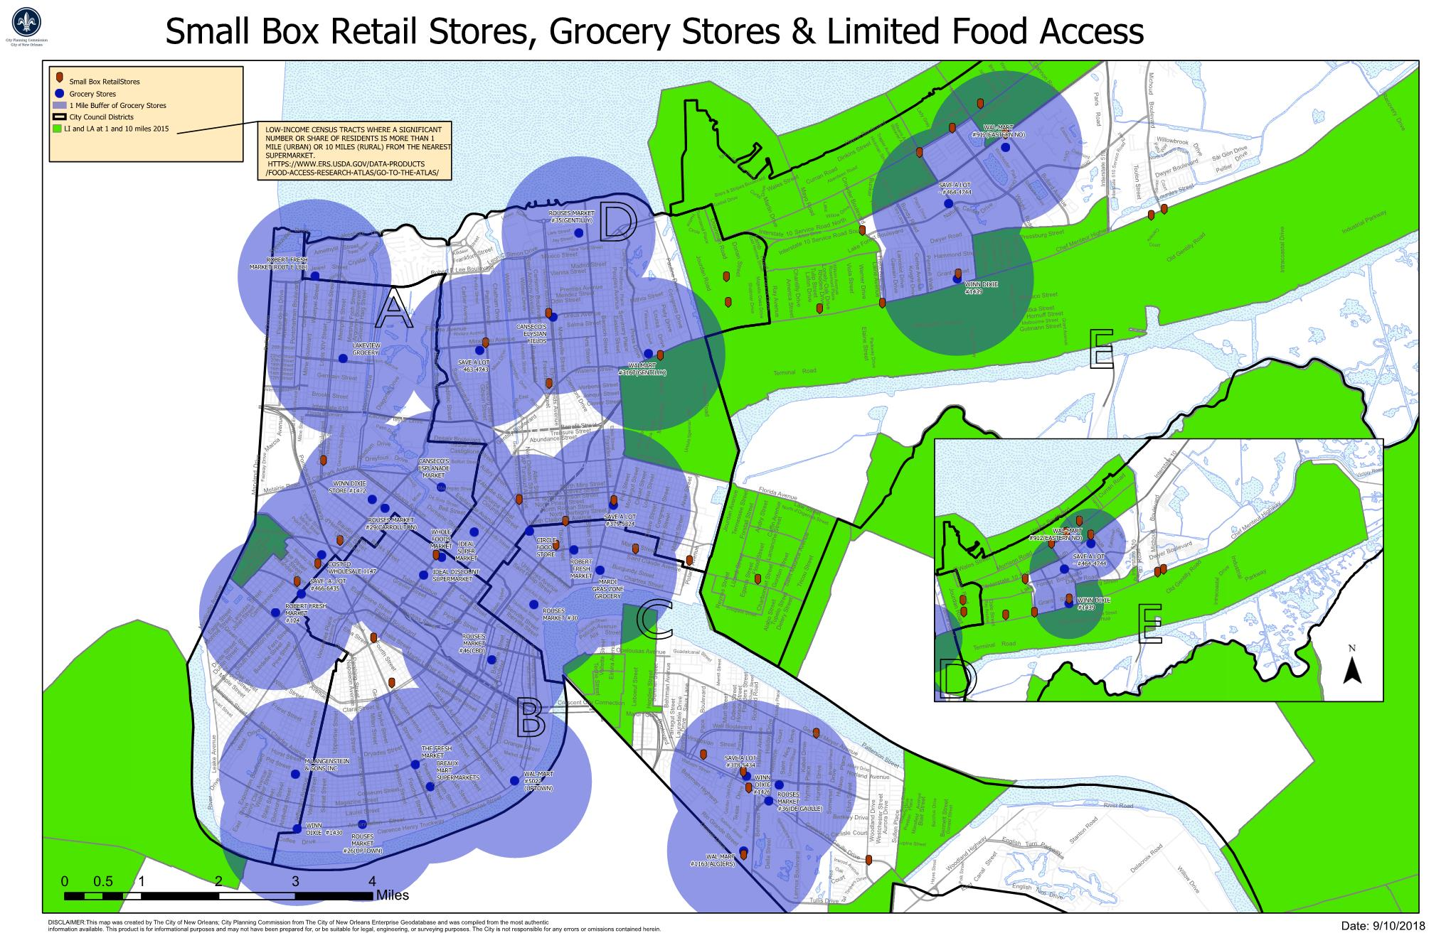
Small Box Retail Diversity Study
Definition: Small Box Discount Stores
For the purposes of the study, “small box discount stores” include businesses that:
Have a floor area of 5,000 to 10,000 square feet,
Sell at retail physical goods, products, or merchandise directly to the consumer, including food or beverages for off-premises consumption, household products, personal grooming and health products, and other consumer goods, with the majority of items being offered for sale at lower than the typical market price
but do not:
Dedicate at least 15% of floor area to fresh foods and vegetables,
Contain a prescription pharmacy, or
Offer for sale gasoline or diesel fuel

Slide 5
Small Box Retail Diversity Study
Motion (As-Corrected) M-18-256 directs the City Planning Commission to:
Conduct a public hearing and study to appropriately define and regulate “small box discount stores,” including but not limited to:
Defining “small box discount stores”
Exploring regulations such as the following:
Use standards:
Requirements to provide fresh food
Limitations on the sale of alcohol
Restrictions based on spacing/number per block-face
Any necessary restrictions to assist in curbing the proliferation of small box discount stores that fail to offer fresh fruits and vegetables
Appropriate zoning districts where “small box discount stores” may be permitted by right, conditional, and prohibited

Slide 6
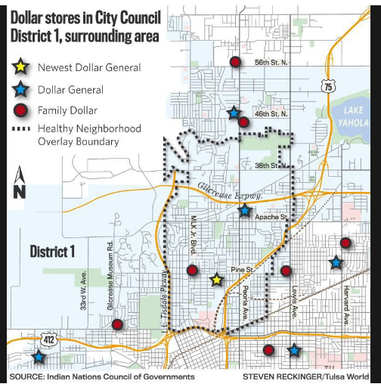
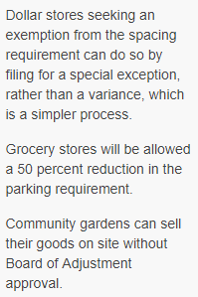
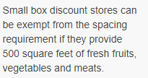
Small Box Retail Diversity Study
Motion (As-Corrected) M-18-256 directs the City Planning Commission to:
The City Planning Commission is encouraged to review similarly situated cities, like Tulsa, Oklahoma, to determine appropriate standards to govern this use and any necessary restrictions to assist in curbing the proliferation of small box discount stores in New Orleans that fail to offer fresh fruits and vegetables.

Slide 7
Small Box Retail Diversity Study
Current Regulations for “Retail Goods Establishments” in the Comprehensive Zoning Ordinance
The Comprehensive Zoning Ordinance (CZO) does not specifically define small box discount retail. The CZO does, however, provide basic regulations for Retail Goods Establishments, which includes small box discount retail.
Retail Goods Establishment. A business that provides physical goods, products, or merchandise directly to the consumer, where such goods are typically available for immediate purchase and removal from the premises by the purchaser. A retail goods establishment does not include any adult uses. A retail goods establishment may not sell alcoholic beverages unless retail sales of packaged alcoholic beverages is allowed within the district and a separate approval is obtained for such use. A retail goods establishment that sells food products, such as a delicatessen, bakery, or grocery, may offer ancillary seating areas for consumption of food on the premises.

Slide 8
Small Box Retail Diversity Study
Current Comprehensive Zoning Ordinance Regulations
Zoning districts whereby the “Retail Goods Establishment” use is permitted, conditional, and prohibited:
Permitted
Conditional
Prohibited
VCC-1
VCC-2
VCE
VCE-1
VCS
VCS-1
HMC-1
HMC-2
HM-MU
HU-B1A
HU-B1
HU-MU
S-B1
S-B2
S-LB1
S-LB2
S-LC
S-MU
C-1
C-2
C-3
MU-1
MU-2
EC
MC
MS
LS
LI
HI
MI
BIP
CBD-1
CBD-2
CBD-3
CBD-4
CBD-5
CBD-6
CBD-7
None
OS-N
OS-G
OS-R
NA
GPD
R-RE
M-MU
VCR-1
VCR-2
HMR-1
HMR-2
HMR-3
VCP
HU-RS
HU-RD1
HU-RD2
HU-RM1
HU-RM2
S-RS
S-RD
S-RM1
S-RM2
S-LRS1
S-LRS2
S-LRS3
S-LRD1
S-LRD2
S-LRM1
S-LRM2
S-LP
S-LM

Slide 9
Small Box Retail Diversity Study
Current Comprehensive Zoning Ordinance Regulations
Zoning districts whereby the “Retail Sales of Packaged Alcoholic Beverages” use is permitted, conditional, and prohibited:
Permitted
Conditional
Prohibited
C-3
LI
HI
MI
VCS
VCS-1
HMC-1
HMC-2
HM-MU
HU-B1
HU-MU
S-B1
S-B2
S-LB1
S-LB2
S-LC
S-MU
C-1
C-2
MU-1
MU-2
LS
BIP
CBD-1
CBD-2
CBD-3
CBD-4
CBD-5
CBD-6
CBD-7
OS-N
OS-G
OS-R
NA
GPD
R-RE
M-MU
VCR-1
VCR-2
HMR-1
HMR-2
HMR-3
VCC-1
VCC-2
VCE
VCE-1
VCP
HU-RS
HU-RD1
HU-RD2
HU-RM1
HU-RM2
HU-B1A
S-RS
S-RD
S-RM1
S-RM2
S-LRS1
S-LRS2
S-LRS3
S-LRD1
S-LRD2
S-LRM1
S-LRM2
S-LP
S-LM
EC
MC
MS

Slide 10
Small Box Retail Diversity Study
Current Comprehensive Zoning Ordinance Regulations
Maximum Allowable Floor Area for Commercial Uses by Zoning District:
District | Maximum Total Floor Area – Commercial Use
HMC-1 | 3,000 SF
HMC-2 | Permitted up to 10,000sf Conditional use approval required for over 10,000sf of total floor area
HU-B1A | Permitted up to 5,000sf of total floor area Conditional use approval required for 5,000sf to 10,000sf of total floor area Uses with over 10,000sf of total floor area are prohibited
HU-B1 | Permitted up to 5,000sf of total floor area Conditional use approval required for over 5,000sf of total floor area Uses with over 10,000sf of total floor area are prohibited
HU-MU | Permitted up to 5,000sf of total floor area Conditional use approval required for over 5,000sf of total floor area Uses with over 10,000sf of total floor area are prohibited
S-B1 | Permitted up to 5,000sf of total floor area Conditional use approval required for 5,000 or more square feet of total floor area
S-B2 | Permitted up to 25,000sf of total floor area Conditional use approval required for 25,000 or more square feet of total floor area
S-LB1 | Permitted up to 5,000sf of total floor area Conditional use approval required for 5,000 or more square feet of total floor area
S-LB2 | Permitted up to 5,000sf of total floor area Conditional use approval required for 5,000 or more square feet of total floor area
S-LC | None
S-MU | Permitted up to 5,000sf of total floor area (ground floor only) Conditional use approval required for 5,000 or more square feet of total floor area No stand-alone commercial uses are allowed unless on the same lot as multi-family residential

Slide 11
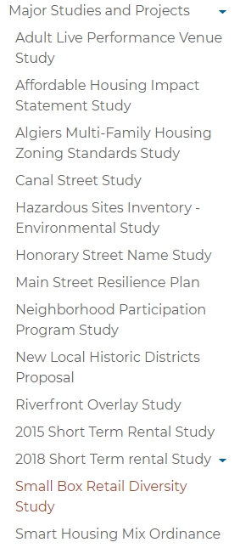
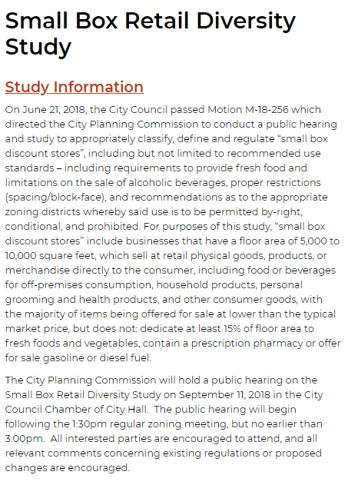
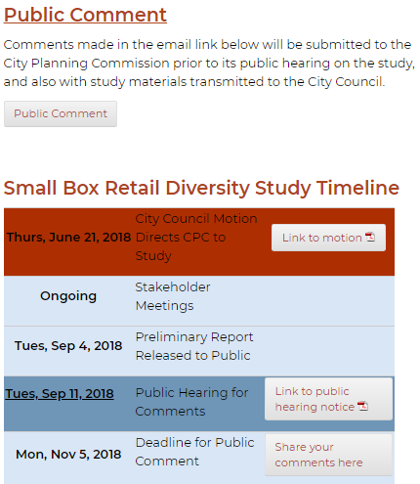
Small Box Retail Diversity Study
How to Provide Input: https://www.nola.gov/cpc
1
3
4
Scroll
2

Slide 12
Small Box Retail Diversity Study
Public Comment
In summary, public comments are due by November 5, 2018 at 5:00 pm and can be submitted:
On CPC’s website:
https://nola.gov/cpc through “Major Studies & Projects” at the “Small Box Retail Diversity Study” page or directly at this link:
https://www.nola.gov/city-planning/major-studies-and-projects/small-box-retail-diversity-study/
By email to:
cpcinfo@nola.gov
By mail or hand delivery to:
City of New Orleans
City Planning Commission
c/o Executive Director Robert Rivers
1300 Perdido Street, 7th Floor
New Orleans, LA 70112

