Slide 1
DEVELOPER’S PROCESS
GESTATION
Concept
Site Selection
Definition
PLANNING
Property Research
Agency Feasibility
Market Research
Financing Options
Due Diligence
Tax Credits
Bond
Equity
Debt
Architecture/ Engineering
Purchase
Conceptual Design
Preconstruction Docs
Agency Review
EXECUTION
Approved Plans
Bid/Sub Contract
Build
Open

Slide 2
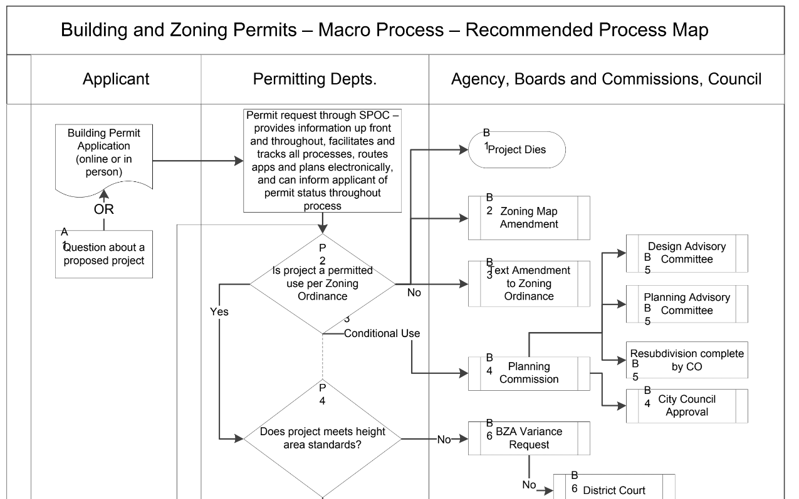
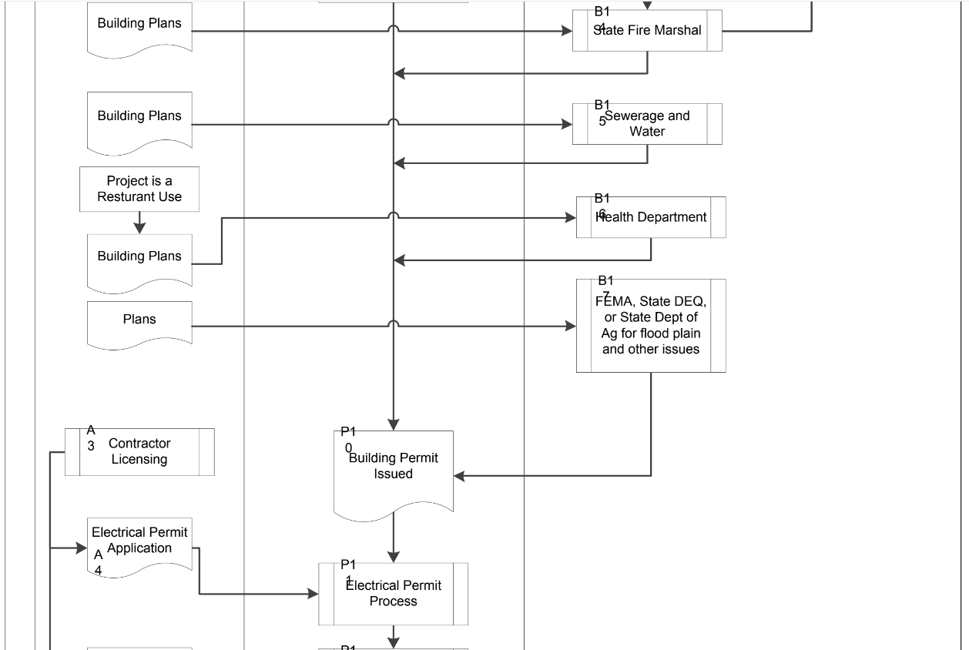
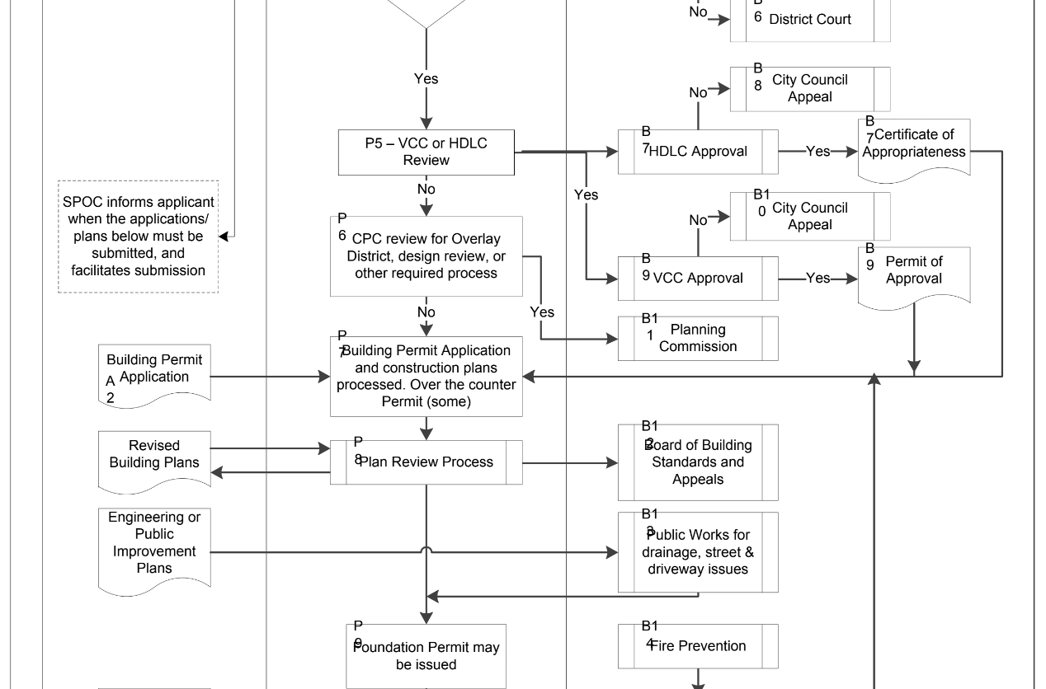
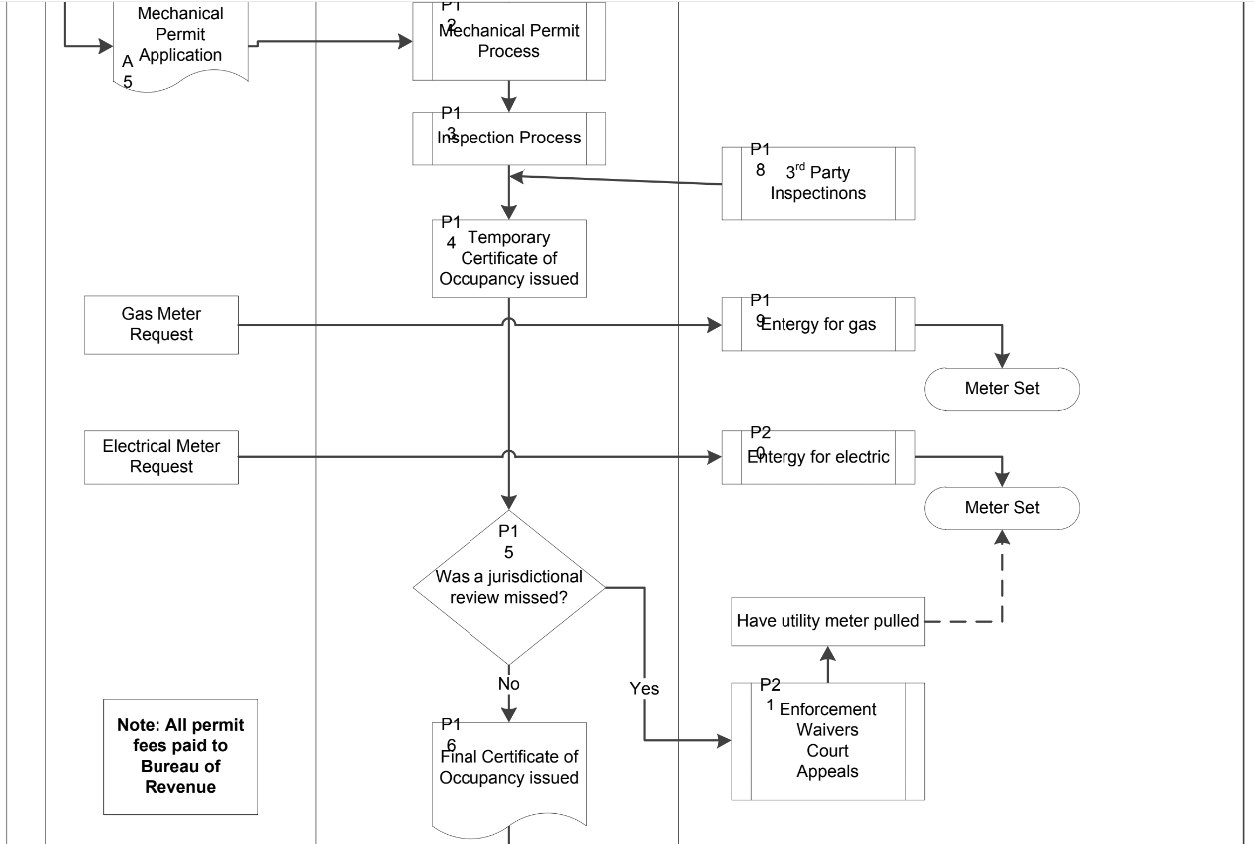

Slide 3
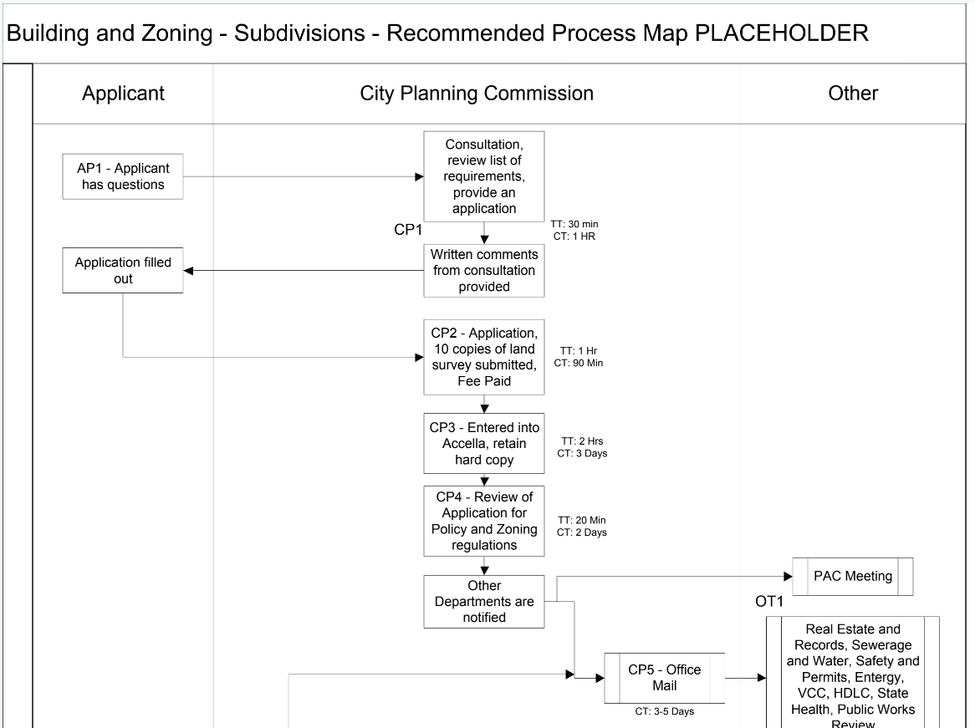
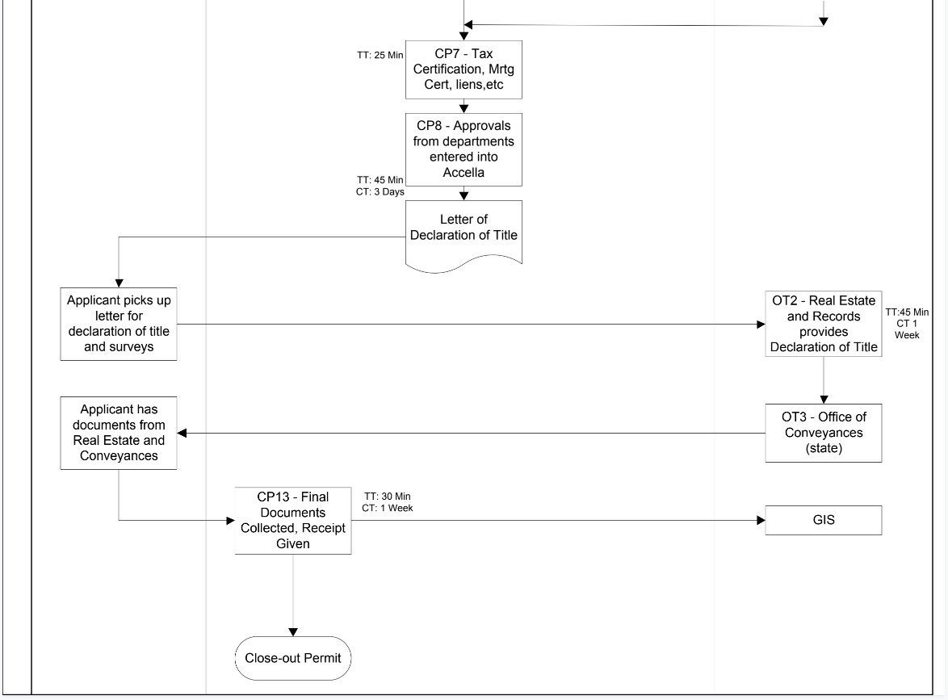
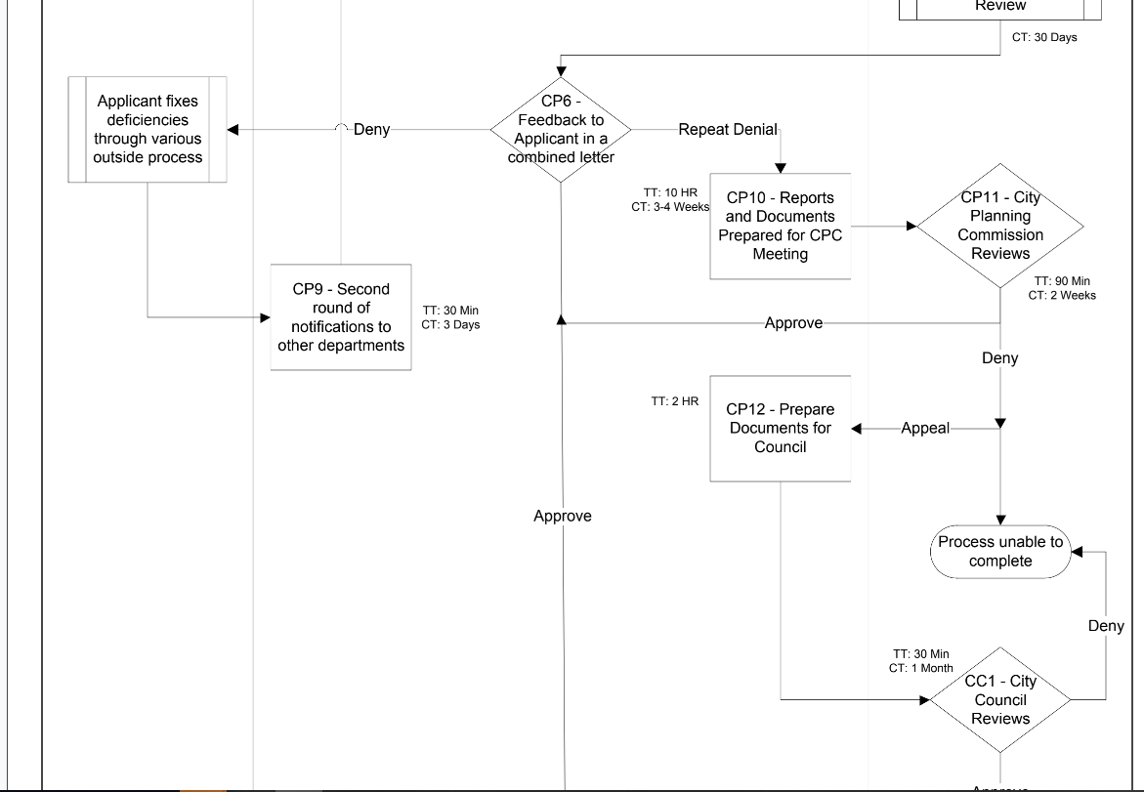
Planning Commission & Council Actions

Slide 5
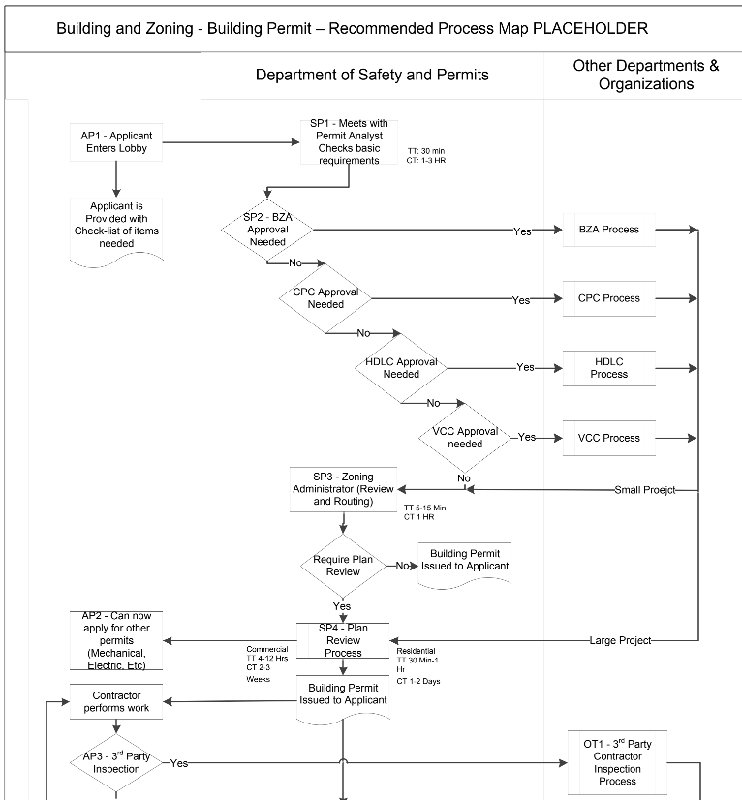
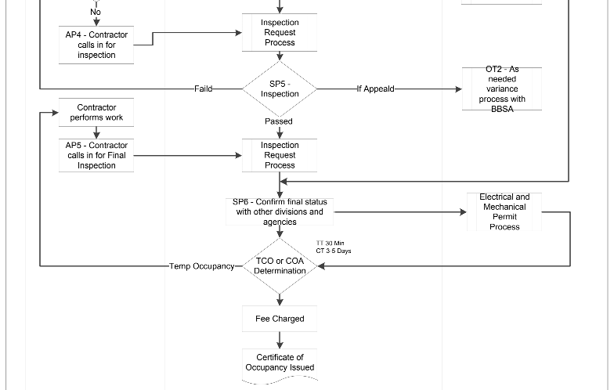

Slide 6
GESTATION
Economic Development
ENGAGEMENT OPPORTUNITIES
Concept
Site Selection
Definition
PLANNING
Property Research
Agency Feasibility
Market Research
Financing Options
Due Diligence
RTA and Credits
Planning and Permitting
Tax Credits
Bond
Equity
Debt
Architecture/ Engineering
Purchase
Conceptual Design
Work Force Development
Preconstruction Docs
Agency Review
EXECUTION
Approved Plans
DBE Opportunities
Bid/Sub Contract
Build
Hire
Open

Slide 7
Development Working Group
Purpose: The purpose of the Development Working Group is to review projects being proposed in New Orleans and identify nexuses of combined opportunity between its member organizations. This group will evaluate each project to maximize local economic impact through employment opportunities, resilient infrastructure, and community benefit.

Slide 8
OneStop Pre-Development Conferences
Purpose: OneStop Pre-Development Conferences are an opportunity to meet with all departments involved in the development process at the same meeting.
These meetings are scheduled to introduce the developers to local development regulations and the officials responsible for most aspects of development.
The meeting offers an applicant the opportunity to explore project viability, major requirements, fees, timeframes, and overall processing issues before filing an application, preparing detailed plans, and committing other time and resources.
The goal of this early consultation is to help applicants understand and improve the flow and compliance of projects as they move through the City's review system. These meetings provide an opportunity for the developer to discuss their proposal with City officials for developments.

