Slide 1
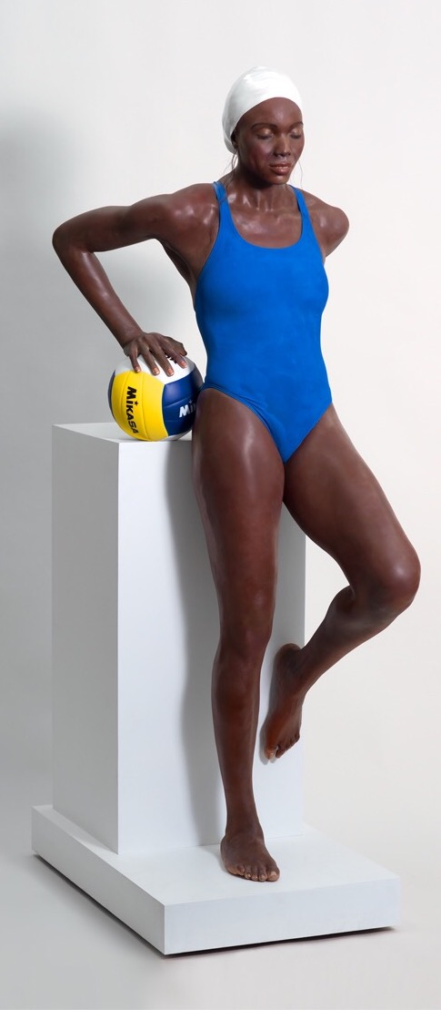
Carole Fuerman
Yanema and the Ball
Lifesize
Fiberglass

Slide 2
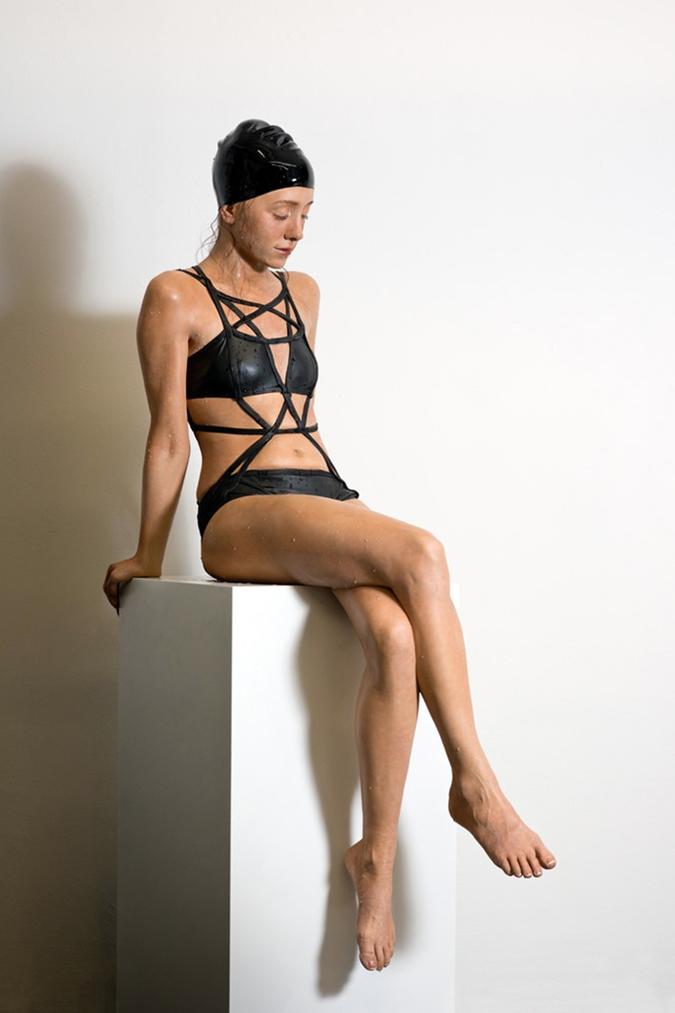
Kendall
Lifesize
Fiberglass

Slide 3
