Slide 1
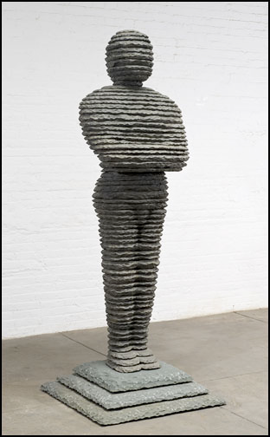
DAVID by Boaz Vaadia
Bronze and bluestone,
91 x 36 x 36 inches

