Slide 1
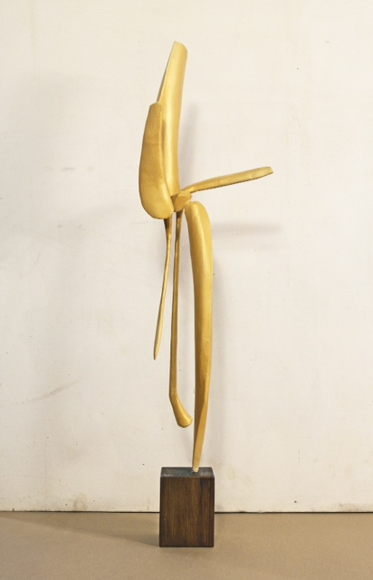
David Borgerding –sculpture
Hammered Bronze
31” x24” x 24”

Slide 2
