Slide 1
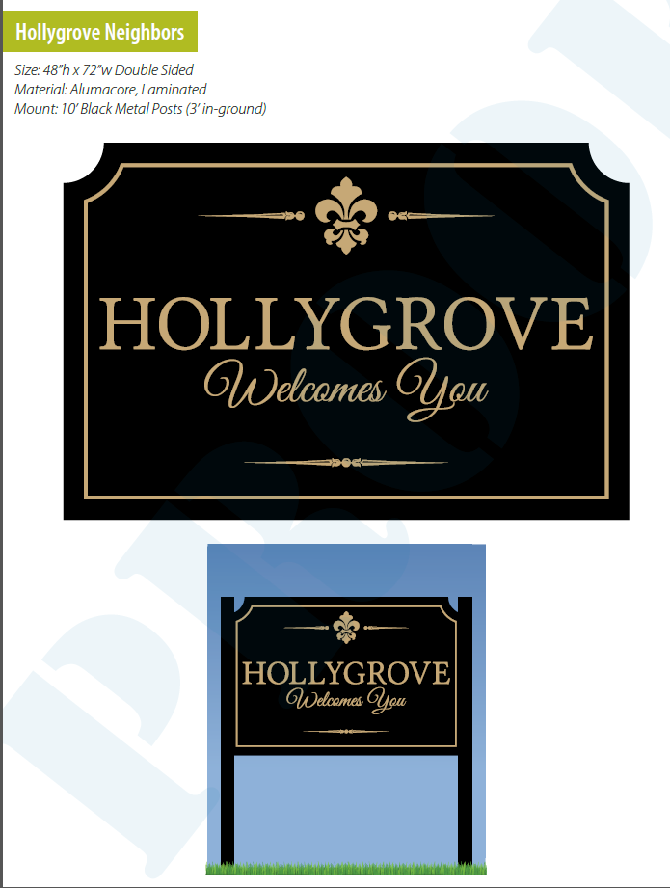
Hollygrove Neighborhood Sign

Slide 2
