Slide 1
Change of aDDRESS Procedures
If any city employee enrolling in the City’s HealthCare Plan and/or the Flexible Spending Account Plan, has had an address change within the last year he/she must complete the following steps, in order, for their information to be updated into the United Healthcare system as well as through the Automatic Data Processing (ADP) system.

Slide 2
Two 5 Step Approaches
Requirement 1
Requirement 2
And

Slide 3
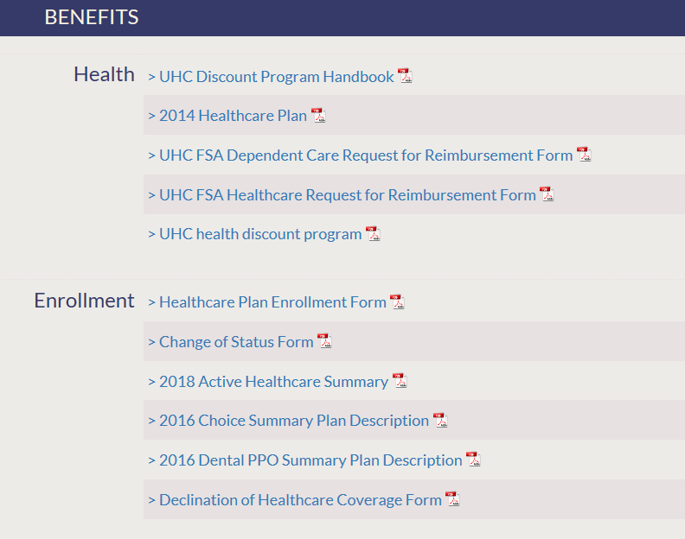
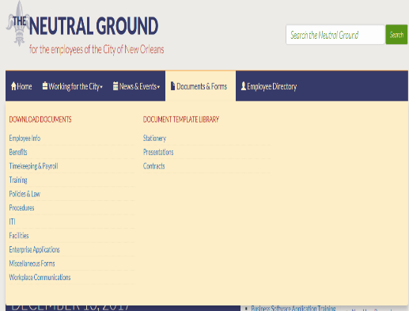
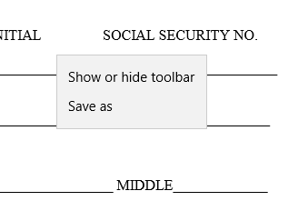
#1: The Neutral Ground
Start
Visit www.employee.nola.gov/neutral
Click Documents and Forms button. Then, click the “Benefits” tab (Found under the Download Documents column.
Next, click Change of Status Form (under the “Enrollment” tab).
Finish
1
2
3
4
5
Fill out and submit form to the HR Manager and Chief Administrative Office at City Hall.
Right Click on the form to Save and Print form.

Slide 4
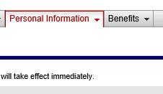
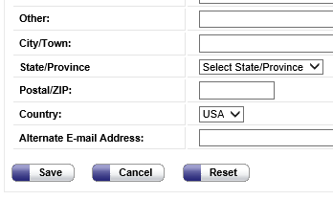
#2: AUTOMATIC DATA PROCESSING
Step: 1
Step: 2
Step: 3
Step: 4
Step: 5
Login with Employee Username ID/ Password
Click “Personal Information” tab
Visit https://portal .adp.com
Select Employee then
Press “Save” after changes have been made
Select option from drop down menu update and click edit at the bottom left of the page

Slide 5
Procedure Inquires
If you have any questions, please contact the Employee Relations Division at (504) 658-8618
Located at 1300 Perdido Street, New Orleans, LA 70112, Rm. 9E06, Chief Administrative Office

