Slide 1
CONFERENCE MEMBERS
HON. HELENA MORENO, MAYOR, CHAIR
HON. LESLI HARRIS, COUNCILMEMBER DISTRICT B
HON. JP MORRELL, COUNCILMEMBER-AT-LARGE (NON-VOTING REP.)
JOSEPH I. GIARRUSSO III, CHIEF ADMINISTRATIVE OFFICER
ALYSSA W. RAMBEAU, DIRECTOR OF FINANCE
MARA BAUMGARTEN FORCE, TULANE UNIVERSITY
REVENUE ESTIMATING CONFERENCE
January 27, 2026

Slide 2
REVENUE ESTIMATING CONFERENCE
January 27, 2026
Adoption of Minutes from December 1, 2025 Revenue Estimating Conference
Consideration of Revised Revenue Projections
  SWBNO Collections
  Wisner
  ARPA
  Parking Enforcement Increase & Collections

Slide 3
SWBNO Collection

Slide 4
SWBNO Collections - $29.5M**
Reimbursement of funds fronted by the City of New Orleans to pay for infrastructure projects
According to CNO, total reimbursement due by SWBNO to CNO is $80M+
II. Mutually agreed upon reimbursements include:
  $24.3M in FEMA reimbursements
  $5.2M in max pave/ bond projects
III. Categorize the receivables as paid for with bond money
**These funds will be recognized as operating cash in 2026.

Slide 5
Wisner

Slide 6
Wisner - $16.4M
Wisner Funds will be dedicated to the General Fund for public benefit instead of distributed to non-profit organizations
$7.6M - Funds in Hand
  As a result of funds owed to City, including settlements
II. $4.8M - 2026 Revenue
  Projected annual revenue from Wisner with CNO as bona fide 60% property owner (other 40% disputed by heirs in Court)
III. $4M – Federal Tax Return
  Part of tax return paid but owed to CNO

Slide 7
ARPA

Slide 8
ARPA - $14.75M
Reclassify Unspent Program Dollars under Revenue Replacement - Government Services
ARPA – $42.4M in Unspent Program Dollars
  Reclassify $14.75M in unspent program dollars under Revenue Replacement – Government Services
  $27.65M in unspent program dollars remain with programs
II. Compliance
  Documented allocation decision by governing body
  Funds used for “government services” as defined by Treasury
  Revenue-loss calculation
  Documented program funding obligation by 12/31/24
  Updated Treasury reporting

Slide 9
Parking Enforcement + Collections

Slide 10
Parking Enforcement and Collections
Parking Enforcement Increase: $7M
  The FY2026 Amended Budget includes funds to hire 50 new Parking Enforcement Officers (PEO) in the first half of the year
  Based on historical collections per PEO plus an increased focus on parking enforcement, this investment will generate at least an additional $7M in 2026. This estimate accounts for a six-month hiring and training period.
Parking Collections Effort: $6.5M
  There is $100M in outstanding parking tickets owed to the City, $11.75M of which has been issued within the last 3 years
  With increased effort to collect outstanding debt, a conservative increase will generate $6.5M

Slide 11
Appendix
ARPA Reductions

Slide 12
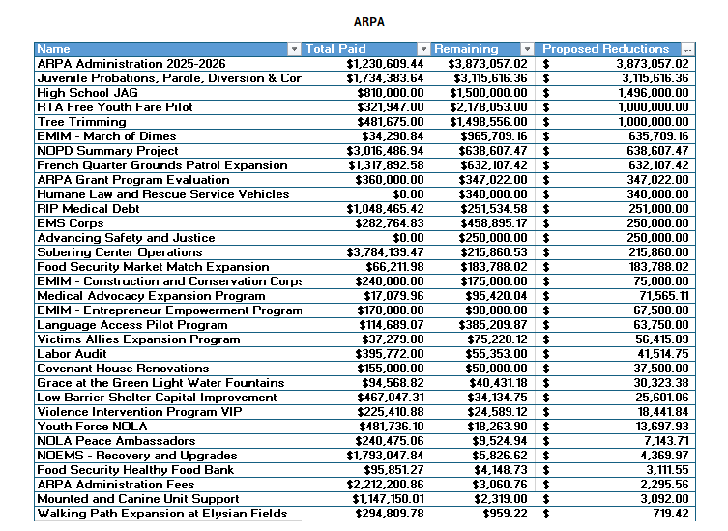

Slide 13
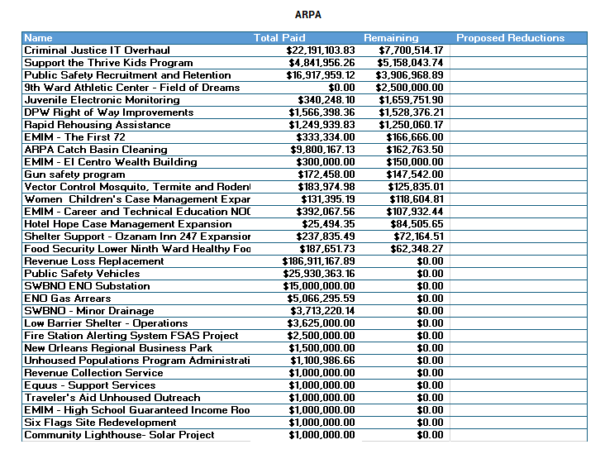

Slide 14
