Slide 1
Rental – Blue Plate Apartments
Gert Town

Slide 2
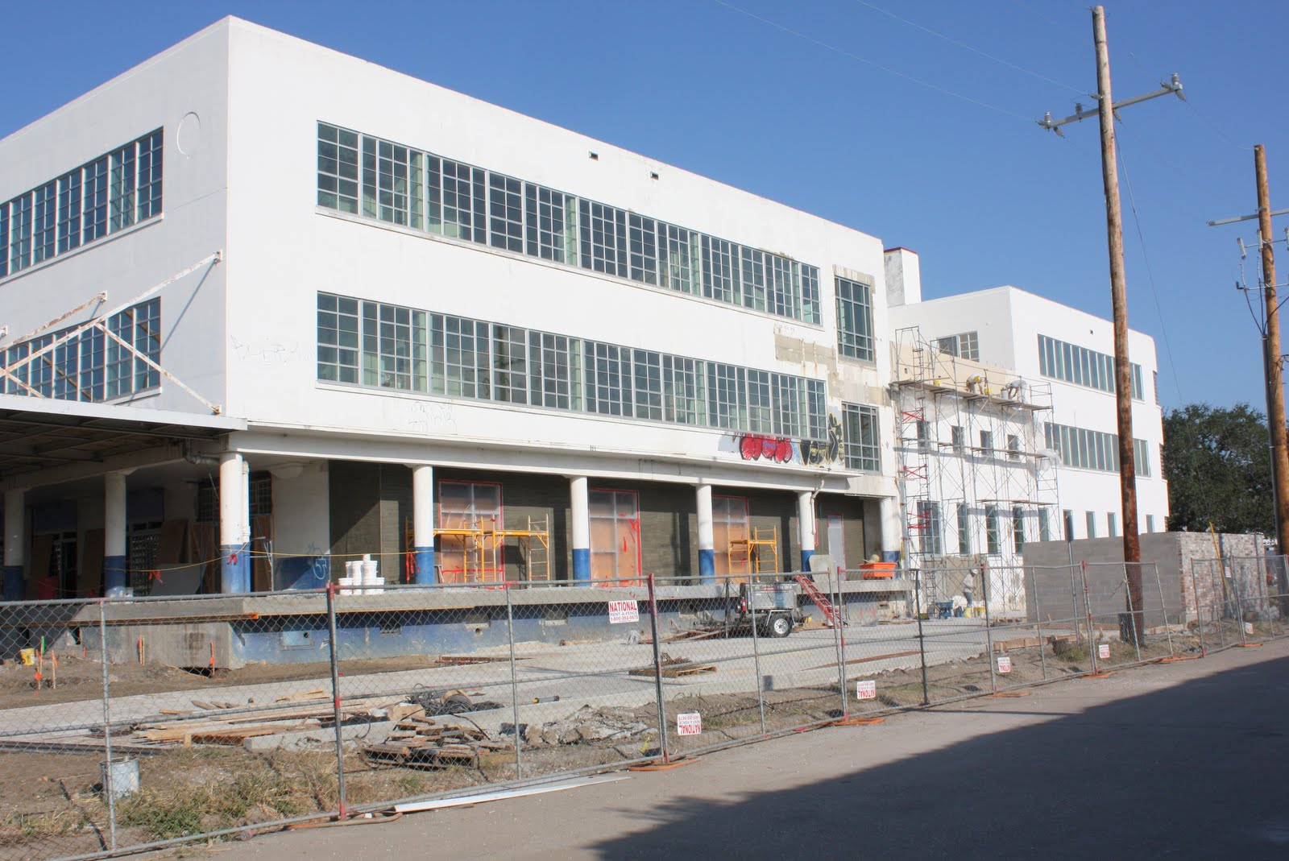
Rental – Blue Plate Apartments
Gert Town

Slide 3
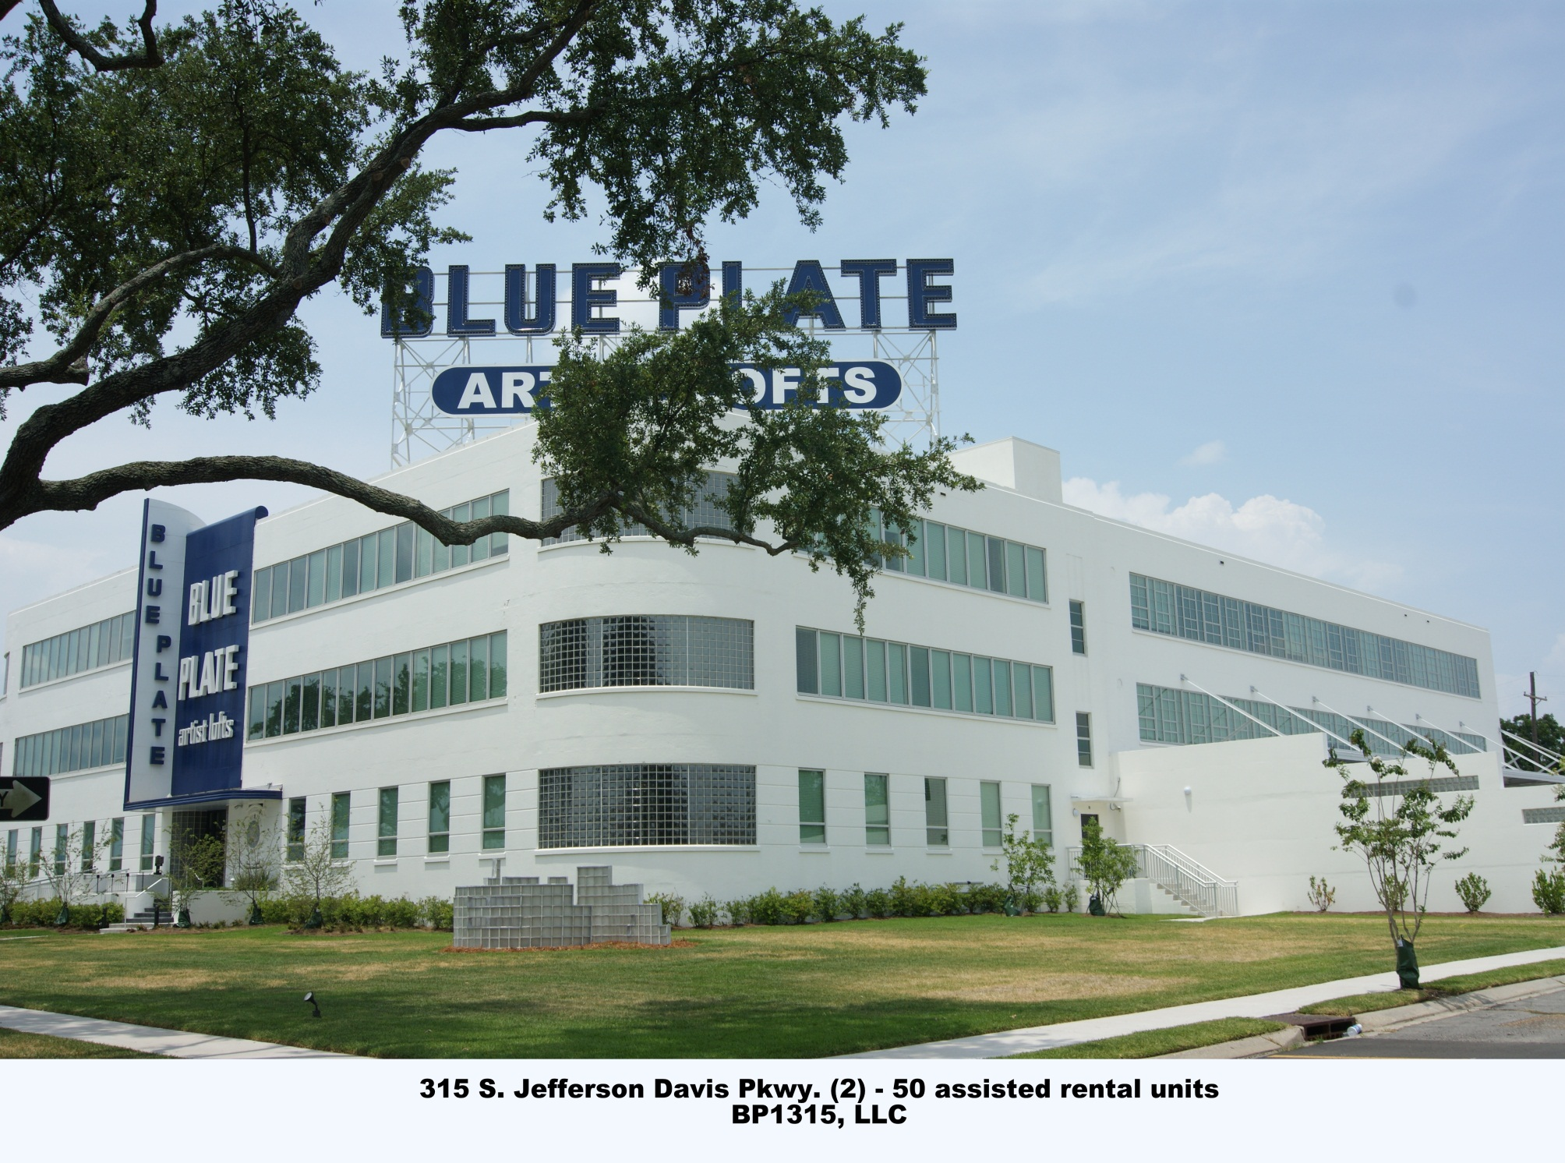

Slide 4
Permanent Supportive Housing 2222 Tulane Apartments – UNITY of GNO/Historic Restoration, Inc.
Mid-City

Slide 5
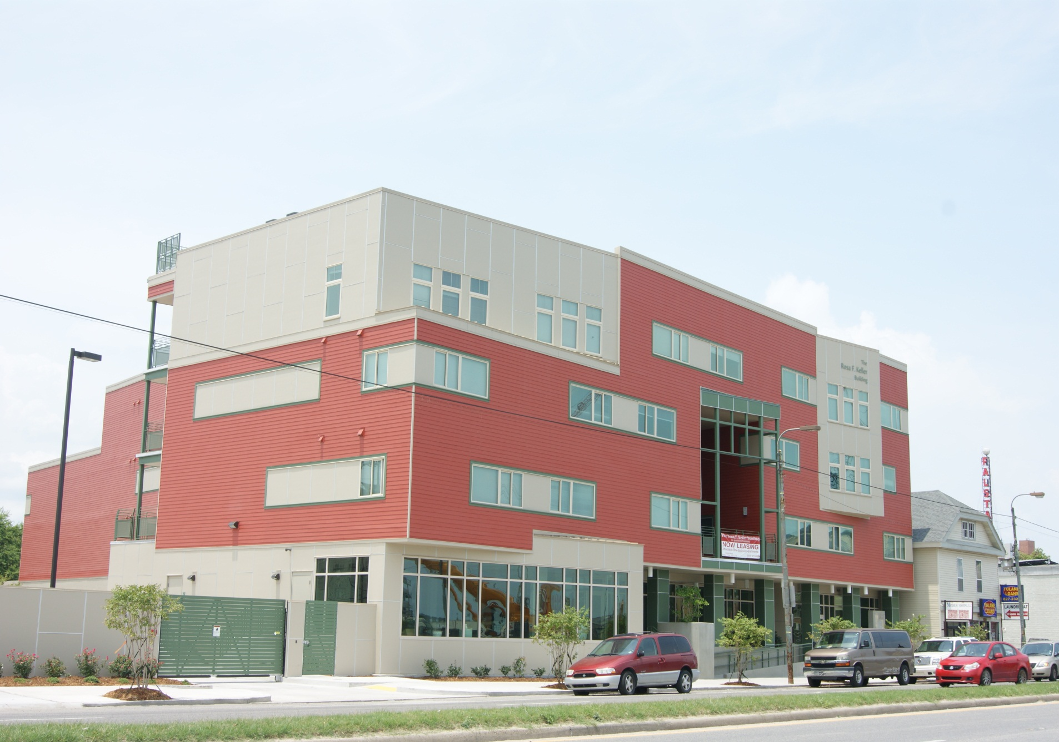
Rosa Keller Building
2222 Tulane Avenue

Slide 6
Rental – Bywater Art Lofts Phase II Historic Restoration, Inc.
Bywater

Slide 7
Rental – Bywater Art Lofts Phase II Historic Restoration, Inc.
Bywater

Slide 8
Rental – The Muses Gulf Coast Housing
Central City

Slide 9
Rental – Eleven37 Apartments Historic Restoration Inc.
Seventh Ward

Slide 10
Permanent Supportive Housing 1201 Freret St. – Murphy McCaleb Foundation
Central City

Slide 11
Homebuyer – Hoffman Triangle III Associated Neighborhood Development
Central City

Slide 12
Homebuyer – Bienville Development Providence Community Housing
Mid-City

Slide 13
Owner-Occupied Rehabilitation Preservation Resource Center
Gentilly

Slide 14
Owner-Occupied Rehabilitation Preservation Resource Center
Lower Ninth Ward

