Slide 1
City of New Orleans Restore Louisiana Program
Office of Housing Policy &
Community Development

Slide 2
Agenda
Please hold questions to the end.
New Orleans Public Library
City of New Orleans
Office of Housing Policy and Community Development
November 11, 2024
5pm
Program Background
Resilient Communities Infrastructure Program
Grant Goals/ Potential Projects
Public Comment Period

Slide 3
CNO Office of Community Development
The City of New Orleans Office of Community Development has been allocated approximately $33.2 million for Hurricanes Laura & Delta, Hurricane Ida & May ‘21 Severe Storms from the State of Louisiana through the Resilient Communities Infrastructure Program.
Through the Resilient Communities Infrastructure Program, the state will address unmet needs in the area of infrastructure across impacted areas in order to expand upon and improve resilient community planning.
80% of these funds MUST be allocated in Most Impacted and Distressed Areas

Slide 4
RCIP Grant Current Budget
The current total allocation for Restore Louisiana funding is $33,280,853.85.
The City of New Orleans's federal allocation has increased since the initial grant award.
1st Public meeting was held on July 28, 2023
2nd Public meeting was held on *April 10, 2024*
The CNO has several projects approved by the state. However, this meeting is to discuss how we can think through additional ideas that can lead to projects not previously mentioned in the first public meetings.

Slide 5
Hurricanes Ida and Severe Storms (2020 and 2021)
How did Hurricane Ida and Severe Storms of 2020 and 2021 affect business owners?
Loss of power – reliance on grid
Loss of revenue – grants in place to ease financial burden post disaster
Flooding- areas that were negatively impacted by street flooding
What infrastructure issues did Hurricane Ida and Sever Storms of 2020 and 2021 exasperate?
Citywide Flooding
Lack of accessible cooling/charging stations
How can we utilize the funds provided to address the defined needs?
Regulatory items:
Project funds are designed to address unmet needs for business growth and economic recovery located by the eligible 2020-21 storms
Eligible Activities: 24 CFR 570-Community Development Block Grants Subpart C- Eligible Activities and the Hometown Revitalization Policy Document

Slide 6
Currently Approved Projects
Resilience Hubs Renewable Backup Power
Solar and backup power to support in emergencies at specific locations
Comprehensive Reforestation
Concrete removal and tree planting
Food Business Incubator
Technical assistance for design and stand-up food entrepreneur facility
Small Business Power Resilience
Install solar and backup power for emergency economic recovery
Main Street Resilience
Technical assistance for corridors to align with Climate Action Plan
City Facilities Solar Installations
City facilities for installation of PV, battery storage, and electrical and efficiency retrofits
Stormwater Master Plan
Developing and Updating the City’s stormwater management strategy

Slide 7
Potential Projects
West End Drainage Project
Installation of an underground Modular Tank System at Fleur De Lis Park
Energy Innovation Incubation
Physical hub that will help develop and lead programming as an energy innovation destination
Green Infrastructure Workforce and Business Development Hub
Physical hub that will buildout hands-on-training to support workforce development (green infrastructure) and business technical assistance

Slide 8
Discussion
What ways can the City help businesses and entrepreneur post disasters like Hurricane IDA?
What types of projects or activities would aid in the business community being better prepared for and recovering from storms and/or outages?
What additional resources can the City provide to the business community to return to commerce quicker, safter, and easier?
Who should be brought into these types of conversations around disaster planning and recovery?

Slide 9
Discussion
What ways can the City help citizens following disasters like Hurricane IDA?
What does post-disaster support look like for residents 1 week later, 3 months, 10 months, 2 years?
Did your neighborhood flood during Hurricane Ida or any of the severe storms of 2020-2021?If so, what neighborhood?
What are some on-going resident challenges that stem from Hurricane Ida?
What are some resources that you would have wanted the City to have to assist in a smoother recovery?

Slide 10
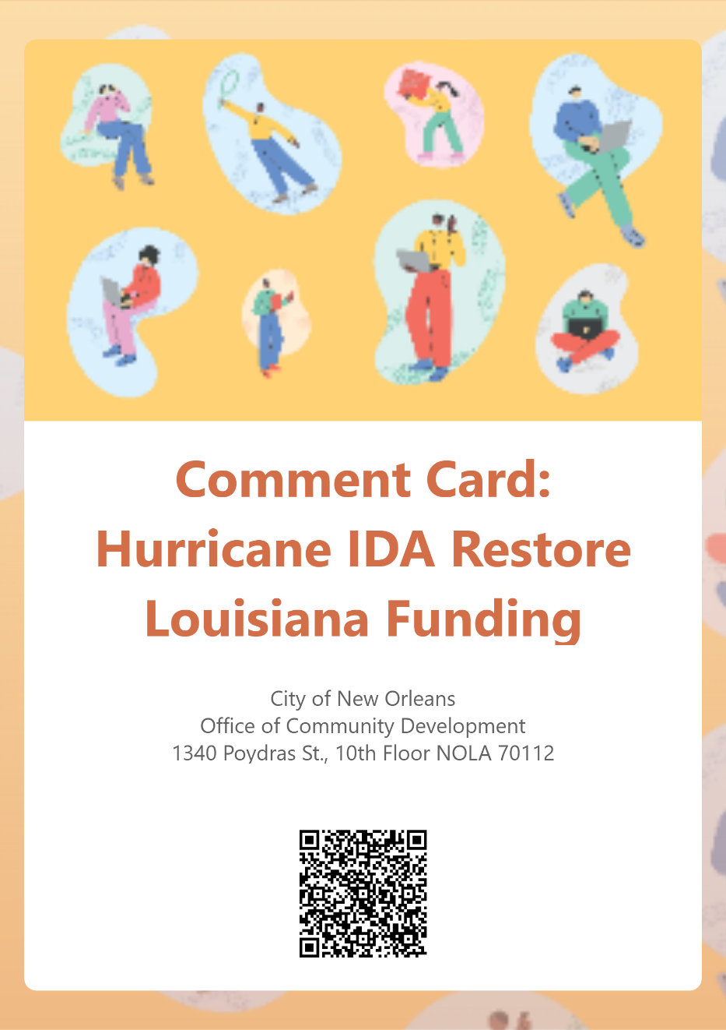
Comment Card and Recommendations
Please provide comments and feedback
Scan QR Code with phone camera or visit the available table with laptops
Paper versions available as well
PDF comment cards are available online for later submission and sharing
*Online form available in English, Vietnamese, Spanish, French*

Slide 11
Public Comment Period
The comment period began on October 31, 2024. All comments must be received no later than November 30, 2024 COB.
Comments can be emailed to RestoreLouisiana@nola.gov or dropped off to 1340 Poydras, Suite 1000, New Orleans, LA 70112
At the end of the comment period, all comments will be reviewed, and a City response will be incorporated in a Responses to Public Comment document. A summary of the comments and the City’s responses will be submitted to the State of Louisiana- Disaster Unit.
For more information about this and other Community Development programs
nola.gov/community-development

Slide 12
Questions?
Wayne Johnson
Grant Manager
RestoreLouisiana@nola.gov
504-658-4216

