Slide 1
City of New Orleans New Restore Louisiana Programs
Office of Housing Policy &
Community Development

Slide 2
The State of Louisiana Office of Community Development has been allocated more than $3.1 billion for Hurricanes Laura & Delta, Hurricane Ida & May ‘21 Severe Storms,
80% of these funds MUST be allocated in Most Impacted and Distressed Areas
The mission of the Office of Community Development is to create a safer and stronger Louisiana by leading the state’s disaster recovery and long-term community resilience planning efforts with a great sense of urgency through innovation, partnerships, and best practices
Louisiana Office of Community Development

Slide 3
City of New Orleans'
Office of Housing Policy Community Development
The Office of Housing Policy and Community Development facilitates the development and preservation of quality housing, and suitable living environments for persons of low and moderate income through strategic investments and partnerships with public, private, philanthropic, non-profit, and resident stakeholders.
The City of New Orleans Office of Housing Policy and Community Development has been awarded $410 million following Hurricanes Katrina/Rita, $15 million following Hurricane Isaac, and $141 million for National Disaster Resilience Competition Grant.
OCD’s vision is one where all New Orleanians live in vibrant neighborhoods with a range of safe, quality housing options that are affordable to them and with access to jobs, services and neighborhood amenities that support their family's well-being.

Slide 4
Agenda
Please hold questions to the end.
New Orleans Public Library
City of New Orleans
Office of Community Development
July 24, 2023
6pm
Program Background
Proposed Projects- Hometown Revitalization
Proposed Projects- Resilient Communities Infrastructure Program
Questions and Answers
Public Comment Period

Slide 5
Hurricane Ida Recovery Overview
Recovery efforts supported by multiple programs including, but not limited to:
FEMA Hazard Mitigation Grants
Milneburg Stormwater Project
Audubon Park Stormwater Project
Joe Brown Solar Microgrid
Sanchez Solar Microgrid design funding
Stormwater Master Plan update
Department of Energy
Grid Resilience planning Technical Assistance
RESTORE Louisiana Program
NOAA Coastal Programs
Bayou Bienvenue Restoration Planning and Design
Irish Bayou Living Shoreline proposed

Slide 7
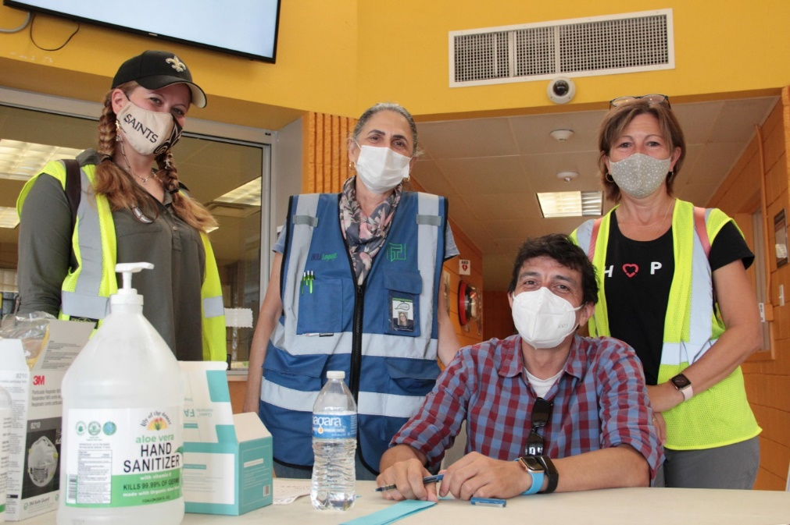
Disaster Recovery: Resilient Staffing
Created new policies that allow the City to augment staff for emergency response
Provided training to city staff and emergency response volunteers
Developed job aids and supplies checklists
New dedicated positions: Access and Functional Needs Coordinator, Mass Care and Logistics Coordinator

Slide 8
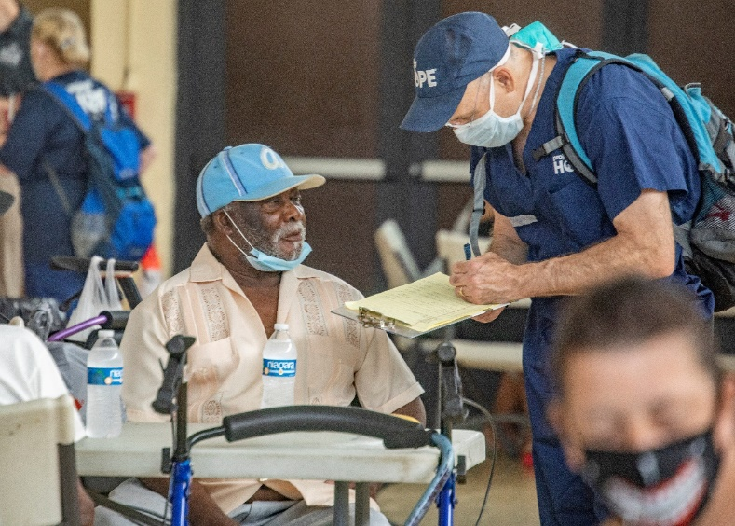
Towards Equitable Disaster Recovery
Focus on vulnerable populations – disasters impact some more than others
Integration with public health and housing teams to design response and address underlying vulnerabilities
Collaborative planning and implementation with service providers and advocates
Address access barriers
Mobility
Trust
Language and Information

Slide 9
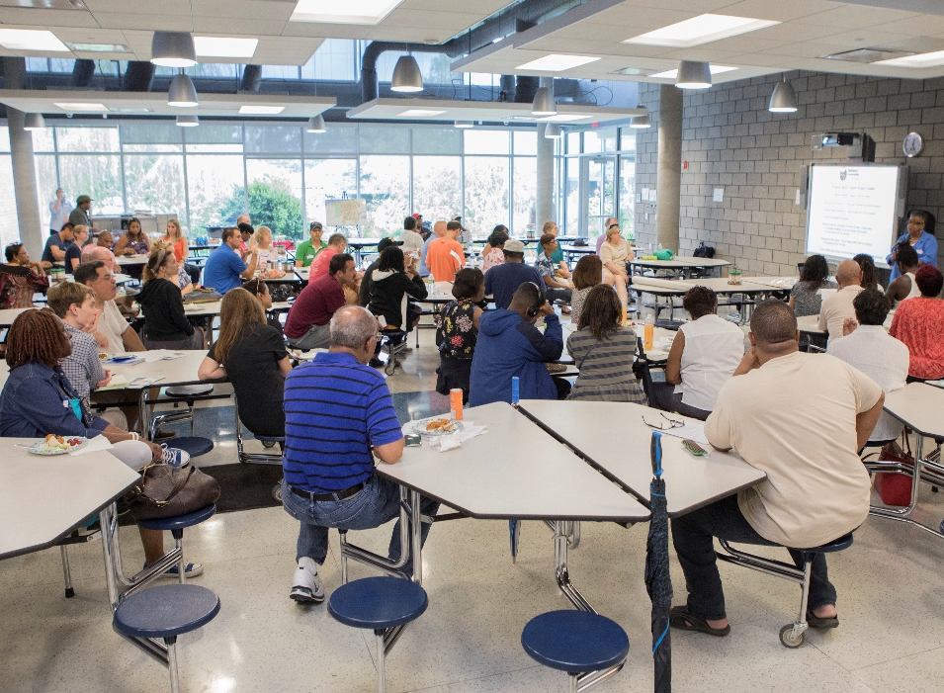
Disaster Recovery:
Supporting Community Initiatives
Funding
Planning Support, Training
Community Emergency Response Network
Developing small business support capacity with Partners in Preparedness

Slide 10
Resilient Communities Infrastructure Program
Orleans Parish
The City of New Orleans was awarded $4,718,041.00 these funds are designed to address the remaining unmet needs in the areas of infrastructure in order to expand upon and improve resilient community planning
Eligible Activities: 24 CFR 570-Community Development Block Grants Subpart C- Eligible Activities

Slide 11
Proposed Projects- Resilient Communities
Priority Projects
Resilience Hub Renewable Backup Power
Reforestation Plan Phase I
Alternate Projects
City Building Solar Installations
MTRCB Operations Complex Wind Retrofit
Stormwater Master Plan

Slide 12
Resilient Communities Infrastructure Program
Resilience Hub Renewable Backup Power
This project would install Solar and Battery backup power systems at 3 locations around the city:
Arthur Monday MultiService Center, 1111 Newton St. New Orleans, LA 70114
Allie Mae Williams Multi Service Center, 2020 Jackson Ave. New Orleans, LA 70113
Hollygrove MultiPurpose Senior Center, 3300 Hamilton St. New Orleans, LA 70118
Allie Mae and Arthur Monday were used as emergency resource centers during the response to Hurricane Ida. This project will equip the facilities for quick response to future emergencies. Hollygrove MSC was identified after Ida as a priority location to add backup power capability.
This project is supportive of the City's Climate Action Plan and Hazard Mitigation Plan.
Project Scope:
Design and Installation of rooftop solar PV and battery backup power systems.

Slide 13
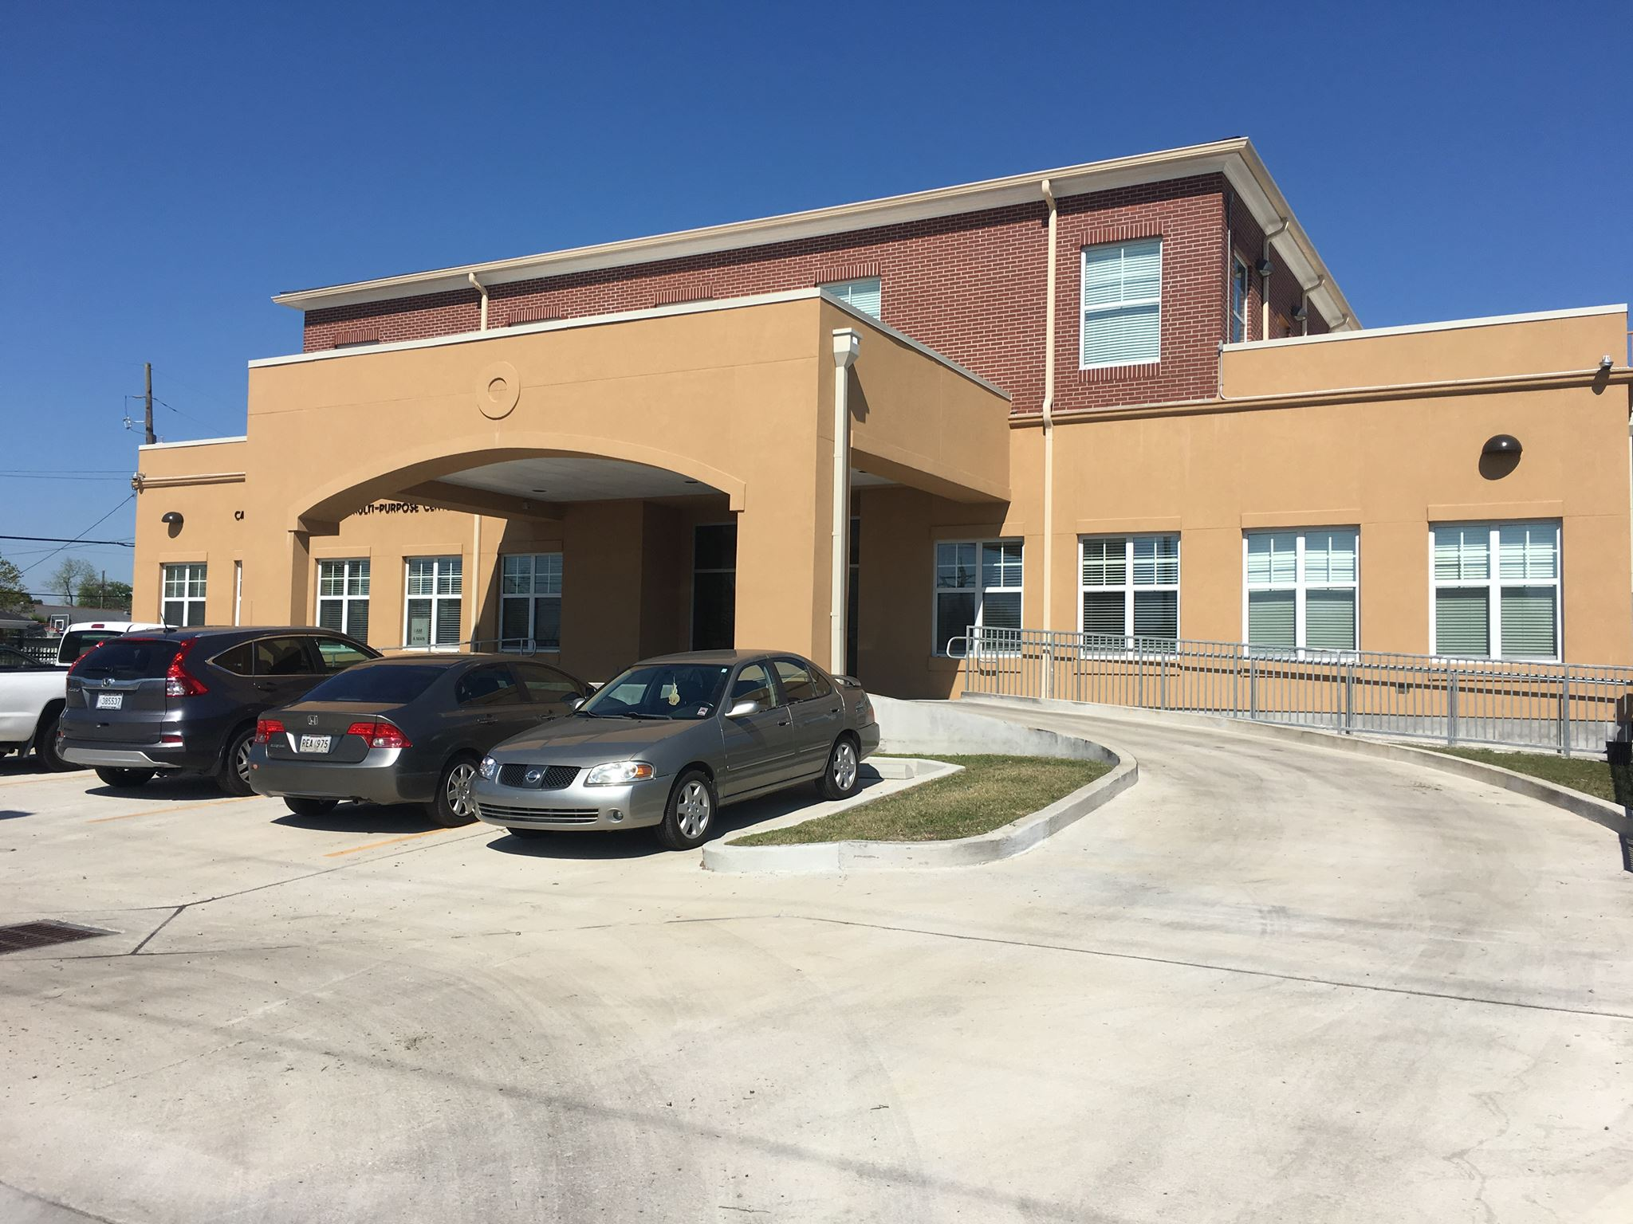
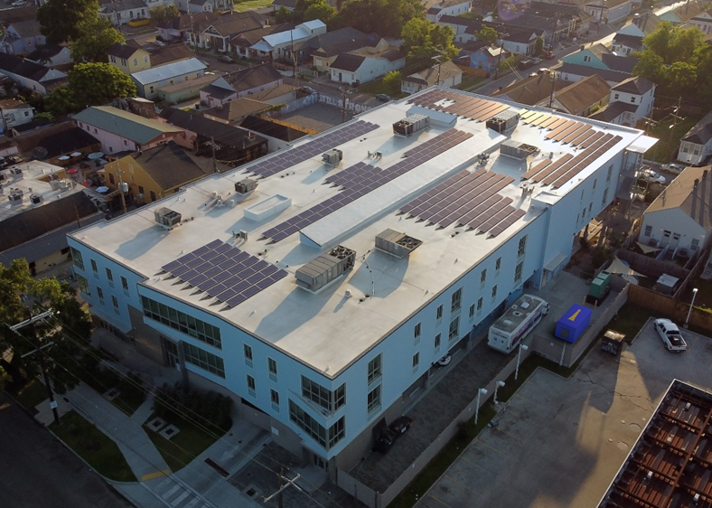
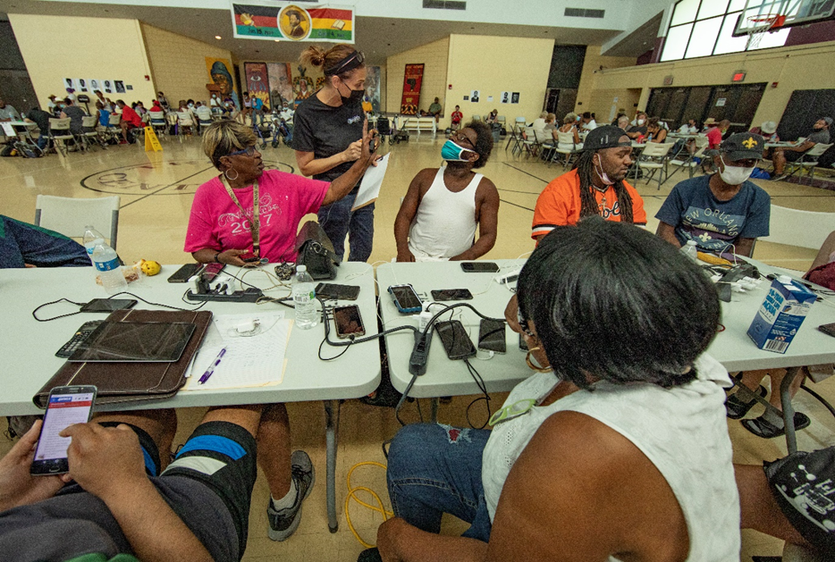
Resilience Hub Renewable Backup Power

Slide 14
Resilient Communities Infrastructure Program
Reforestation Plan Phase I
Currently, the City has a tree canopy covers only 18.5% of New Orleans.
During Hurricane Ida heavy winds destroyed several trees. The City would like to add additional trees to specific neighborhoods to assist with resilience to storm and climate change.
The proposed project will directly address the unmet needs of recovery from the 2020-21 storms by replacement of tree canopy that was damaged in the storms. This project will contribute to mitigation of extreme heat and urban flood risk. Implementation of the reforestation plan is identified in the Hazard Mitigation Plan
Trees provide the City of New Orleans with various positive health benefits; these same trees are a vital part of green infrastructure as they have the capacity of drink over 200 gallons of water in a day’s time. They are also the most frugal tools with regards to green infrastructure and way of managing flooding in and around your neighborhood.
This project would prioritize tree planting projects in Hollygrove, St. Bernard, Whitney, and Central City neighborhoods. The pilot plan calls for a focused effort to plant trees in five neighborhoods over the next 5 years to meet the goal of increasing canopy coverage by 10% citywide. The selection of pilot project locations included consideration of social vulnerability and heat exposure risk.

Slide 15
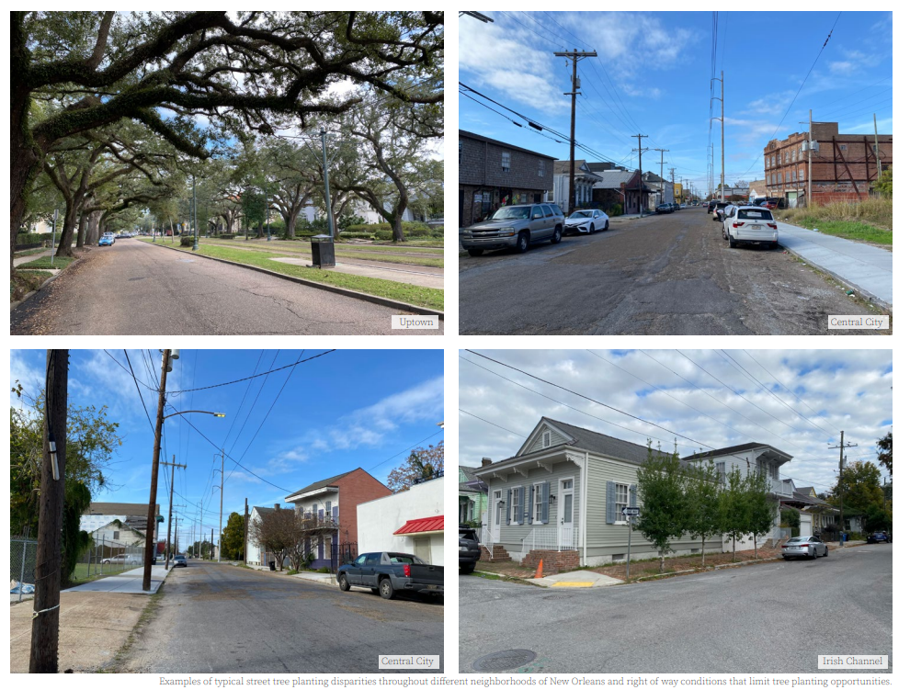
Reforestation Plan Phase I
The benefits of trees have historically been inequitable in low-income neighborhoods. The proposed project aids in the addition of trees as a means of resilience and long-term recovery and resilience goals.

Slide 16
Proposed Resilient Communities Budget

Slide 17
DISCUSSION
What are your thoughts on the projected projects?
How do the projects help the City of New Orleans and expand resilient community planning?
What does post disaster infrastructure support look like in the community?

Slide 18
Proposed Projects- Hometown Revitalization
Priority Projects
Food Business Incubator
Small Business Power Resilience Program
Alternate Projects
Microloans (Small Businesses)
Disaster Response Grant Program
Façade Renew Program

Slide 19
Hometown Revitalization Program
Orleans Parish
The City of New Orleans was awarded $7,002,068.00 these funds are designed to address unmet needs for business growth and economic recovery located by the eligible 2020-21 storms
Eligible Activities: 24 CFR 570-Community Development Block Grants Subpart C- Eligible Activities and the Hometown Revitalization Policy Document

Slide 20
Proposed Hometown Revitilization Budget

Slide 21
DISCUSSION
WHAT ARE YOUR THOUGHTS ON THE PROJECTED PROJECTS?
HOW DO THE PROJECTS HELP THE CITY OF NEW ORLEANS AND ITS BUSINESSES?
WHAT DOES POST DISASTER SUPPORT LOOK LIKE FOR BUSINESSES AND THE OVERALL ECONOMY?

Slide 22
Public Comment Period
The comment period on the proposed is 30 days. All comments must be received no later than August 25, 2023 COB.
Comments can be emailed to bmwilson@nola.gov or dropped off to 1340 Poydras, Suite 1000, New Orleans, LA 70112
At the end of the comment period, all comments will be reviewed, and a City response will be incorporated in a Responses to Public Comment document. A summary of the comments and the City’s responses will be submitted to the State of Louisiana- Disaster Unit.

Slide 23
Questions?
Beyonka Wilson
D-CDBG Program Manager
bmwilson@nola.gov
504-901-2414

