Slide 1
2013 Proposed Budget – NOPD
November 14, 2012
Mayor’s Office of Communications

Slide 2
2013 Budget Presentation
Department Mission & Vision
2012 Year in Review
2013 Allocation
2013 Key Performance Indicators
2013 Department Goals
Actions to meet 2013 KPIs and Goals

Slide 3
Department Mission & Vision
Mission Statement
The mission of the New Orleans Police Department is to provide professional police services to the public in order to maintain order and protect life and property. We will identify and solve problems by forming partnerships with the citizens of our community to enhance the quality of life for our citizens and visitors. Our service will be delivered through transparency, accountability, collaboration and integrity.
Vision Statement
It is our goal to make significant strides in reducing overall crime and making our streets safe for all who live, visit and do business in the City of New Orleans. The reduction of violent crime remains our highest priority. Building new and invigorating existing partnerships with members of our community is critical to our success. We believe that the overall satisfaction of the community we serve assists in heightening the performance and response level of the men and women of our Department. Increased satisfaction and the resulting confidence of the community in the NOPD will result in lower crime rates and more successful prosecution of those persons who committed crime in our community. As a direct result of our recent reorganization and consolidation of departmental functions, we are poised to provide more accountability and efficiency in managing the daily operations of the New Orleans Police Department for years to come.

Slide 4
2012 Year In Review
Office of the Superintendent of Police
Field Operations Bureau (FOB)
Investigation & Support Bureau (ISB)
Public Integrity Bureau (PIB)
Management Services Bureau (MSB)

Slide 5
2012 Year In Review
Office of the Superintendent of Police
Consent Decree
Attorney General Eric Holder stated, as reported in a July 24, 2012 New York Times article, “…meaningful progress has already been made… Mayor Landrieu and Chief Serpas did not wait for our findings to begin the reform process.”
On July 25, 2012, the City of New Orleans formally agreed to enter into a Consent Decree with the U.S. Department of Justice/Civil Rights Division. Certain costs within the New Orleans Police Department’s 2013 Budget Proposal are reflective of funding required to meet specific compliance timelines established under this Agreement. Funding allocation for Consent Decree will be placed in separate miscellaneous fund in the Chief Administrative Office. As part of the City’s overall proposed $7,000,000 Consent Decree funding request for 2013, direct cost related to NOPD operations total $4,750,000 and include:
Consent Decree - Direct Cost / NOPD Operations | 2013
NOPD Personnel (Consent Decree Administrator, Curriculum Director, HR Manager, Technology Project Manager, Technology Architecture) | $ 877,832
Lexipol Policy Development | $ 97,950
AVL and Mobile Data Terminal | $ 1,297,098
In Car Camera System | $ 1,410,000
2 Year Data Storage | $ 383,200
Electronic Control Weapons | $ 601,220
Digital Audio Recorders | $ 32,700
Training Supplies | $ 50,000
Total | $ 4,750,000

Slide 6
2012 Year In Review
Office of the Superintendent of Police cont.
Compliance - Audits
Customer Satisfaction Surveys, initiated in the summer of 2010 continue and are conducted on random Part I UCR Major Crime reports, resulting in 604 surveys.
Reviewed 2,407 random reports for accuracy, a 7% increase in 2012 compared to 2011.
Since June 2010, more than 10,000 police reports and police response to Calls For Service have been reviewed
Technology
Implemented Omega Crime View Dashboards in crime analysis system for a more robust crime analysis/tracking system and response strategy by District Commands
Implemented a workload analysis and patrol staffing optimization system using state-of-the-art software
Expanded the use of Digital Mobile Video/Audio Recording systems in department patrol vehicles
Increased the number of Digital Mobile Video/Audio Recording systems in interview rooms
Implemented an on-line Daily Training Bulletin system for all commissioned officers which requires successful testing
Assisted multiple agencies/consultants/entities with data requests for crime reductions or assessment of NOPD initiatives
Promotion of Police Officers
NOPD’s training academy working closely with the Fraternal Order of Police created a first of its kind on-line training program in 2012 to provide for the 40 hours of necessary training for Police Officer II candidates
On November 4th, 208 Police Officer II candidates were promoted - each receiving a 5% pay increase
Expand on-line training for Police Officer II, III and IV in 2013
Personnel Service base budget will allow for Police Officer II, III and IV, as well as Sergeant and Lieutenant promotions in 2013

Slide 7
2012 Year In Review
Office of the Superintendent of Police cont.
Departmental Staffing
Today there is 1,266 officers of any rank, compared to 1,539 in May 2010 – a reduction of 17.74% or 273 less officers
  The 2013 proposed budget provides full year funding for 1,260 sworn and 246 civilian staff
  NOPD will monitor attrition and, if budget warrants, NOPD will start Police Recruit Class for 2013
Today there are 14% fewer Police Officers of any rank than May 2010
Today there are 9% fewer Police Sergeants than May 2010
Today there are 16% fewer senior leaders (Lieutenant, Captain Major, Commanders or Deputy Chief) than May 2010
Assignment of Sworn NOPD
About 70% of all sworn personnel (Recruit through Deputy Superintendent) are assigned to the Field Operations Bureau
  Patrol Districts; Patrol Investigations (robbery, assault, burglary, thefts) and Special Operations (SWAT, K9, Traffic, Bomb)
About 16% of all sworn personnel are assigned to Investigative Support Bureau
  Homicide, Sex Crimes, Child Abuse, Juvenile, DV, Intelligence, Gang, Major Narcotics, Vice/Prostitution, Computer Forensic, Crime Lab (firearms examiners, drug chemistry), City Hall, Municipal/Traffic/Juvenile Courts, District Attorney’s Office
  “Unlike Patrol functions where a number of standards my be applied…there is currently no industry standard of the number of detectives required,” recent staffing study report, Glendale, AZ Police Department
About 7% of all sworn personnel are on long term sick leave, military leave, limited duty due to injury, etc.
About 7% of all sworn personnel are assigned throughout: Public Integrity (criminal/admin/Early Warning), Academy (In-Service/Firearm/Driving), Compliance and Audits, Crime Analysis, oversight of Consent Decree Compliance

Slide 8
2012 Year In Review cont.
Field Operations Bureau
The NOPD responds to 9,500 Calls For Service per week – less than 1% are classified as murder, rape, robbery or assault; less than 4% are classified as burglary, theft or auto theft; 25% are classified as Miscellaneous Issues. Calls For Service demands to the NOPD are increasing this year, and this is a healthy sign of growing community support.
Recent analysis of response time to violent crime estimates that nationwide police respond to a crime of violence within 10 minutes 53% of the time. In the NOPD for 2011, and 2012 YTD, the NOPD responds in 10 minutes or less 64% of the time. Given the nearly 18% decline in staffing these last 2.5 years, we are encouraged by our officer’s attention to responding to crimes of violence as quickly as we can. However, response time to non-violent and non-emergency calls will continue to decline
Collaborated on the Group Violence Reduction Strategy with Professor David Kennedy and Dr Robin Engel who joined forces to combat violence in New Orleans by identifying gang/group members who are responsible for violent crime in the city. As a result, 39 gangs/groups involving 649 people were identified and are now the focus of this initiative. The NOPD had previously identified 30 gangs/groups with about 400 members
Implemented Mission 2 program which deploys Headquarters personnel into district patrol units each week, and simultaneously allows District Commanders to use walking beats in areas they deem appropriate.
The Community Coordinating Sergeants, created in August 2010, continues to provide a direct link between our eight District Commanders and the communities we serve. 2012 YTD, CoCo Sergeants have led 1,067 meetings sharing the NOPD message of Community Policing, Problem Identification/Solving Techniques, Crime Prevention, Neighborhood Watch, calling in any crime or request for police service timely, etc., with nearly 21,000 New Orleanians. The NOPD will maintain the eight (8) CoCo Sergeants and 13 QOL Officer staffing as long as feasible.
The Volunteers Can Lead (VoCal) was initiated in October 2011, each volunteer donates 12 hours per month. In 2011 there were 421 hours donated. In 2012 YTD, there has been 1,936 hours donated by 63 volunteers
The NOPD Reserve Division has 80 contributing members, who have donated 18,576 hours YTD

Slide 9
2012 Year In Review cont.
Investigation & Support Bureau
Central Evidence & Property Section conducted a 100% audit of inventory, and BEAST- entry of all DNA evidence. This project has allowed for total accountability and organization of all DNA evidence in NOPD’s possession.
Project Bloodwork, initiated in December 2011, is a collaborative effort between the New Orleans Police Department and the Louisiana State Police Crime Lab (LSPCL) to perform DNA analysis on blood evidence collected from burglary scenes. 88 cases have been submitted to the lab for processing and 86 of those 88 cases (97.7%) have been completed.
82 of blood work cases (95.3%) have resulted in a DNA profile. 82 cases with a DNA profile, 64 (78%) have resulted in a DNA match with a total of 53 separate offenders. Some offenders have been linked to more than one case, 64 of the 82 cases have come back with a potential offender identity.
In early 2012, the NOPD-Victim/Witness Assistance Unit launched our Rapid Engagement of Support in the Event of Trauma (R.E.S.E.T.) initiative. The program provides resource information to neighborhoods within 24-48 hours after a homicide occurs. R.E.S.E.T. Program had 32 activations and 551 interactions with citizens and generated 7 leads in active homicide investigations.
ISB Leadership has utilized effectively a strategy created in early 2012 to flood the area of recent homicides, using undercover, narcotics purchases, intelligence gather, etc., to help solve murders. This effort has been successful in at least 7 cases where arrest were made in what originally appeared to be highly unsolvable cases. Federal grant overtime was used.
The recently announced Multi-Agency Gang Unit will be led by ISB commanders incorporated with our Intelligence, Narcotics and Homicide commands to follow up using the Group Violence Reduction Strategy of the NOLA FOR LIFE campaign to fight the crimes of murder and violence among these gangs/groups that have been identified. NOPD HAS SUBMITTED A BFO OFFER TO FUND SOME OF COST OF THE NEW MULTI-AGENCY GANG UNIT.
The NOPD requested DOJ-Bureau of Justice Assistance analysis of the Homicide Unit in June 2010. The report was issued in March 2011. DOJ-BJA experts laid out 82 recommendations to advance our Homicide Unit policies, procedures and practices. In early 2012, ISB leadership implemented these recommendations. One critical recommendation was to staff 32 Homicide Detectives and a separate Cold Case Unit of 4-5 Detectives. Despite staffing shortfalls in many critical investigative units, the NOPD has maintained and will maintain the Homicide unit’s staffing.

Slide 10
2012 Year In Review cont.
Public Integrity Bureau
Complaints Against Police Officers – Citizen or Supervisor Initiated – Satisfaction with Officer Contact
  -19.0% reduction in total complaints YTD (full year 2011 vs. 2010, there was a 16% reduction in total complaints)
  -23.1% reduction in citizen complaints YTD
  -11.8% reduction in supervisor initiated complaints YTD
  Disciplinary actions from criminal or administrative investigations are down 24% YTD
  Suspension issued are down 14% YTD
  A 40% reduction in Accident Review Board cases, with a 47% reduction in suspension resulting from Board Review
  In August 2009, 53% of people who had a contact with an NOPD Officer described it as pleasant or very pleasant.
  Asking the same question in August 10, February 11, August 11, February 12 and August 12, this data now averages 76%
  All of these reductions can be attributed to a combination of integrity checks and the following training updated or new policies implemented since May 2010: Professional Performance Enhancement Program, Complaint Avoidance, Internal Investigations, Performance Evaluation, and Job Performance Improvement Planning.
Integrity Checks
  177 integrity checks YTD
Professional Performance Enhancement Training (PPEP)
  7 – PPEP classes conducted YTD
  100 – Officers trained YTD
2012 In-Service Training Program
  206 supervisors trained
    Internal Investigations
    Performance Employee Evaluation
    Job Performance Improvement Planning
790 officers trained
    Compliant Avoidance
Staffing – Use of Force Investigation
Staffed and established the Force Investigation Team (FIT)
Secured Office Space for FIT

Slide 11
2012 Year In Review cont.
Management Services Bureau
Education /Training and Recruitment Division
• Trained and graduated 28 of the 32 recruits hired, 88% completion rate.
• Collaborated with Lexipol to create Daily Training Bulletins, which features on-line learning and mandatory testing
• Created on-line training module for promotional purposes for Police Officer II candidates
• Coordinated and participated in IACP leadership training (LPO) for 100 supervisors. Will identify “train the trainers”
Updated NOPD website to reflect new hiring criteria
Developed recruitment manual and updated recruit application
Records Management
May 2012, the Department began selling automobile accident reports online. Convenience fee is $6 and accident reports are $20.
Fleet
Anticipate in 2013 the purchase of 100 new police vehicles
Risk Management
Accident Review Board identifies the cause of auto crashes, and through training and discipline, attempts to reduce the severity of auto crashes involving police vehicles.
Accident Review serves as an accountability tool which aids in managing the department’s resources.
Human Resources
Administrative Duties Division (ADD) held seven (7) Rule IX hearings and heard a total of 105 cases.
ADD manages employees who are in an extended leave status due to work related injuries, military deployment, etc.
The ADD Unit manages between 85-100 (about 7% of sworn staff) long term illness, limited duty, military leave, etc., daily

Slide 12
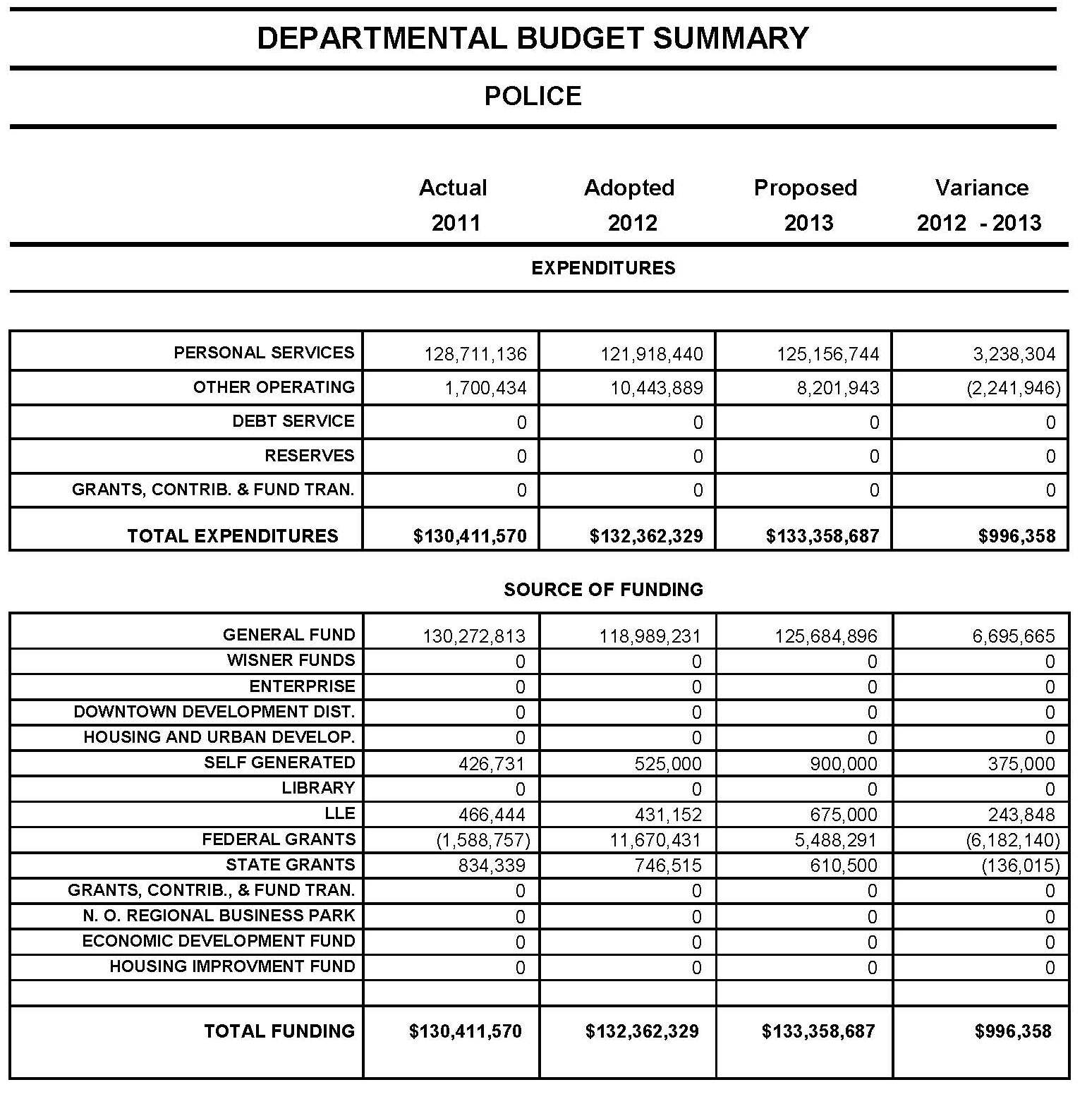
2013 Allocation
Will be populated from Budget Book. Departments are not required to complete this section.

Slide 13
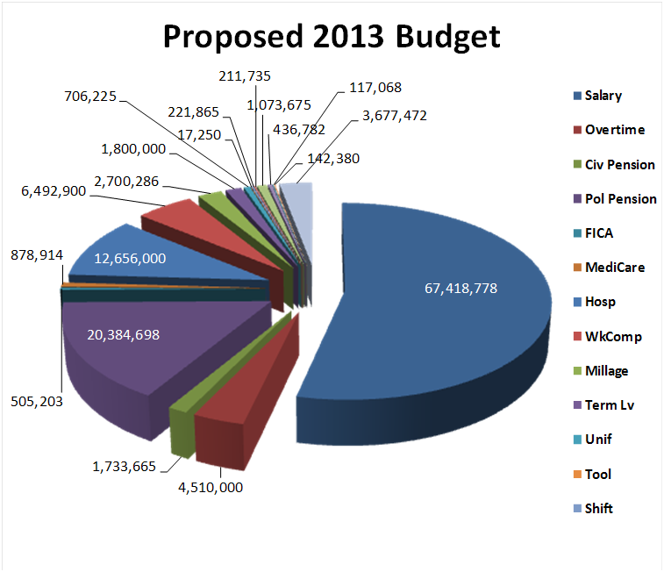
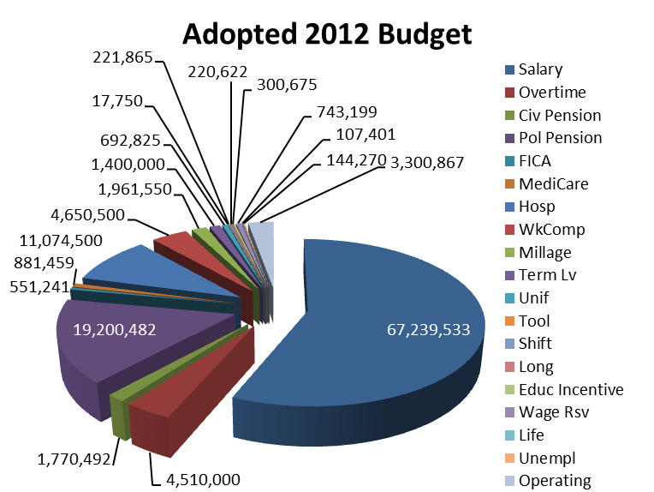
2013 Allocation cont.
Adopted 2012 = $118,989,231
Proposed 2013 = $125,684,896

Slide 14
Historical Police Pension Trends

Slide 15
2013 Key Performance Indicators

Slide 16
2013 Goals
Goal 1: Feeling Safe in Neighborhoods and Crime Fighting
Goal 2: Community Policing
Goal 3: Maintain high standards through proactive approach by Public Integrity Bureau
Goal 4: Highway Safety Initiatives
16

Slide 17
Actions to Meet 2013 KPIs and Goals
Feeling Safe in Neighborhoods and Crime Fighting
Action 1. New Orleans residents feeling safe in their neighborhood continues to be the highest priority of the NOPD. Maintaining this level, or higher, of safety requires a daily focus on crime fighting, community policing, Quality of Life enforcement and developing a high performing organization. Effective recruiting, training, disciplining and deployment of officers and staff are the principal means of responding to crime, particularly violent crime. The Department will continue to be a flexible, responsive and an innovative policing agency designed to reduce crime, maintain response time to emergency calls at current levels, enforce Quality of Life standards and enhance public perception of the Police Department. Enforcement stops, directed patrols of District Task Forces and Narcotics Units, deployment of Mission 2 personnel, collaboration on a daily basis with local, state and federal law enforcement officials, etc. are a few examples of the Department’s commitment to advancing public safety in New Orleans. The NOPD will continue to work aggressively through the NOLA FOR LIFE strategy and its holistic approach to strategically attacking the root causes of murder in our community with innovative programs such as CeaseFire and the Group Violence Reduction Strategy. Recent and continuing survey data shows that about 77% of those responding feel safe in their neighborhood in five different polls, conducted each six months, beginning in August 2010. The NOPD is committed to continued advancement of our citizens feeling safe.
Community Policing
Action 2. The Community Coordinating Sergeant program, established in August 2010, is responsible for initiating and increasing neighborhood, community and business watch groups to advance the NOPD’s relationship in the community, crime prevention techniques and implementing Community Policing strategies. CoCo Sergeants supervise and coordinate the duties of District Quality of Life officers, follow up on contacts generated by the Crime Prevention Division, and provide support to District Commanders to foster relationships with neighborhood, community, and business groups throughout their district. This relationship building effort is the cornerstone of implementing Community Policing. Community Policing through shared dialogue and information with the community enhances police efforts. From January 2011 to now, the CoCo Sergeants have led 1,967 meetings in our community with over 48,000 attendees. As NOPD staffing continues to fall, the assignment of eight (8) CoCo Sergeants and 13 Quality of Life Officers may become unsustainable. The NOPD will staff these critical positions as long as possible.
17

Slide 18
Actions to Meet 2013 KPIs and Goals Cont.
Maintain high standards through proactive approach by Public Integrity
Action 3. The Public Integrity Bureau through proactive measures such as Integrity Checks will assist with ensuring that training, policy and the disciplinary process is functioning properly and will bring more officers into compliance with the rules and regulations of the Department. This use of Integrity Checks will increase the public confidence in the Department and the disciplinary system. The PIB is on track to complete 240 integrity checks for 2012. The Public Integrity Bureau is also actively engaged in preparing for finalization of the Consent Decree.
Highway Safety Initiatives
Action 4. The Department will again set an increase in the goal for DWI arrest. For 2013 the target will be a 10% increase over 2012. The aggressive enforcement of DWI advances personal and roadway safety further enhancing the quality of life for the citizens of New Orleans.
In 2013, the Department also plans to actively engage in more public service awareness campaigns for DWI & under age drinking.
Together, these four Key Performance Indicators serve to advance the entire NOPD in service to this community.
18

Slide 19
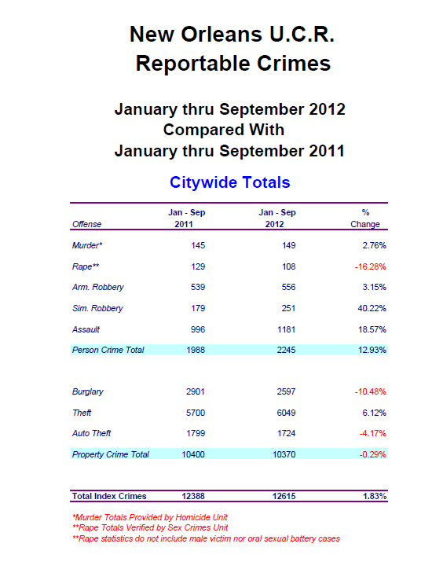
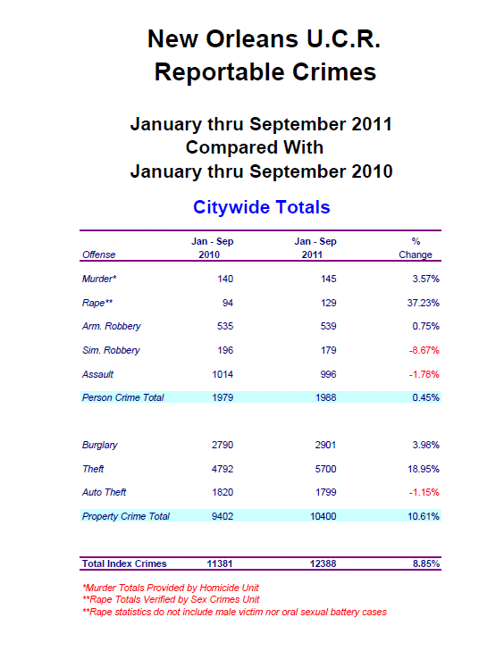
UCR Data – Jan. through September
19

Slide 20
2011 Final UCR – NOLA Compared
NOLA historically has had a high murder rate; but, the total violent crime rate (murder, rape, robbery and assault) remains favorable to other cities
We all understand that NOLA has too much crime and work everyday to fight all crime – we are making headway
When compared to Tourist Cities, NOLA’s violent crime rate compares favorably. *The FBI cautions against the use of per capita comparisons among individual cities. The FBI does report per capita data for groupings of cities by population
 | 2011 Census | per/1000 | per/1000 | per/1000 | per/1000 | per/1000 | per/1000 | per/1000 | per/1000 | per/1000 | per/1000
Sort by ALL CRIME Per/1000 |  | All Crime | Violent | Murder | Rape | Robbery | Assault | Property | Burglary | Theft | Auto Theft
Las Vegas | 589,317 | 88.64 | 18.35 | 0.14 | 1.10 | 5.93 | 11.18 | 70.29 | 21.49 | 37.29 | 11.52
Atlanta | 432,427 | 83.81 | 14.10 | 0.20 | 0.34 | 5.42 | 8.14 | 69.71 | 17.34 | 39.95 | 12.42
Orlando | 243,195 | 81.15 | 10.65 | 0.12 | 0.49 | 2.87 | 7.18 | 70.50 | 17.13 | 47.98 | 5.39
Houston | 2,145,146 | 60.24 | 9.74 | 0.09 | 0.36 | 3.75 | 5.53 | 50.50 | 12.80 | 31.98 | 5.73
Nashville (2) | 609,644 | 59.86 | 11.87 | 0.08 | 0.61 | 3.10 | 8.08 | 47.99 | 12.37 | 32.78 | 2.83
Dallas | 1,223,229 | 57.38 | 6.81 | 0.11 | 0.35 | 3.32 | 3.03 | 50.57 | 15.31 | 28.73 | 6.53
Seattle | 620,778 | 57.12 | 5.90 | 0.03 | 0.16 | 2.28 | 3.42 | 51.21 | 10.97 | 34.77 | 5.48
DC | 617,996 | 57.12 | 11.30 | 0.17 | 0.28 | 6.08 | 4.77 | 45.81 | 6.23 | 32.56 | 7.02
San Francisco | 812,826 | 47.05 | 6.61 | 0.06 | 0.16 | 3.80 | 2.59 | 40.43 | 5.42 | 29.90 | 5.14
New Orleans | 360,740 | 46.46 | 7.62 | 0.55 | 0.45 | 2.94 | 3.68 | 38.85 | 10.69 | 21.11 | 7.04
Chicago (1) | 2,707,120 | 43.68 | N/A | 0.16 | N/A | 5.16 | 4.58 | 43.68 | 9.76 | 26.73 | 7.18
Denver | 619,968 | 42.27 | 5.98 | 0.05 | 0.64 | 1.84 | 3.44 | 36.28 | 7.85 | 22.65 | 5.79
Boston | 625,087 | 39.51 | 8.40 | 0.10 | 0.43 | 3.05 | 4.82 | 31.11 | 5.57 | 22.50 | 3.04
20

Slide 21
2011 Final UCR – NOLA Compared
When comparing NOLA violent crime rate to cities more directly our size, and to all cities 250k-499k, NOLA compares very well
We will not be satisfied until we rank at the bottom of these Annual FBI UCR data releases. *The FBI cautions against the use of per capita comparisons among individual cities. The FBI does report per capita data for groupings of cities by population
 |  | All Crime | Violent | Murder | Rape | Robbery | Assault | Property | Burglary | Theft | Auto Theft
Sort by ALL CRIME Per/1000 | 2011 Census | per/1000 | per/1000 | per/1000 | per/1000 | per/1000 | per/1000 | per/1000 | per/1000 | per/1000 | per/1000
Saint Louis | 318,069 | 99.41 | 18.71 | 0.36 | 0.59 | 6.69 | 11.07 | 80.70 | 22.05 | 48.06 | 10.59
Cleveland | 393,806 | 78.08 | 13.78 | 0.19 | 0.90 | 8.01 | 4.68 | 64.30 | 27.19 | 26.72 | 10.39
Oakland | 395,817 | 69.62 | 16.81 | 0.26 | 0.51 | 8.50 | 7.43 | 52.81 | 13.06 | 23.82 | 15.93
Miami | 408,750 | 67.94 | 11.86 | 0.17 | 0.23 | 4.90 | 6.56 | 56.08 | 12.58 | 36.89 | 6.61
Tulsa | 396,466 | 65.28 | 9.99 | 0.12 | 0.67 | 2.75 | 6.44 | 55.30 | 18.55 | 30.61 | 6.14
Minneapolis | 387,753 | 59.09 | 9.60 | 0.08 | 1.00 | 4.10 | 4.42 | 49.49 | 13.16 | 31.75 | 4.58
Wichita | 384,445 | 58.28 | 7.67 | 0.07 | 0.62 | 1.27 | 5.71 | 50.61 | 10.42 | 35.25 | 4.94
Corpus Christi | 307,953 | 54.83 | 6.45 | 0.04 | 0.63 | 1.20 | 4.58 | 48.37 | 8.66 | 38.19 | 1.52
Cities with/ Pop. 250,000-499,000 | 13,579,069* | 51.16 | 7.73 | 0.12 | 0.43 | 2.94 | 4.24 | 43.43 | 11.11 | 27.17 | 5.14
Arlington | 373,698 | 51.06 | 5.01 | 0.06 | 0.36 | 1.45 | 3.15 | 46.05 | 11.74 | 31.46 | 2.84
Bakersfield | 352,428 | 47.40 | 5.29 | 0.05 | 0.11 | 1.55 | 3.58 | 42.11 | 12.26 | 23.05 | 6.80
New Orleans | 360,740 | 46.46 | 7.62 | 0.55 | 0.45 | 2.94 | 3.68 | 38.85 | 10.69 | 21.11 | 7.04
Pittsburgh | 307,484 | 40.78 | 8.05 | 0.14 | 0.22 | 3.66 | 4.03 | 32.73 | 8.74 | 22.43 | 1.56
Tampa | 346,037 | 36.47 | 6.44 | 0.08 | 0.17 | 1.70 | 4.49 | 30.03 | 7.85 | 20.35 | 1.83
Riverside | 310,651 | 35.22 | 4.22 | 0.04 | 0.18 | 1.47 | 2.52 | 31.00 | 6.70 | 20.21 | 4.10
Anaheim | 341,361 | 28.63 | 3.75 | 0.04 | 0.31 | 1.31 | 2.09 | 24.88 | 4.13 | 17.47 | 3.28
Santa Ana | 329,427 | 23.94 | 3.99 | 0.04 | 0.19 | 1.79 | 1.96 | 19.96 | 3.24 | 12.82 | 3.90
21

Slide 22
Other NOLA Comparisons - Context
The violent crime rate (murder, rape, aggravated assault, robbery) for cities with 250k-499k residents is 773.1/100,000 according to FBI data released for 2011
The violent crime rate in 2011, for NOLA residents is 761.8/100,000…NOLA has a violent crime rate that is about 1.5% lower than the rate of cities of 250k-499k
When compared to this population group for 2011, NOLA has lower rates of: Part I Major crime index; violent crime index, property crime index, robbery, aggravated assault, burglary and theft. The rate of rapes in NOLA is 0.45/1000 compared to 0.43/1000. Of the Part I Major Crimes, NOLA is lower in all categories except murder and auto theft
The rate of murder continues to be several times the national average, and is a crime of young men, who typically know each other, acting out against each other. NOLA FOR LIFE confronts these relationships directly to stop the shooting and killing
In NOLA for the year 2000, the rate of all Part I Major Crimes (murder, rape, robbery, aggravated assault, burglary, theft and auto theft) was 69.8/1,000 residents
In NOLA for the year 2011, the rate of all Part I Major Crimes was 46.5/1,000 residents, a reduction of 33.4%
In NOLA during 2011 there was 50% fewer actual Part I Major Crime events, and 26% fewer residents than in the year 2000
The NOPD is focused on further reducing crime and will continue to be focused
*The FBI cautions against the use of per capita comparisons among individual cities. The FBI does report per capita data for groupings of cities by population
22

Slide 23
Major Events
The NOPD has provided professional, competent and successful policing services for the following major events in the last year:
  2011 Bayou Classic
  New Years
  Sugar Bowl
  BCS National Football Championship Game
  Mardi Gras
  Mardi Gras Marathon
  NCAA Final Four Basketball
  Crescent City Classic
  War of 1812 Celebration
  Ironman Triathlon
  French Quarter Festival
  Jazz Festival
  4th of July Events
  Essence Festival
  2012 Bayou Classic
  New Years Eve
  Sugar Bowl
  First Weekend of Mardi Gras 2013
  Super Bowl
  Second Weekend of Mardi Gras 2013
  NCAA Women’s Final Four
23

