Slide 1
2014 Proposed Budget New Orleans Police Department
October 30, 2013
New Orleans Police Department

Slide 2
2014 Budget Presentation
Department Mission & Vision
2013 Year In Review
2014 Allocation
2014 Department Goals
Performance Measures
New Orleans Police Department

Slide 3
Department Mission & Vision
Mission Statement
The mission of the New Orleans Police Department is to provide professional police services to the public in order to maintain order and protect life and property. We will identify and solve problems by forming partnerships with the citizens of our community to enhance the quality of life for our citizens and visitors. Our service will be delivered through transparency, accountability, collaboration and integrity.
Vision Statement
It is our goal to make significant strides in reducing overall crime and making our streets safe for all who live, visit and do business in the City of New Orleans. The reduction of violent crime remains our highest priority. Building new and invigorating existing partnerships with members of our community is critical to our success. We believe that the overall satisfaction of the community we serve assists in heightening the performance and response level of the men and women of our Department. Increased satisfaction and the resulting confidence of the community in the NOPD will result in lower crime rates and more successful prosecution of those persons who committed crime in our community. As a direct result of our recent reorganization and consolidation of departmental functions, we are poised to provide more accountability and efficiency in managing the daily operations of the New Orleans Police Department for years to come.
New Orleans Police Department

Slide 4
2013 Year In Review
Office of the Superintendent of Police
Field Operations Bureau (FOB)
Investigation & Support Bureau (ISB)
Public Integrity Bureau (PIB)
Management Services Bureau (MSB)
New Orleans Police Department

Slide 5
2013 Year In Review
Office of the Superintendent of Police
Consent Decree
On July 25, 2012, the City of New Orleans formally agreed to enter into a Consent Decree with the U.S. Department of Justice/Civil Rights Division. Certain costs within the New Orleans Police Department’s 2013 Budget Proposal are reflective of funding required to meet specific compliance timelines established under this Agreement. Funding allocation for Consent Decree will be placed in separate miscellaneous fund in the Chief Administrative Office. As part of the City’s overall proposed $7,000,000 Consent Decree funding request for 2013, direct cost related to NOPD operations total $4,750,000 updated status below:
NOPD Personnel – $877,832
• Consent Decree Administrator (Deputy Superintendent) / Position approved by Civil Service on 10/21/13, awaiting Council endorsement (proposed
salary $117, 562).
• Curriculum Director / Position approved by both Civil Service & Council, currently being advertised (proposed salary $55,102)
• HR Manager interviewing candidates (proposed salary $51,783)
• Technology Project Manager (City ITI)
• Technology Architecture (City ITI)
Lexipol Policy Development – $97,950 (2014)
AVL & Mobile Data Terminal – $1,297,098 (still remaining in 2013 budget – available grant funds used to offset this cost)
In-Car Camera System - $1,410,000 (NOPD intends to re-direct use of $200,000 before year end for purchase of body worn cameras
2 Year Data Storage - $383,200 (City ITI)
Electronic Control Weapons - $601,220 (spent in 2013)
Digital Audio Recorders - $32,700 (still remaining in 2013 budget – available grant funds used to offset this cost)
Training Supplies - $50,000 (still remaining in 2013 budget)
New Orleans Police Department

Slide 6
2013 Year In Review
Office of the Superintendent of Police cont.
Compliance – Audits – Policy and Planning
Customer Satisfaction Surveys, initiated in the summer of 2010 continue and are conducted on random Part I UCR Major Crime reports, resulting in 684 surveys YTD and 3,834 since June 2010.
Since June 2010, more than 10,000 police reports and police response to Calls For Service have been reviewed
Completed re-write of the entire NOPD manual on June 30, 2013 (over 1,000 page document) to be consistent with Best Practices and Consent Decree requirements.
Technology
Implemented Omega Crime View Dashboards in crime analysis system for a more robust crime analysis/tracking system and response strategy by District Commands
Implemented a workload analysis and patrol staffing optimization system using state-of-the-art software
Expanded the use of Digital Mobile Video/Audio Recording systems in department patrol vehicles
Increased the number of Digital Mobile Video/Audio Recording systems in interview rooms
Implemented an on-line Daily Training Bulletin system for all commissioned officers which requires successful testing
Assisted multiple agencies/consultants/entities with data requests for crime reductions or assessment of NOPD initiatives
Initiated purchasing procedures to acquire BODY WORN CAMERAS for NOPD officers – deployment expected within 6-12 weeks
Promotion of Police Officers
NOPD’s training academy worked closely with the Fraternal Order of Police created a first of its kind on-line training program in 2012 to provide for the 40 hours of necessary training for Police Officer II candidates, in 2013 we expanded program to include Police Officers III and IV
November 2012, 208 Police Officer II candidates were promoted - each receiving a 5% pay increase
September 2013, 212 Police Officer III candidates were promoted - each receiving a 5% pay increase
Personal Service base budget will allow for Police Officer IV, as well as Sergeant and Lieutenant promotions in 2014
New Orleans Police Department

Slide 7
2013 Year In Review
Office of the Superintendent of Police cont.
Departmental Staffing
Today there are 1,204 officers of any rank, compared to 1,539 in May 2010 – a reduction of 21.77% or 335 less officers
The 2014 proposed budget provides full year funding for 1,260 sworn and 225 civilian staff
Today there are 19% fewer Police Officers of any rank than May 2010
Today there are 15% fewer Police Sergeants than May 2010
Today there are 20.5% fewer senior leaders (Lieutenant, Captain Major, Commanders or Deputy Chief) than May 2010
Assignment of Sworn NOPD
About 64% of all sworn personnel (Recruit through Deputy Superintendent) are assigned to the Field Operations Bureau
Patrol Districts; Patrol Investigations (robbery, assault, burglary, thefts) and Special Operations (SWAT, K9, Traffic, Bomb)
About 17.5% of all sworn personnel are assigned to Investigative Support Bureau
Homicide, Sex Crimes, Child Abuse, Juvenile, DV, Intelligence, Gang, Major Narcotics, Vice/Prostitution, Computer Forensic, Crime Lab (firearms examiners, drug chemistry), City Hall, Municipal/Traffic/Juvenile Courts, District Attorney’s Office
“Unlike Patrol functions where a number of standards my be applied…there is currently no industry standard of the number of detectives required,” recent staffing study report, Glendale, AZ Police Department
About 9.5% of all sworn personnel are on long term sick leave, military leave, limited duty due to injury, administrative, etc.
About 9% of all sworn personnel are assigned throughout: Public Integrity (criminal/admin/Early Warning), Academy (In-Service/Firearm/Driving), Compliance and Audits, Crime Analysis, oversight of Consent Decree Compliance
New Orleans Police Department

Slide 8
2013 Year In Review cont.
Field Operations Bureau
While the 2013 DWI arrest numbers show a 12% decrease from 2012 YTD, the significant strides made in enforcement
have indicated that checkpoints are up 38%. The Louisiana Highway Safety Commission has increased grant funding by
8% in Orleans Parish due to the New Orleans Police Department’s diligence in promoting highway safety and addressing the number of traffic fatalities in the City.
DWI arrests for 2013 have declined in all areas with the exception of the motorcycle platoons and checkpoints; the following is the comparison by DWI category:
2012 2013
Radio Dispatched 375 361 - 4%
Self-Initiated 562 468 - 17%
Hwy Safety OT 125 73 - 12%
Checkpoint Arrests 67 96 +30%
Motorcycle Platoon’s 44 63 +30%
Certified District Personnel (1st – 8th) 71 28 - 61%
New Orleans Police Department

Slide 9
2013 Year In Review cont.
Investigation & Support Bureau
In early 2012, ISB, under the recommendations of DOJ-BJA to advance our Homicide Unit’s policies, procedures and practices, and to staff the unit with an adequate number of detectives, has shown an improvement in the overall clearance rate and murder reduction in 2013. The Homicide Unit’s clearance rate is now 63% and murder has been reduced by 25.1%. The unit had 163 murders at this time last year and has 123 this year which is a reduction of 40 murders.
In late 2012, the Multi-Agency Gang Unit was developed and led by ISB commanders in conjunction with our Intelligence, Narcotics and Homicide commands. The goal was to conduct follow up using the Group Violence Reduction Strategy of the NOLA FOR LIFE campaign. The strategy was to fight the crimes of murder and violence among identified gangs/groups. The Gang Unit has successfully identified 13 gang groups and has dismantled 7 of those groups which resulted in 67indictments of gang members. In 2013, the Street Gang Unit also made a total of 1,263 arrest which includes: 266 Felony, 419 Misdemeanor, 116 Municipal, 64, traffic, 12 Juvenile, 68 Guns, 224 Narcotics arrest. The goal for 2014 is to dismantle and/or disrupt at least the same number of groups, as in 2012, using the “Gang Violence Reduction Strategy.”
In 2013, the Major Case Narcotics Unit is working on increasing the number of street level narcotics dealers arrested by the unit and continue these efforts in 2014. MCN will also attempt to dismantle and federally prosecute at least the same number of drug trafficking organizations as in 2012.
In 2012, the NOPD-Victim/Witness Assistance Unit launched our Rapid Engagement of Support in the Event of Trauma (R.E.S.E.T.) initiative. The program provides resource information to neighborhoods within 24-48 hours after a homicide occurs. The R.E.S.E.T. Program continued in 2013 and generated 1 lead, had 26 activations and 445 interactions with citizens in active homicide investigations.
Central Evidence & Property Section successfully conducted a 100% audit of inventory, and BEAST- entry of all DNA evidence. This project has allowed for total accountability and the organization of all DNA evidence in NOPD’s possession. After this effort was accomplished in 2012, a similar effort was accomplished in the main facility’s newly-created DNA room.
In addition to a full reorganization of DNA on-hand, we integrated DNA evidence into our higher-controlled “sensitive evidence” operation, permanently assigning a Police Officer and Police Criminalist to oversee DNA maintenance daily. Our goal for 2014 is to continue to work towards disposing of all prescribed evidence, via court orders, that is no longer useful. A mammoth task involving the purging of numerous types and vast amounts of evidence throughout our facility, with the utmost integrity, will free up considerable space.
Crime Lab’s goal is to improve the unit’s average response time and increase testing, per examiner by the Crime Lab’s Firearm Examiner, on the number of guns processed. It will maintain the current number of district fingerprint officers (DFO) trained on an annual basis. (This number can change based upon the number of kits purchased by the NOPD to supply our officers.) The Crime Lab also proposes to increase the annual number of quality fingerprints lifted from crime scenes per crime scene technician. In addition, it will make every NIBIN entry within 30 days of receipt, to prevent any backlog longer than 30 days.
New Orleans Police Department

Slide 10
2013 Year In Review cont.
Public Integrity Bureau
Complaints Against Police Officers - Citizens or supervisor Initiated- Satisfaction with Officer Contact
-15 % reduction in total complaints YTD (2012 vs 2011, there was a 16.1 % reduction in total complaints; 2011 vs 2010 there was a 13.8% reduction of employee misconduct cases)
-2.6 % reduction in citizens complaints YTD
-34.5 % reduction in supervisor initiated complaints YTD
A reduction in Accident Review Board cases, with a 74% reduction in suspension resulting from Board Review
Disciplinary actions from criminal or administrative investigations are up 33.1 % YTD
Suspensions issued are up 34.4 % YTD
Integrity Checks
The Public Integrity Bureau has completed 210 integrity checks as of October 22, 2013. Goal is 240 by end of 2013.
Professional Performance Enhancement Training (PPEP)
5- PPEP classes conducted YTD
56- Officers trained YTD
Staffing Use of Force Investigation
FIT (Force Investigation Team) Members attended a 32-hour block of instruction hosted and conducted by FBI regarding case management, interviewing and investigative techniques, etc. Additional training included Taser training, Internal Investigations, Use of Force, Excited Delirium and Arrest Related Deaths. A 24 hour training course on Officer Involved shootings is scheduled for November, 2013.
Update PIB directives consistent with Consent Decree mandates.
FIT has drafted an internal manual of standard operational policy and procedures in compliance with the
“Consent Decree.”
Submitted Negotiated Settlements proposal for review.
Members of PIB have completed approximately 88 hours of training. This training included instruction hosted
and conducted by FBI on case management, interview and investigative techniques, etc. Other training
attended by FIT (Force Investigation Team) members were Taser training, Internal Investigation, and Use of
Force and Excited Delirium and Arrest Related Deaths. A training course on Officer Involved Shootings
scheduled for November, 2013.
New Orleans Police Department

Slide 11
2013 Year In Review cont.
Management Services Bureau
Recruitment Division/Education & Training
Hired & Trained 30 new recruits
Established new online Recruitment campaign, as of yesterday:
11,326 visits to joinnopd.org
1,681 applications downloaded
Trained 14 instructors to teach IACP leadership classes (train-the-trainer); 30 supervisors trained in IACP leadership
Recruitment staff increased attendance at job fairs by 10%
Reduced background investigation time from average of 90-120 days, current average 75-80 days
Created on line training for PO III & IV
Records Management
Implement the opening of the Records Rooms window Monday through Friday for access to background checks, police reports and letters of good conduct in an effort to serve the public as well as to realize a gain in revenue for the City of New Orleans.
Data compiled from our customer service surveys since the July 2013 inception have yielded a 98% Very Satisfied rating.
Since its July 2012 inception Sales of online Docview accident reports are in line to show an average monthly percentage increase of 21.14% through the end of 2013.
Fleet
Administration purchased 100 new vehicles (currently being outfitted with decals & equipment)
Risk Management
Two Accident Review Boards. Twenty three cases heard.
Working on updating schedule of assessments
Fiscal & Human Resources (HR)
Held 22 Rule IX hearing, increase of 32% from 2012 and heard 107 cases
HR processed promotions for over 400 patrol officers (Nov 2012 & Sept 2013)
New Orleans Police Department

Slide 12
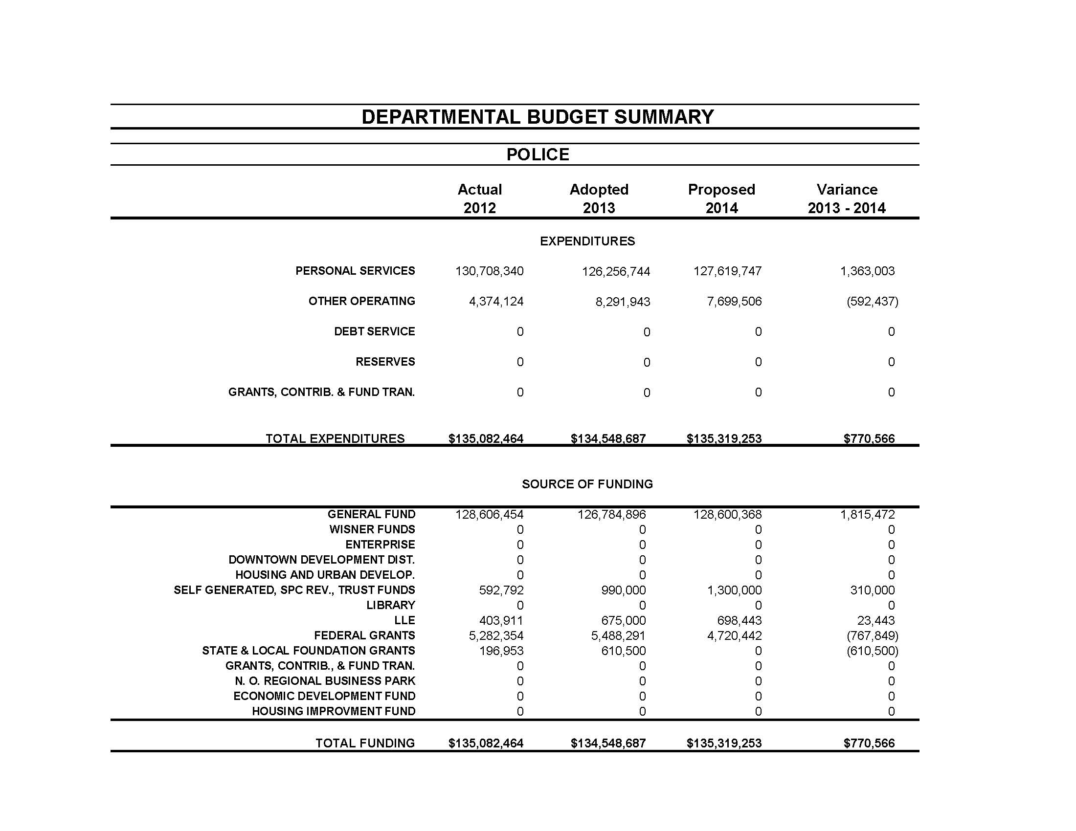
2014 Allocation
New Orleans Police Department

Slide 13
Funding Summary
Year | 2008 | 2009 | 2010 | 2011 | 2012 | 2013 | 2014
 | Actual | Actual | Actual | Actual | Actual | Adopted | Proposed
GF Expenditures | $113,098,644 | $119,332,022 | $127,883,538 | $130,272,813 | $128,606,454 | $126,784,896 | $128,600,368
Total Funding | 134,970,675 | 146,223,978 | 129,769,614 | 130,411,570 | 135,082,464 | 134,548,687 | 135,319,253
#FTEs* | 1847.02 | 1811.72 | 1754.07 | 1642.68 | 1607.68 | 1514.57 | 1489.07
* All Full Time Employees figures are adopted.
New Orleans Police Department

Slide 14
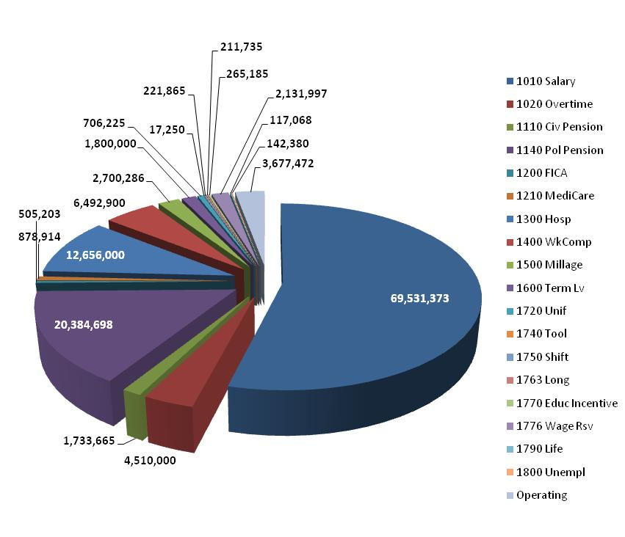
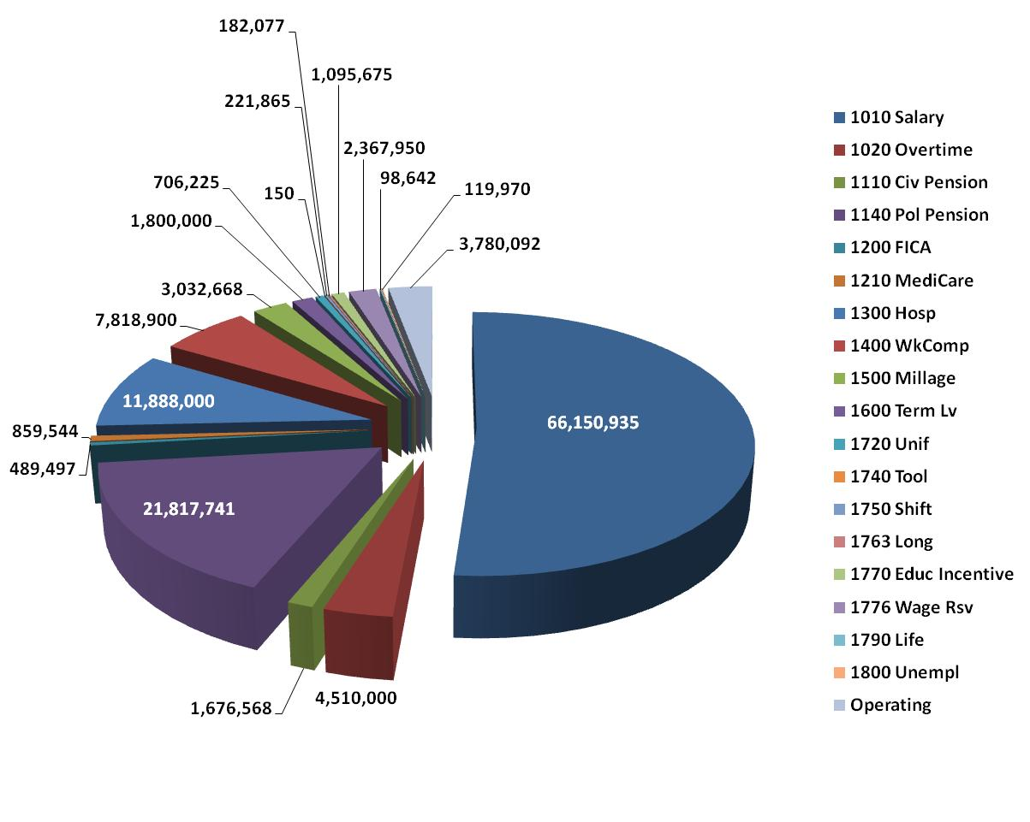
2013 Adopted Budget
2014 Proposed Budget
Adopted 2013 = $ 128,684,216
Proposed 2014 = $ 128,616,499
New Orleans Police Department

Slide 15
Resigned | 41 | 46%
Retired | 40 | 45%
Dismissed | 7 | 8%
Deceased | 1 | 1%
Total | 89
Hired | 41 | 48%
Net Loss (Positions) | -48
New Orleans Police Department

Slide 16
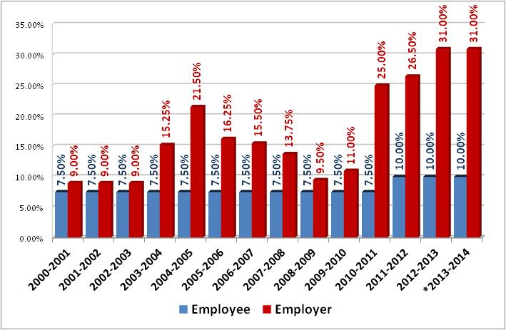
Historical Police Pension Trends
MUNICIPAL POLICE EMPLOYEES’ RETIREMENT SYSTEM
Employee and Employer Contribution Rates
(July 1 – June 30)
* Projected 2013 - 2014 contributions - Pension Board will provide new rate in December 2013 upon receipt from actuary
New Orleans Police Department

Slide 17
Performance Measures
Key Performance Indicator | 2013 Mid-Year Actual | 2013 Mid-Year Target | 2013 Year-End Target | 2014 Target
Average monthly number of crimes against person | 460 | Management Statistic | Management Statistic | Management Statistic
Average monthly number of crimes against property | 2,238 | Management Statistic | Management Statistic | Management Statistic
Clearance rate for crimes against persons | 44% | ≥41% | ≥41% | ≥41%
Clearance rate for crimes against property | 15% | ≥18% | ≥18% | ≥16%
Number of Driving While Intoxicated (DWI) arrests | 626 | ≥885 | ≥1,770 | ≥1,355
Number of complaints about officers made to the NOPD Public Integrity Bureau that were sustained | New Measure in 2014 | New Measure in 2014 | New Measure in 2014 | Establishing Baseline
Number of integrity checks | 119 | ≥120 | ≥240 | ≥240
Percent of police reports reviewed | New Measure in 2014 | New Measure in 2014 | New Measure in 2014 | Establishing Baseline
Number of Neighborhood Watch (Community Coordinating) meetings | 494 | ≥400 | ≥800 | ≥822
Percent of officers completing 40 hours of in-service training | 42% | ≥50% | 100% | 100%
Number of recruit classes | New Measure in 2014 | New Measure in 2014 | New Measure in 2014 | ≥3
New Orleans Police Department

Slide 18
Actions to Meet 2014 KPI’s and Goals
Goal 1: Feeling Safe in Neighborhoods and Crime Fighting
Goal 2: Community Policing
Goal 3: Maintain high standards through proactive approach by Public Integrity Bureau
Goal 4: Highway Safety Initiatives
18
New Orleans Police Department

Slide 19
Actions to Meet 2014 KPIs and Goals
Feeling Safe in Neighborhoods and Crime Fighting
Action 1. New Orleans residents feeling safe in their neighborhood continues to be the highest priority of the NOPD. Maintaining this level, or higher, of safety requires a daily focus on crime fighting, community policing, Quality of Life enforcement and developing a high performing organization. Effective recruiting, training, disciplining and deployment of officers and staff are the principal means of responding to crime, particularly violent crime. The Department will continue to be a flexible, responsive and an innovative policing agency designed to reduce crime, maintain response time to emergency calls at current levels, enforce Quality of Life standards and enhance public perception of the Police Department. Enforcement stops, directed patrols of District Task Forces and Narcotics Units, deployment of Mission 2 personnel, collaboration on a daily basis with local, state and federal law enforcement officials, etc. are a few examples of the Department’s commitment to advancing public safety in New Orleans. The NOPD will continue to work aggressively through the NOLA FOR LIFE strategy and its holistic approach to strategically attacking the root causes of murder in our community with innovative programs such as Cease Fire and the Group Violence Reduction Strategy. Recent and continuing survey data shows that about 85% of those responding feel safe in their neighborhood in five different polls, conducted each six months, beginning in August 2010. The NOPD is committed to continued advancement of our citizens feeling safe.
Community Policing
Action 2. The Community Coordinating Sergeant program, established in August 2010, is responsible for initiating and increasing neighborhood, community and business watch groups to advance the NOPD’s relationship in the community, crime prevention techniques and implementing Community Policing strategies. CoCo Sergeants supervise and coordinate the duties of District Quality of Life officers, follow up on contacts generated by the Crime Prevention Division, and provide support to District Commanders to foster relationships with neighborhood, community, and business groups throughout their district. This relationship building effort is the cornerstone of implementing Community Policing. Community Policing through shared dialogue and information with the community enhances police efforts. From January 2012 to October 2013, the CoCo Sergeants have led 2,019 meetings in our community with over 40,762 attendees. As NOPD staffing continues to fall, the assignment of eight (8) CoCo Sergeants and 13 Quality of Life Officers may become unsustainable. The NOPD will staff these critical positions as long as possible.
19
New Orleans Police Department

Slide 20
Actions to Meet 2014 KPIs and Goals Cont.
Maintain high standards through proactive approach by Public Integrity
Action 3
Ensure PIB directives comply with Consent Decree mandates.
Provide semi-annual training sessions for all PIB investigators which include investigation techniques and policy analyses that are complaint/investigation-driven.
Ensure PIB personnel compliance with mandatory Departmental training requirements.
Complete written communications with complainants regarding initiation, identification of the investigator, and outcome of the investigation.
Within 3 days of classification all complaints are entered into the complaint management system within 15 days of the date received by PIB and updated within 15 days of completion.
Each quarter, conduct 60 integrity and quality assurance checks of Department personnel according to complaint trends and other information obtained from internal and external sources.
PIB - Administrative Investigation Section
Ensure that all administrative investigations are completed within 120 days.
Ensure all section personnel receive 40-60 hours of role-specific training for investigators.
Maintain a user-friendly and reliable database for tracking and managing formal internal investigations.
Ensure the complainant is contacted by section personnel every 30 days via email, telephone, or letter and kept apprised of the status of the complaint.
Ensure the accused officer is notified of the recommended disposition and hearing date within 120 days of the cognizance of the administrative investigation.
20
New Orleans Police Department

Slide 21
Actions to Meet 2014 KPIs and Goals Cont.
Highway Safety Initiatives
Action 4. In 2014, the Department plans to actively engage in more public service awareness campaigns for DWI & under age drinking.
Juvenile Underage Drinking has long been problematic in Orleans Parish and in addition to the regular enforcement conducted primarily by the 8th District Bourbon Street Promenade; the Louisiana Highway Safety Commission includes this component in their funding package to the New Orleans Police Department. With the deployment of plainclothes officers that target known challenging areas that cater to minors, there has been a significant increase in this enforcement component that has shown a 65% increase in the summonses issued to violators from 2012 to 2013 ytd. We expect that trend to continue, and while the numbers have significantly increased, several university newspapers have published articles in their respective newspaper ‘s warning students to expect enforcement.
While we strive to increase arrest numbers annually for DWI, we know that removing impaired drivers from our streets are the most significant factor in reducing fatal crashes; we believe that our strategy and initiatives are effective and could be a model for any agency in the United States. Our partnership with the LHSC and NHTSA allows us to expand our enforcement and coupled with our enforcement, we will continue to send media releases through the Public Information Office which will only enhance our effectiveness annually.
21
New Orleans Police Department

Slide 22
UCR Data – Jan. through September
Citywide Totals
 |  | Jan – Sep |  | Jan - Sep (1) |  |  | %
Offense |  | 2012 |  | 2013 |  |  | Change
Murder* |  | 149 |  | 111 |  |  | -25.50%
Rape** |  | 108 |  | 123 |  |  | 13.89%
Arm. Robbery |  | 556 |  | 522 |  |  | -6.12%
Sim. Robbery |  | 251 |  | 273 |  |  | 8.76%
Assault |  | 1181 |  | 1161 |  |  | -1.69%
Person Crime Total |  | 2245 |  | 2190 |  |  | -2.45%
Burglary |  | 2597 |  | 2414 |  |  | -7.05%
Theft |  | 6049 |  | 6768 |  |  | 11.89%
Auto Theft |  | 1724 |  | 1585 |  |  | -8.06%
Property Crime Total |  | 10370 |  | 10767 |  |  | 3.83%
Total Index Crimes |  | 12615 |  | 12957 |  |  | 2.71%
(1) Estimate (based on Jan-Jun actual UCR / Jul - Sep estimated)
*Murder Totals Provided by Homicide Unit
**Rape Totals Provided by Sex Crimes Unit
**Rape statistics do not include male victim nor oral sexual battery cases
22
New Orleans Police Department

Slide 23
2012 Final UCR – NOLA Compared
 | 2012 | All Crime | Violent | Murder | Rape | Robbery | Assault | Property | Burglary | Theft | Auto Theft
 | Population | per/1000 | per/1000 | per/1000 | per/1000 | per/1000 | per/1000 | per/1000 | per/1000 | per/1000 | per/1000
Saint Louis | 318,172 | 86.92 | 17.79 | 0.36 | 0.63 | 5.59 | 11.22 | 69.13 | 15.67 | 42.49 | 10.97
Oakland | 400,740 | 85.60 | 19.87 | 0.32 | 0.68 | 10.82 | 8.05 | 65.73 | 15.39 | 32.93 | 17.41
Cleveland | 390,928 | 76.12 | 13.94 | 0.21 | 0.93 | 8.32 | 4.48 | 62.18 | 24.92 | 27.65 | 9.62
Miami | 413,892 | 65.54 | 11.73 | 0.17 | 0.16 | 5.06 | 6.34 | 53.81 | 10.28 | 36.98 | 6.55
Tulsa | 393,987 | 62.83 | 10.02 | 0.11 | 0.80 | 2.70 | 6.42 | 52.81 | 15.83 | 30.87 | 6.12
Wichita | 385,577 | 62.09 | 7.44 | 0.06 | 0.59 | 1.28 | 5.51 | 54.65 | 10.16 | 39.76 | 4.72
Minneapolis | 392,890 | 59.13 | 9.86 | 0.10 | 1.03 | 4.38 | 4.35 | 49.27 | 12.17 | 32.48 | 4.62
Bakersfield | 358,597 | 54.89 | 5.38 | 0.09 | 0.16 | 1.94 | 3.18 | 49.51 | 13.93 | 26.60 | 8.98
Corpus Christi | 312,195 | 51.63 | 6.59 | 0.05 | 0.59 | 1.20 | 4.75 | 45.04 | 7.85 | 35.77 | 1.42
Cities with/ Pop. 250,000-499,000 * | 14,272,134 | 50.56 | 7.77 | 0.12 | 0.43 | 2.99 | 4.24 | 42.78 | 10.19 | 27.34 | 7.48
Arlington | 375,600 | 45.31 | 5.08 | 0.05 | 0.36 | 1.42 | 3.26 | 40.23 | 9.43 | 28.26 | 2.53
New Orleans | 369,250 | 45.08 | 8.01 | 0.52 | 0.37 | 2.88 | 4.24 | 37.07 | 9.27 | 21.80 | 6.00
Pittsburgh | 306,211 | 42.58 | 7.66 | 0.13 | 0.15 | 3.70 | 3.67 | 34.91 | 8.29 | 24.85 | 1.78
Riverside | 313,673 | 38.92 | 4.43 | 0.05 | 0.24 | 1.65 | 2.49 | 34.49 | 7.16 | 22.60 | 4.71
Tampa | 347,645 | 34.83 | 6.22 | 0.07 | 0.12 | 1.51 | 4.38 | 28.61 | 7.12 | 19.74 | 1.75
Anaheim | 343,248 | 33.06 | 3.73 | 0.04 | 0.24 | 1.28 | 2.16 | 29.34 | 4.68 | 20.47 | 4.20
Santa Ana | 330,920 | 26.36 | 4.03 | 0.03 | 0.17 | 1.63 | 2.20 | 22.33 | 3.12 | 14.44 | 4.77
Population from: http://quickfacts.census.gov/qfd/index.html
City Crime data from: http://www.fbi.gov/about-us/cjis/ucr/crime-in-the-u.s/2012/crime-in-the-u.s.-2012 (Table 8 , Table 10 for Jefferson Parish (un-incorp))
* Data from: http://www.fbi.gov/about-us/cjis/ucr/crime-in-the-u.s/2012/crime-in-the-u.s.-2012 (Table 16 )
(1) The data collection methodology for the offense of forcible rape used by Chicago, Illinois, does not comply with national Uniform Crime Reporting Program guidelines. a part)
Consequently, its figures for forcible rape and violent crime ,of which forcible rape is, are not published in this table.
(2) Area patrolled by LVMPD ( Clarke County, minus the cities of Henderson North Las Vegas, Boulder City, & Mesquite)
23
New Orleans Police Department

Slide 24
2012 Final UCR – NOLA Compared
 | 2012 | All Crime | Violent | Murder | Rape | Robbery | Assault | Property | Burglary | Theft | Auto Theft
 | Population | per/1000 | per/1000 | per/1000 | per/1000 | per/1000 | per/1000 | per/1000 | per/1000 | per/1000 | per/1000
Atlanta | 443,775 | 77.92 | 13.58 | 0.19 | 0.25 | 5.13 | 8.01 | 64.34 | 13.95 | 38.79 | 11.60
Orlando | 249,562 | 75.38 | 10.05 | 0.10 | 0.41 | 2.42 | 7.12 | 65.33 | 15.14 | 44.97 | 5.23
Houston | 2,160,821 | 59.83 | 10.00 | 0.10 | 0.31 | 4.34 | 5.25 | 49.83 | 12.32 | 31.46 | 6.05
DC | 632,323 | 58.06 | 11.78 | 0.14 | 0.37 | 5.89 | 5.38 | 46.28 | 5.57 | 35.10 | 5.61
Seattle | 634,535 | 56.23 | 5.90 | 0.04 | 0.19 | 2.24 | 3.44 | 50.32 | 10.28 | 34.44 | 5.60
San Fransico | 825,863 | 54.09 | 7.00 | 0.08 | 0.13 | 4.22 | 2.56 | 47.10 | 6.44 | 34.20 | 6.46
Nashville | 624,496 | 53.81 | 12.09 | 0.10 | 0.50 | 2.76 | 8.73 | 41.72 | 9.19 | 30.24 | 2.29
Dallas | 1,241,162 | 50.50 | 6.75 | 0.12 | 0.39 | 3.30 | 2.94 | 43.75 | 12.96 | 25.10 | 5.69
New Orleans | 369,250 | 45.08 | 8.01 | 0.52 | 0.37 | 2.88 | 4.24 | 37.07 | 9.27 | 21.80 | 6.00
Denver | 634,265 | 42.91 | 6.10 | 0.06 | 0.59 | 1.84 | 3.61 | 36.80 | 8.09 | 22.93 | 5.79
Chicago (1) | 2,714,856 | 41.43 | N/A | 0.18 | N/A | 4.96 | 4.52 | 41.43 | 8.38 | 26.78 | 6.26
Las Vegas (2) | 1,480,359 | 39.20 | 7.83 | 0.05 | 0.40 | 2.58 | 4.80 | 31.36 | 9.61 | 17.24 | 4.52
Boston | 636,479 | 37.10 | 8.27 | 0.09 | 0.39 | 3.00 | 4.79 | 28.83 | 5.22 | 21.05 | 2.55
Population from: http://quickfacts.census.gov/qfd/index.html
City Crime data from: http://www.fbi.gov/about-us/cjis/ucr/crime-in-the-u.s/2012/crime-in-the-u.s.-2012 (Table 8 , Table 10 for Jefferson Parish (un-incorp))
* Data from: http://www.fbi.gov/about-us/cjis/ucr/crime-in-the-u.s/2012/crime-in-the-u.s.-2012 (Table 16 )
(1) The data collection methodology for the offense of forcible rape used by Chicago, Illinois, does not comply with national Uniform Crime Reporting Program guidelines. a part)
Consequently, its figures for forcible rape and violent crime ,of which forcible rape is, are not published in this table.
(2) Area patrolled by LVMPD ( Clarke County, minus the cities of Henderson North Las Vegas, Boulder City, & Mesquite)
24
New Orleans Police Department

