Slide 1
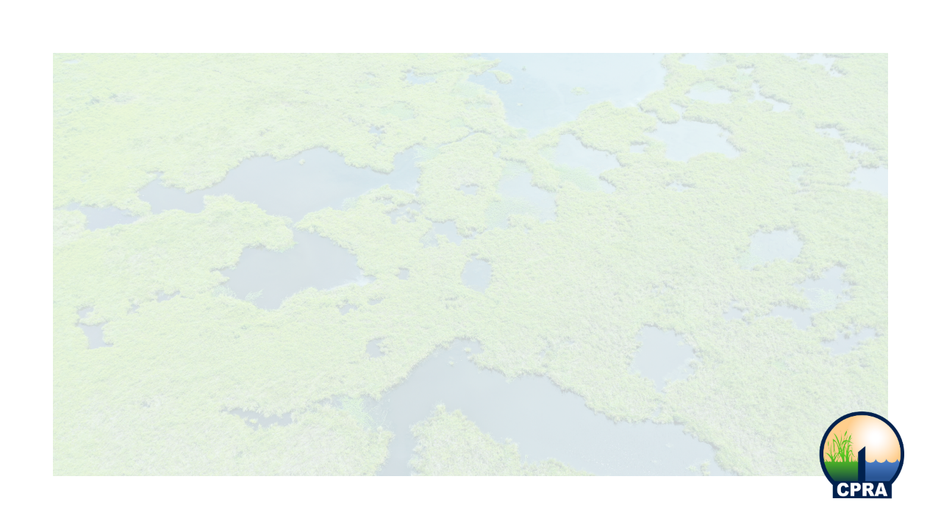
PO-207 Irish Bayou Living Shoreline
COASTAL PROTECTION AND RESTORATION AUTHORITY
Stakeholder Engagement Meeting
Joe Brown Park
5601 Read Blvd, New Orleans, LA
August 11th, 2025

Slide 2
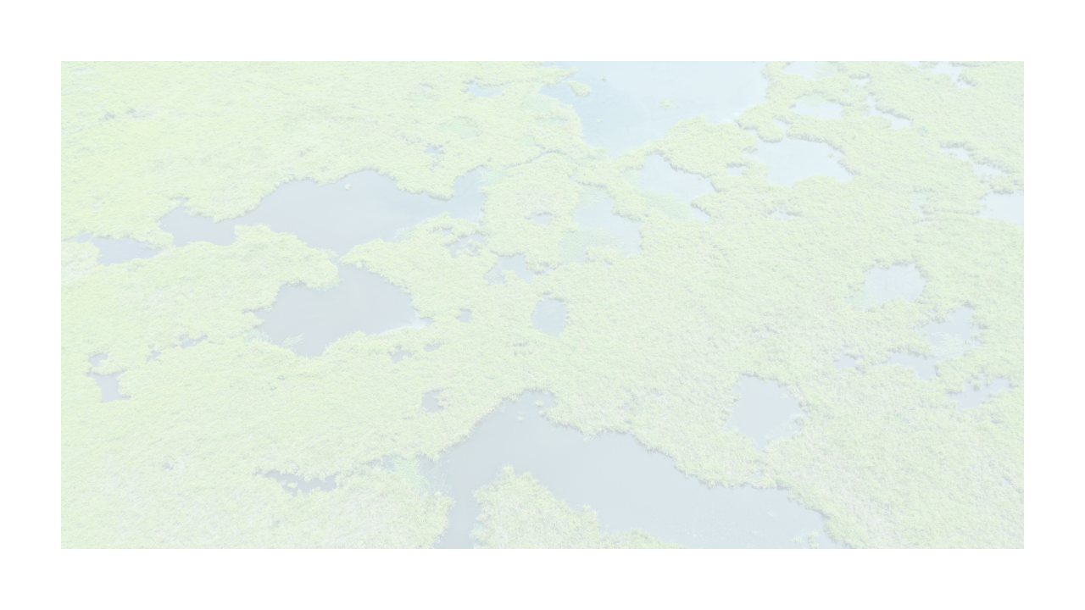
Meeting Purpose and Outcomes
Stakeholder input
  Preferred features
  Specific locations to address; areas of concern
  General discussion/ Q&A
Awareness
  Project details
  Survey participation
  Future engagement
Additional restoration opportunities
  Plantings, sediment placement, additional reef features, etc.
  Potential partnerships (funding dependent)

Slide 3
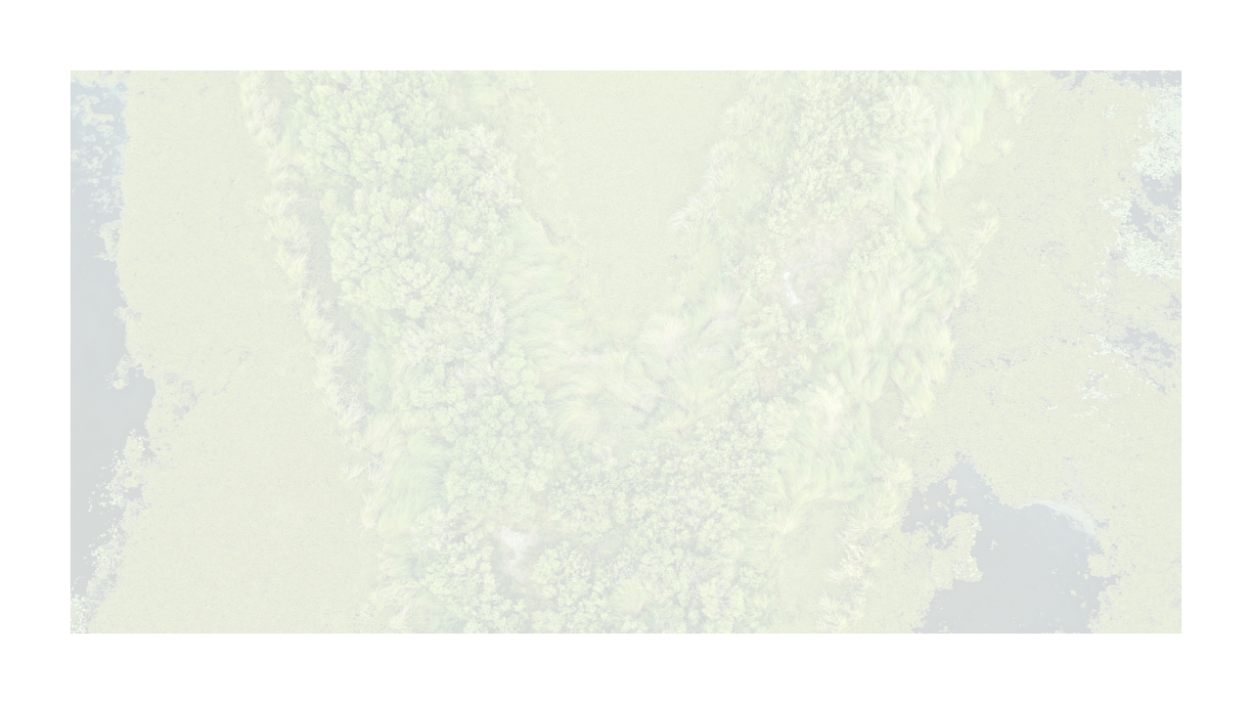
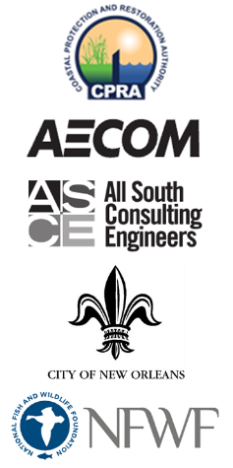
Project Team
Lead: CPRA
Engineering consultants: AECOM and All South
Public Engagement Lead: City of New Orleans
Funding Partners: National Fish and Wildlife Foundation (NFWF)

Slide 4

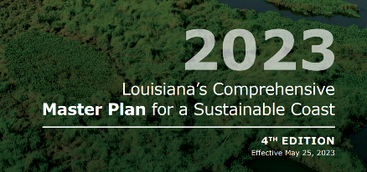
Coastal Protection and Restoration Authority
Created under Act 8 of the 2005 special legislative session, the CPRA is the single state entity to articulate priorities and to focus development and implementation efforts to achieve comprehensive coastal restoration and protection for Louisiana
CPRA’s mandate is to develop and implement the comprehensive coastal protection and restoration Master Plan.
coastal.la.gov

Slide 5
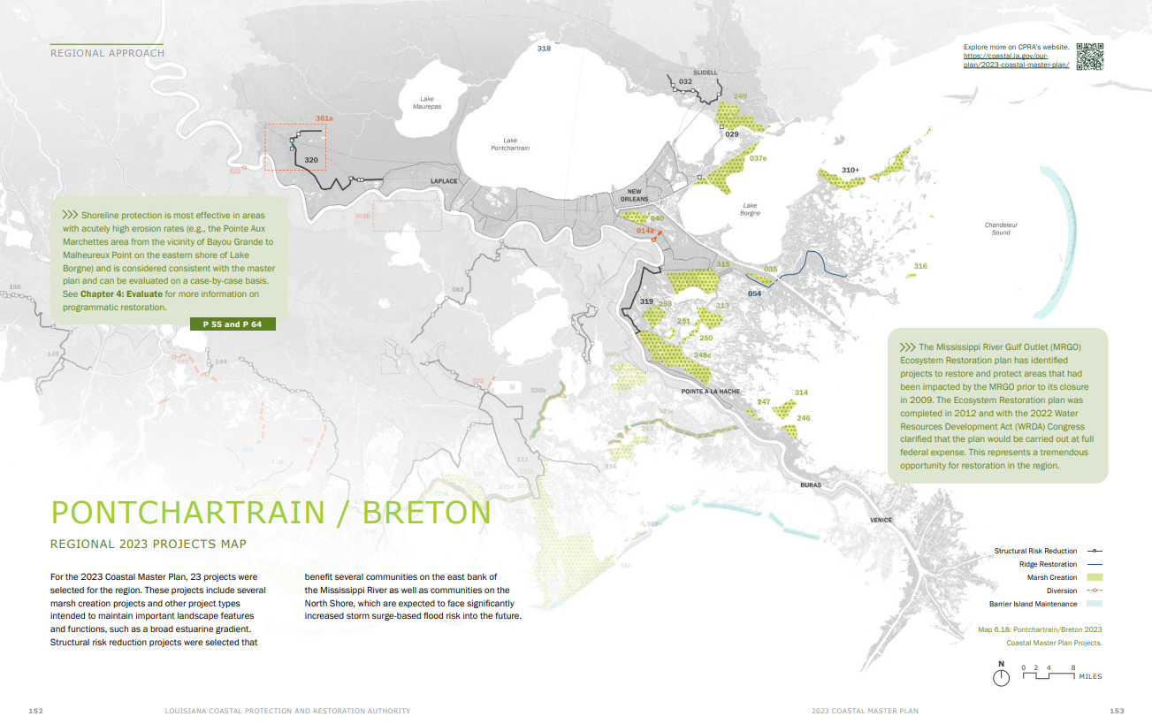
Master Plan Development

Slide 6
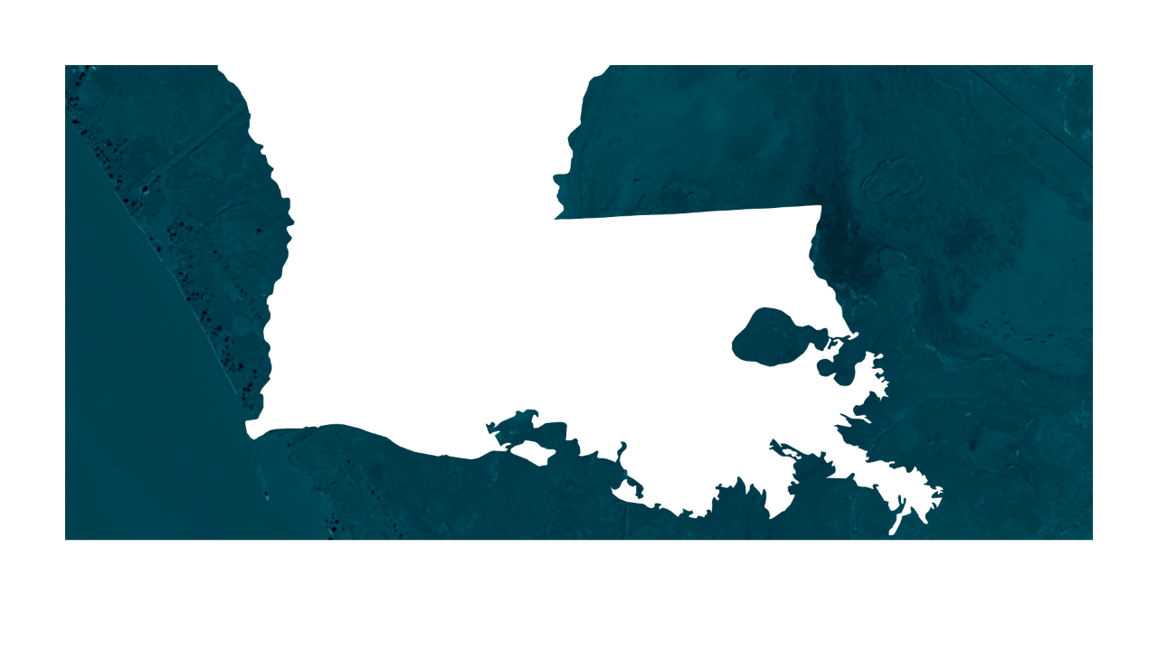

Master Plan Project Implementation
Project Location
PO-207 Irish Bayou Loving Shoreline
Orleans Parish

Slide 7
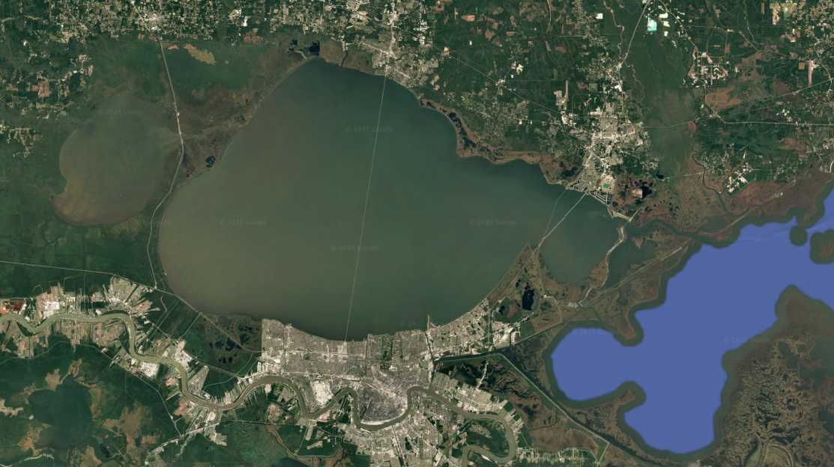
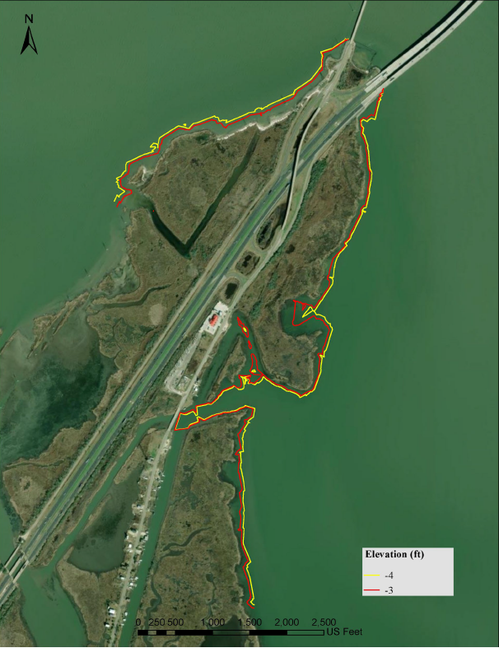

Slide 8
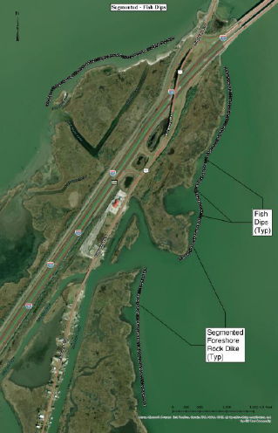
Project Location: Regional Priority
Programmatically consistent with the Master Plan: shoreline protection and living shoreline
Identified as a priority area in for Mississippi River Gulf Outlet (MRGO) restoration efforts
Regional Protection
  Irish Bayou
  Bayou Sauvage National Wildlife Refuge
  Interstate 10, Hwy 11

Slide 9
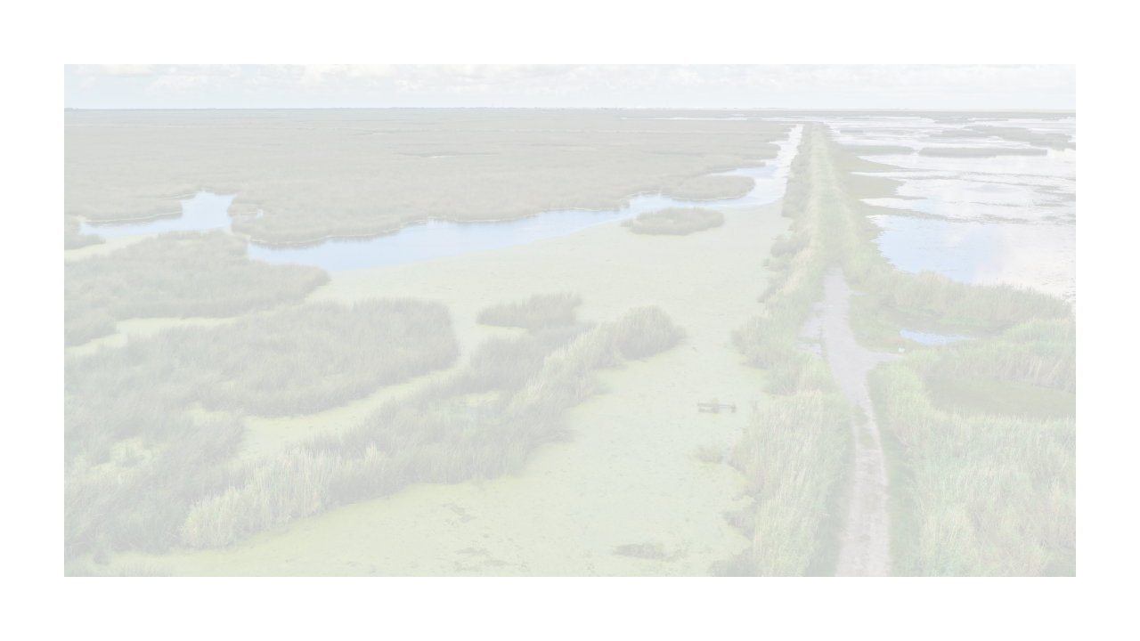
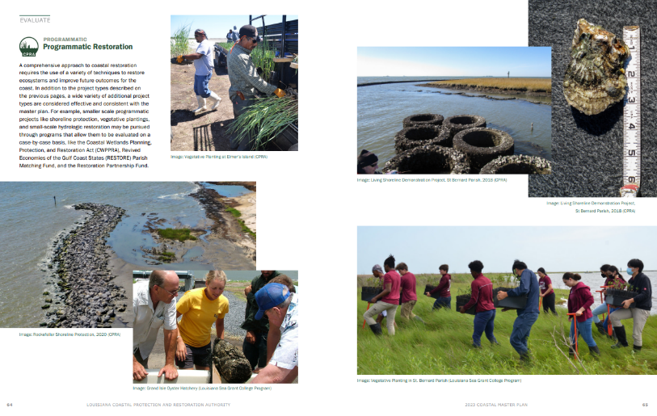
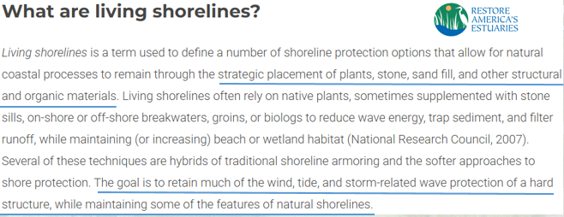
Living Shoreline 101

Slide 10
Project Goal and Issues Addressed
Develop 30% Engineering and Design Plans for a living shoreline project in Orleans Parish in the vicinity or Irish Bayou, LA
  Data Gap Analysis
  Land Ownership Investigation
    Access agreements for surveys
    Construction easements
  Site Investigations (Surveys)
  Cultural Resources Investigation
  Alternatives Analysis
  Public Engagement
Once constructed, the project will protect approximately 2 miles of shoreline from wind-induced wave erosion, sustain and augment fisheries habitat, buffer against storms, and limit wave fetch to reduce vegetation loss.
Optimized Living Shoreline feature for the specific geographic location

Slide 11
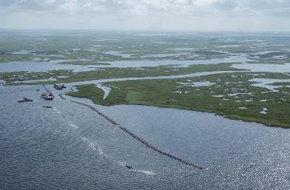
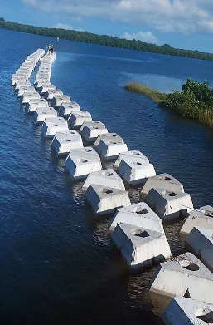
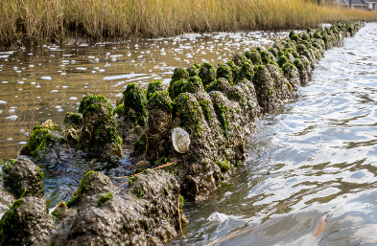
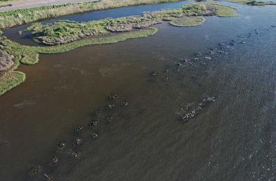
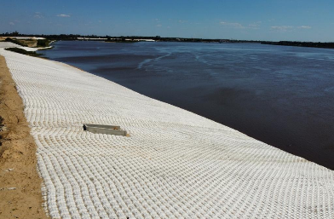
Living Shoreline Alternatives
Rock Dike Breakwaters
Artificial Reefs
Artificial Sills
Rubble Mounds
Armored Revetment

Slide 12
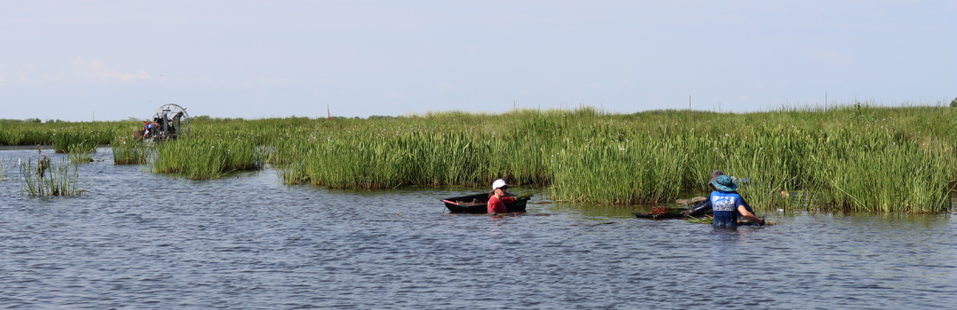
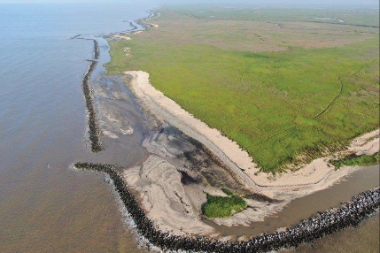
Additional Complimentary Features
Wetland Planting
Sediment Placement
Artificial Sills

Slide 13
Project Alternatives Estimated Cost
Current 30% E&D effort is funded by National Fish and Wildlife Foundation
Total cost estimate for construction is under development and is be dependent on-
  Alternative(s) included
  Amount of material and site conditions
  Amount and type of additional complimentary features included
Living shoreline alternatives will make up majority of costs. Additional complimentary features are significantly cheaper and can be strategically deployed in smaller increments.
Construction funding is pending. The intent is for the preferred alternative(s) to be scalable and adaptable to funding source priorities and amount allocated or awarded

Slide 14
Project Timeline
Planning
30% E&D
100% E&D
Construction
OM&M
Preliminary 30% Engineering and Design (E&D) currently scheduled to be complete early in 2026
  Data Gap Analysis and Surveys complete
  Alternatives Analysis and Public Engagement ongoing
  Cultural Resources Investigation upcoming
Final E&D and Construction TBD
  Both need funding sources identified
  Amount and sources of funding will be determined by this 30% effort

Slide 15
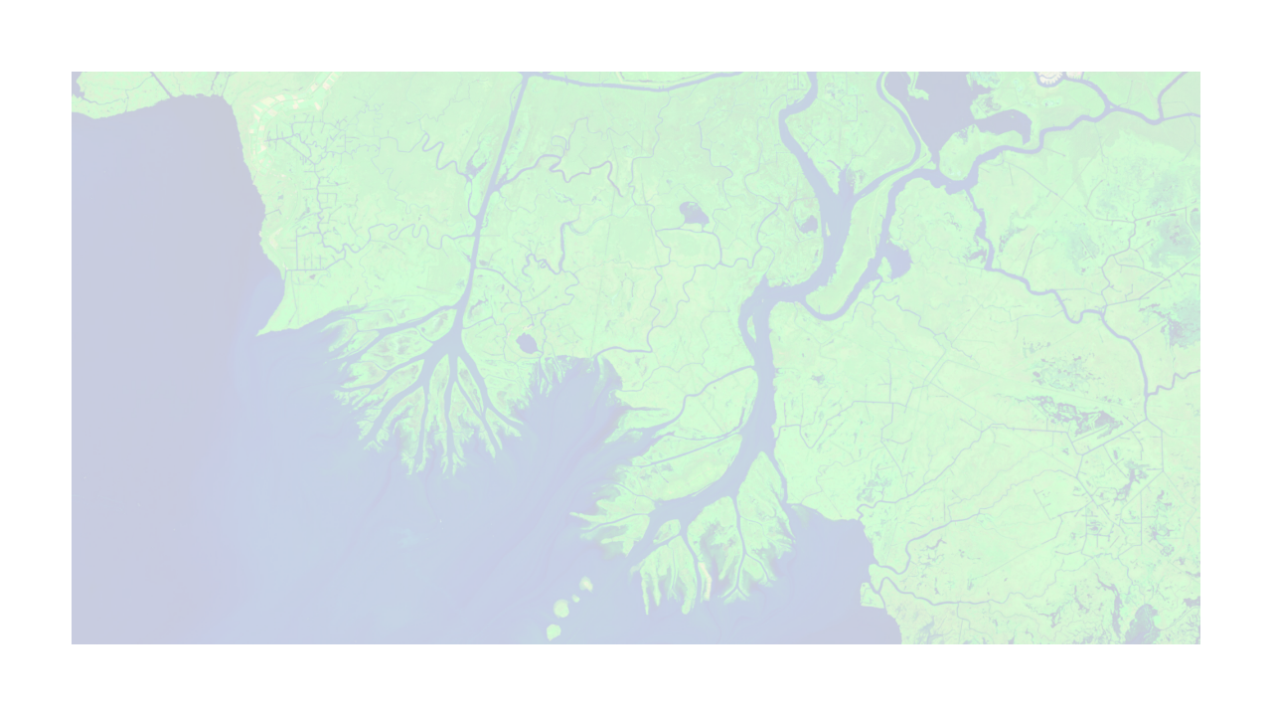
Public Engagement Phases
During preliminary E&D phase
  Survey
  Today’s meeting
  Follow up meeting prior to finalization, likely November or December 2025
During final E&D Phase
  Continued engagement with frequency and type TBD
Construction
  Land owner and adjacent land owner construction notifications and direct communication of activities and updates on progress
  Signage/ buoys

Slide 16
Meeting Purpose and Outcomes
Stakeholder input
  Preferred features
  Specific locations to address; areas of concern
  General discussion/ Q&A
Awareness
  Project details
  Survey participation
  Future engagement
Additional restoration opportunities
  Plantings, sediment placement, additional reef features, etc.
  Potential partnerships (funding dependent)

Slide 17


Slide 18
Project Alternatives Estimated Cost
Rock Dike Breakwater (Continual) – $ 4.6 Million/Mile
Rock Dike Breakwater (with Fish Dips) – $ 4.2 Million/Mile
Rubble Mounds – $5.2 Million/Mile
Artificial Reefs – $4.2 Million/Mile
Artificial Sills – $0.9 Million/Mile
Armored Revetment – $4.4 Million/Mile

