Slide 1

Non-Commercial Short-Term Rental
Application Training

Slide 2
WHAT IS A SHORT-TERM RENTAL?
Rental of all or any portion thereof of a residential dwelling unit for dwelling, lodging or sleeping purposes to one party with duration of occupancy of less than thirty (30) consecutive days. Common bathroom facilities may be provided rather than private baths for each room.
Hotels, motels, bed & breakfasts are not considered to be short term rentals.

Slide 3
IMPORTANT INFO FOR NSTR LICENSES
A maximum of 1 NSTR or Bed & Breakfast (B&B) may be permitted per square. Where more than one person applies per square for a NSTR License, licenses will be allocated by lottery.
Application period for NSTR Licenses: September 16 - 22, 2026. The application will be available on the One Stop App at 8am & will be removed from the One Stop App at 8am. All applications must be submitted by September 22 @ 11:59pm. Any applications submitted after September 22 @ 11:59pm will be denied. No Exceptions!
$50 non-refundable application fee for ALL STR Owner & Operator Licenses.
Lottery will be held October 6, 2026 & live streamed via TEAMS. (If there are no squares with multiple applications, there will be no lottery.)
Lottery winners will have FIVE CALENDAR DAYS to pay for their license, or they will forfeit their right to the license.
If there is an NSTR License on your square, you are not eligible to apply.

Slide 4
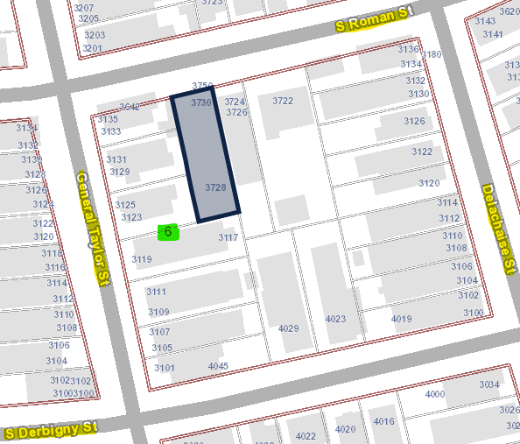
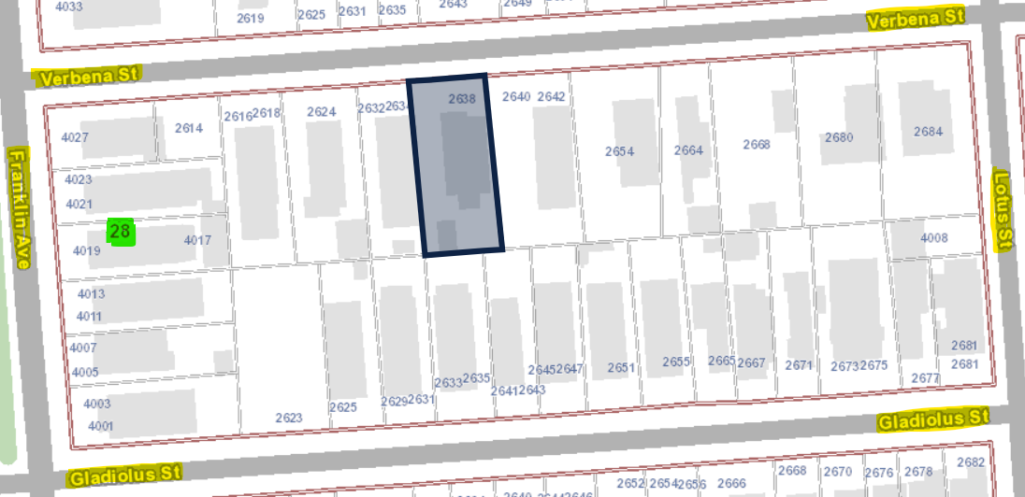
WHAT IS A SQUARE?

Slide 5
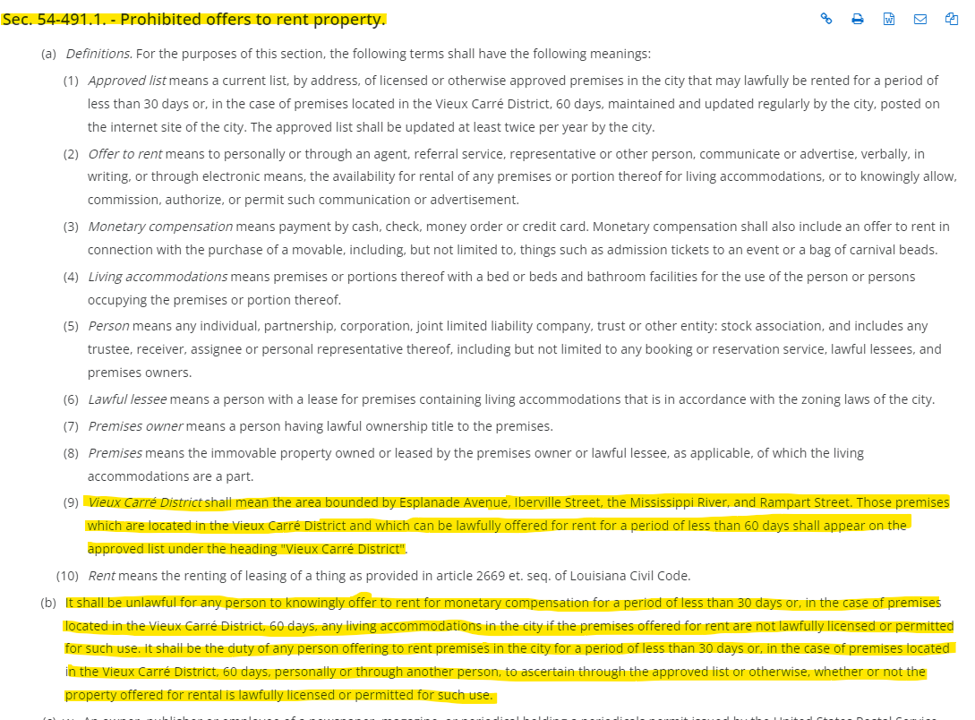
VCC STR RESTRICTIONS

Slide 6
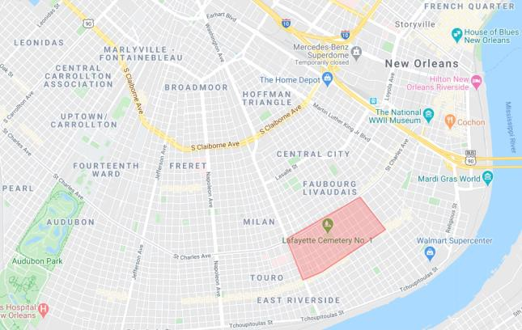
NSTR ELIGIBLE ZONES
ZONE | NSTR |  | Notwithstanding the above, STR is prohibited between the center line of St. Charles Ave., the downriver side of Jackson Ave., the center line of Magazine St., and the downriver side of Louisiana Ave.
R-RE | L/SE
M-MU | L/SE
HMR-1 | L/SE
HMR-2 | L/SE
HMR-3 | L/SE
VCE | L/SE
HMC-1 | L/SE
HMC-2 | L/SE
HM-MU | L/SE
HU-RS | L/SE
HU-RD1 | L/SE
HU-RD2 | L/SE
HU-RM1 | L/SE
HU-RM2 | L/SE
HU-B1A | L/SE
HU-B1 | L/SE
HU-MU | L/SE
S-RS | L/SE
S-RD | L/SE
S-RM1 | L/SE
S-RM2 | L/SE
S-LRS1 | L/SE
S-LB1 | L/SE
S-LB2 | L/SE
S-LC | L/SE
S-MU | L/SE
MU-1 | L/SE
MU-2 | L/SE
EC | L/SE
CBD-1 | L/SE
CBD-2 | L/SE
CBD-3 | L/SE
CBD-5 | L/SE
CBD-6 | L/SE

Slide 7
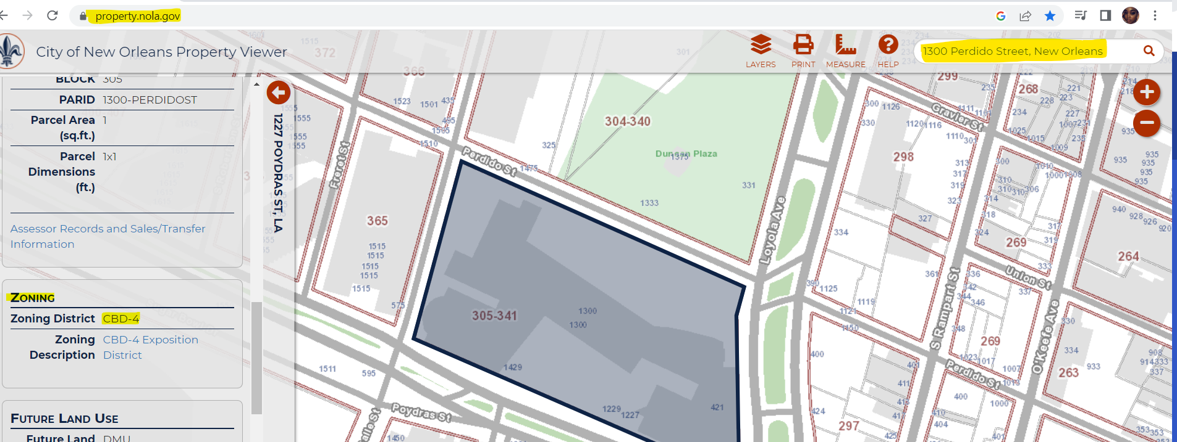
HOW DO I FIND MY ZONE?

Slide 8
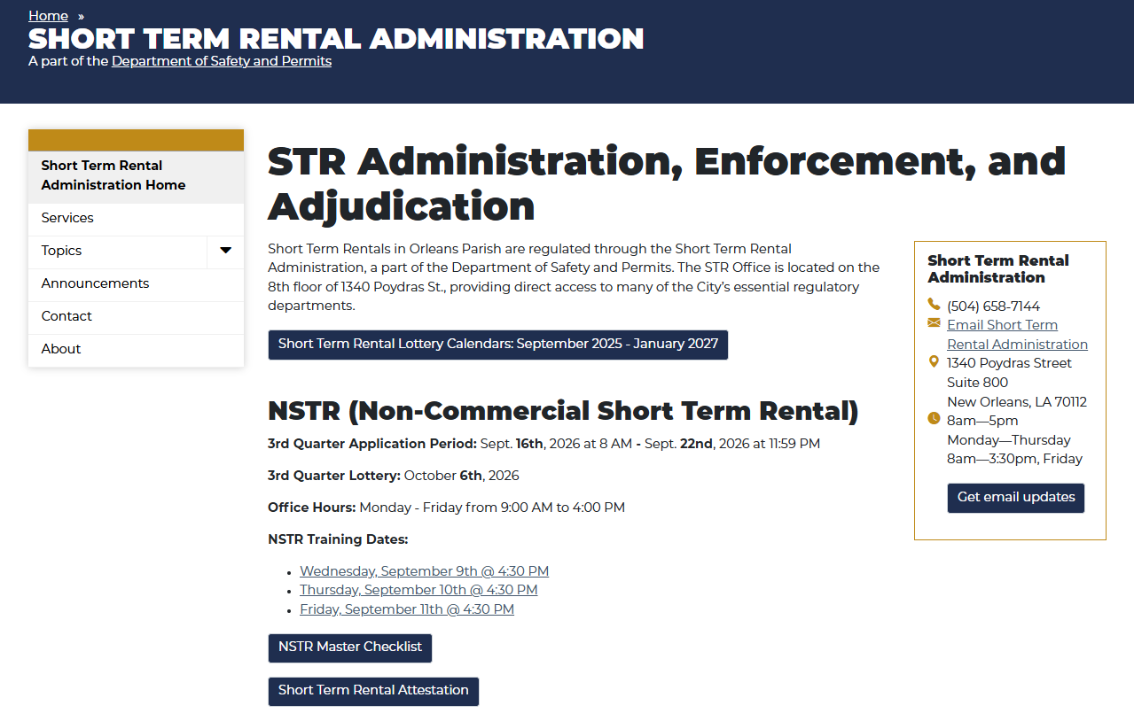
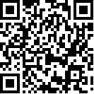
NSTR LICENSE MAP via NOLA.GOV/STR

Slide 9
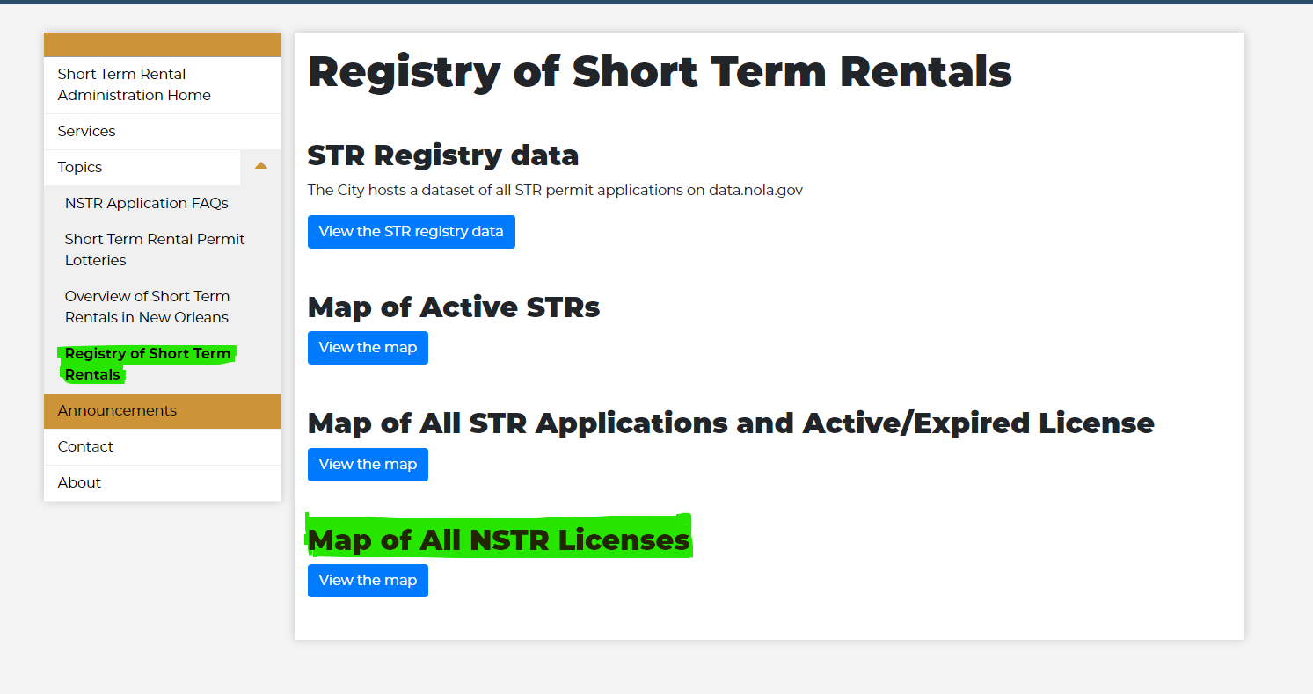
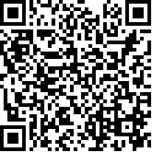
NSTR LICENSE MAP via NOLA.GOV/STR

Slide 10
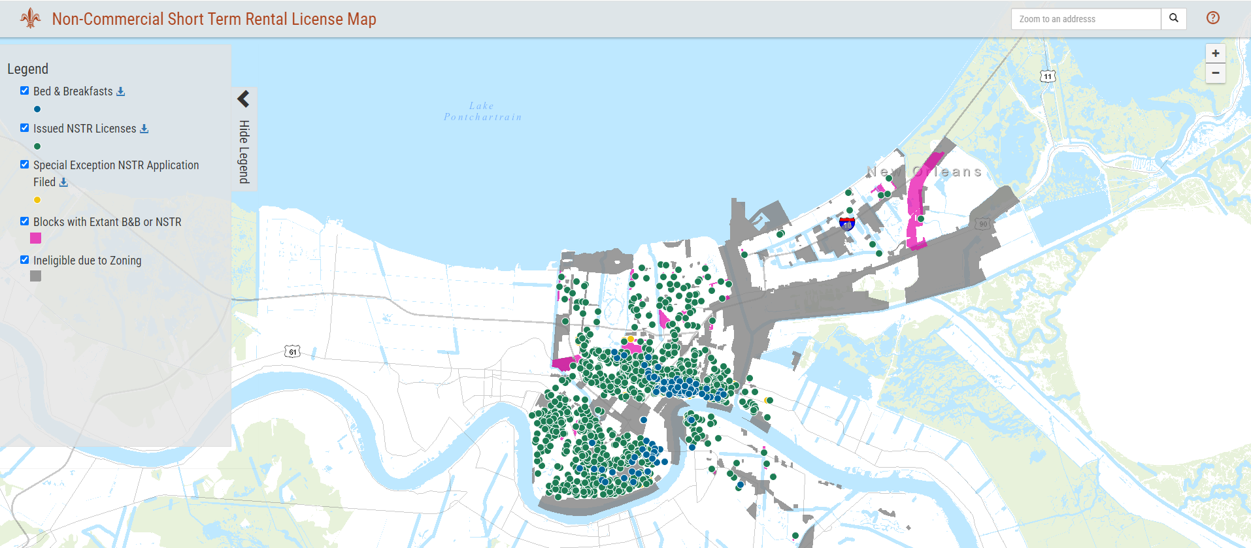

Slide 11
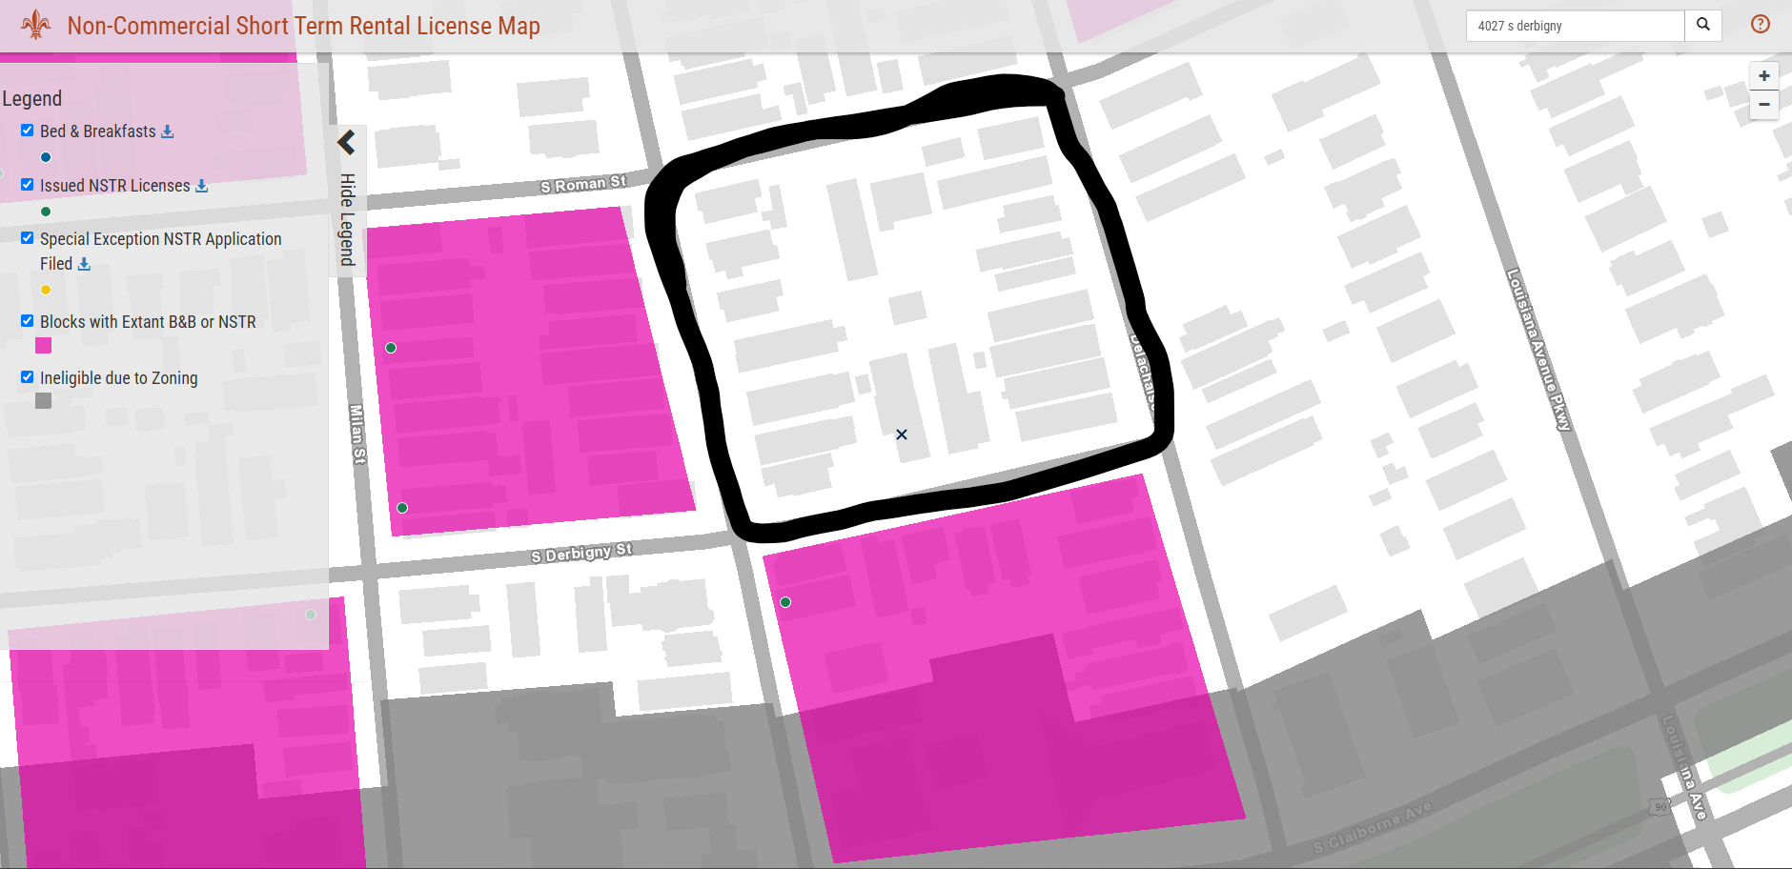
Example of available square
PINK SQUARES NOT ELIGIBLE FOR AN NSTR LICENSE

Slide 12
NON-COMMERCIAL STR LOTTERY
Application period - September 16 – September 22.
Office hours during this time to assist with completing application (Monday - Friday, 9:00am – 4:00pm).
A complete application will also require that the property has no outstanding electrical or mechanical violations, violations for work without permits, open permits, or unresolved zoning or addressing issues. Applicants are advised to begin working on these issues and verifying their zoning and addressing status with the Department immediately.
NSTR Owner Permit Fee: $375
NSTR Operator Permit Fee: $150
CSTR Operator Permit Fee: $1000
CSTR & NSTR Operator Permit Fee: $1000

Slide 13
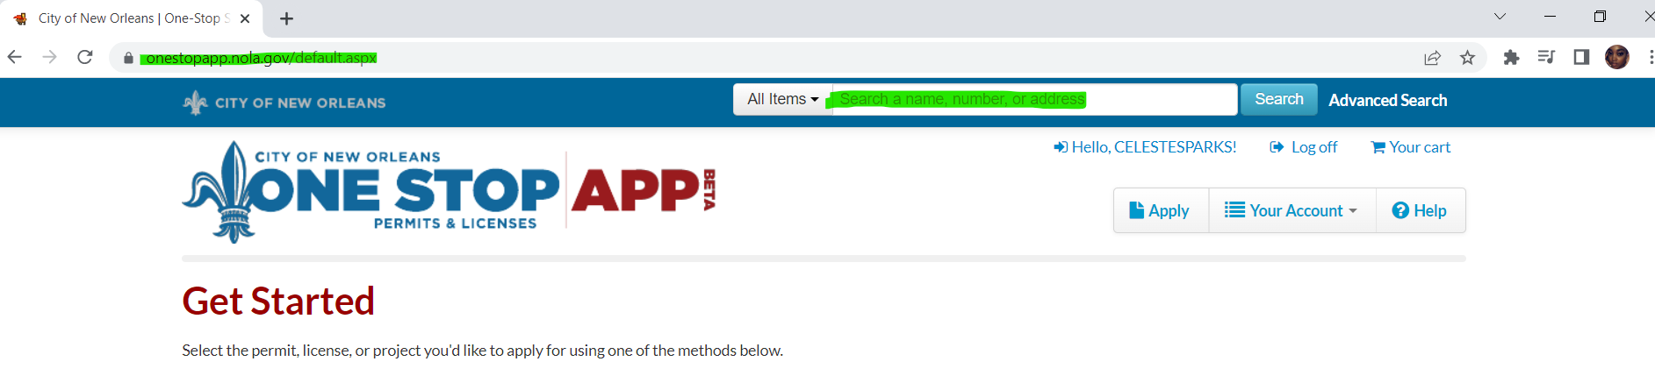
Check your property for any open permits & violations

Slide 14
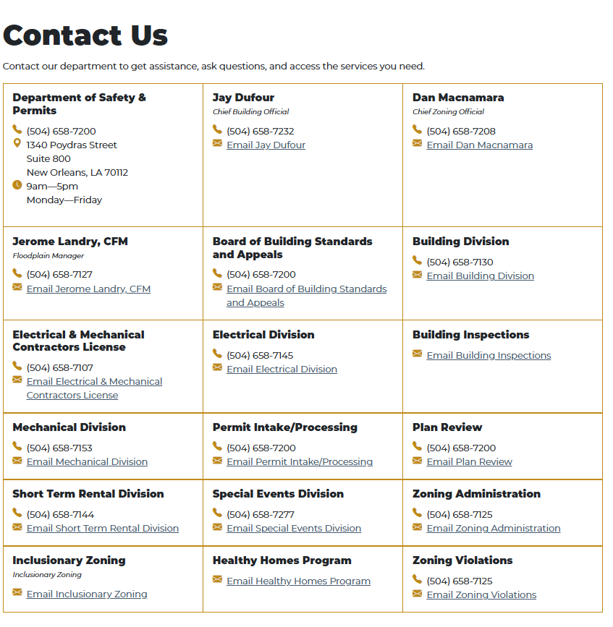
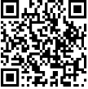
Safety & Permits Contacts Contact the respective division to close out permits & violations

Slide 15
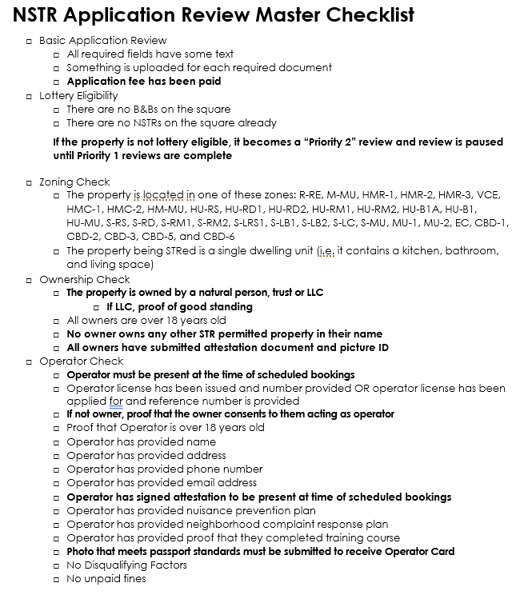

Slide 16
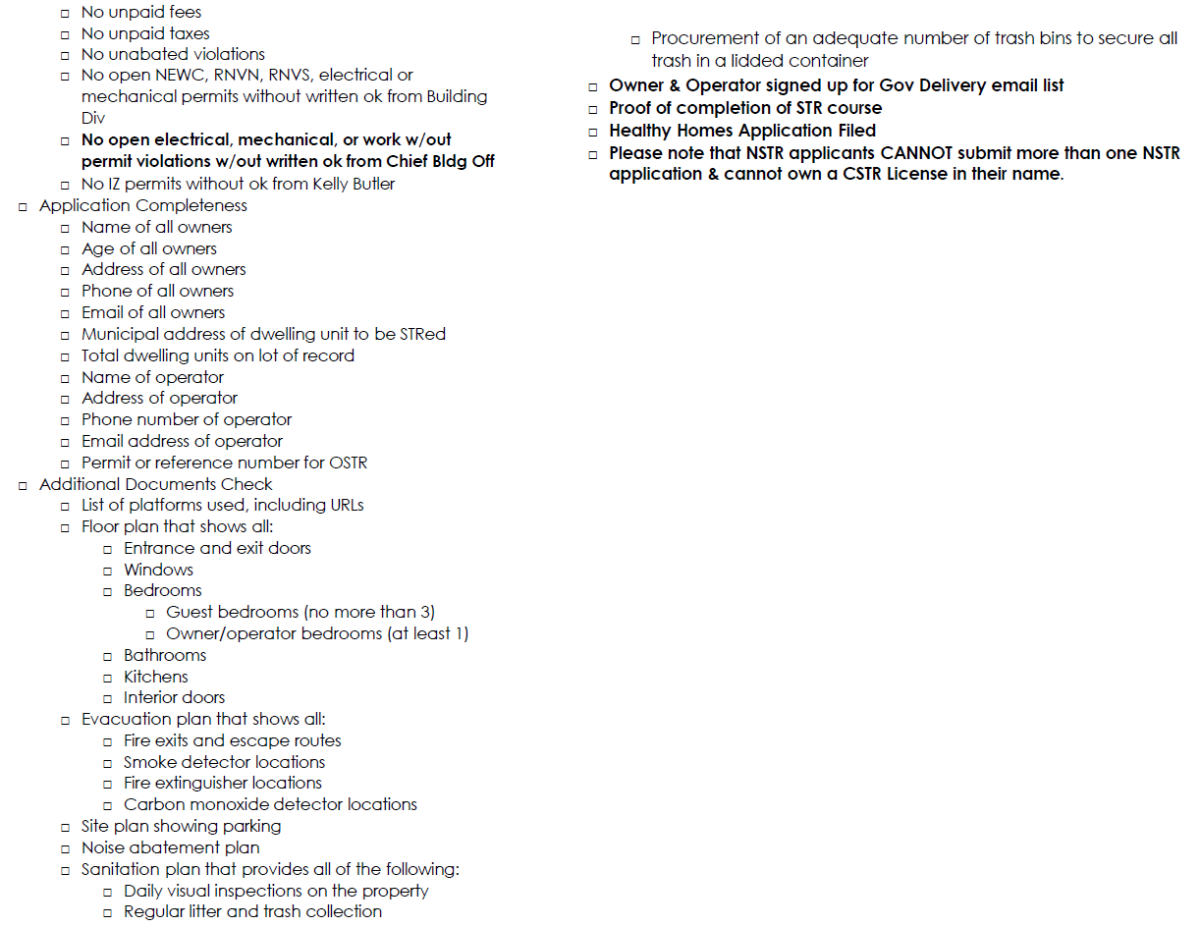

Slide 17
PERMIT APP & ELIGIBILITY
No dwelling unit may be used as a short-term rental unit unless an owner possesses a short­ term rental owner permit. Issuance of a short-term rental owner permit shall be subject to the following rules and criteria:
  No person or entity may possess more than one short-term rental owner permit or own, in whole or in part, more than one property used as a non-commercial short-term rental; - One NSTR application per applicant. You cannot own a CSTR & apply for an NSTR License with the same name.
  The Non-Commercial STR License will expire on June 30, 2027, and shall be renewed during the designated renewal period (April/May 2027).

Slide 18
COMPLETE NSTR APPLICATION
Operator permit, either issued or a completed application (+app fee); if you have not already, please complete this application FIRST.
Proof of completion of the STR Owner training class as provided by the Department; (provide the training code word)
A floor plan (max 3 bedrooms for 6 guests); LEGIBLE
An evacuation plan; identifying all emergency exits, required smoke detectors, carbon monoxide detectors and fire extinguishers; LEGIBLE
A site plan showing parking
A noise abatement plan - Please describe in detail your plans to contain noise to the STR unit & to prevent disturbances to neighbors.
A sanitation plan - Please describe in detail your plans to ensure that the property is kept in a sanitary fashion & that all garbage and recyclables are collected in accordance with New Orleans City Code. (Please contact 3-1-1- if you need to order additional trash or recycle cans)
Picture ID
Consent letter authorizing designated operator (if not owner).
Attestation document and picture ID for each owner

Slide 19
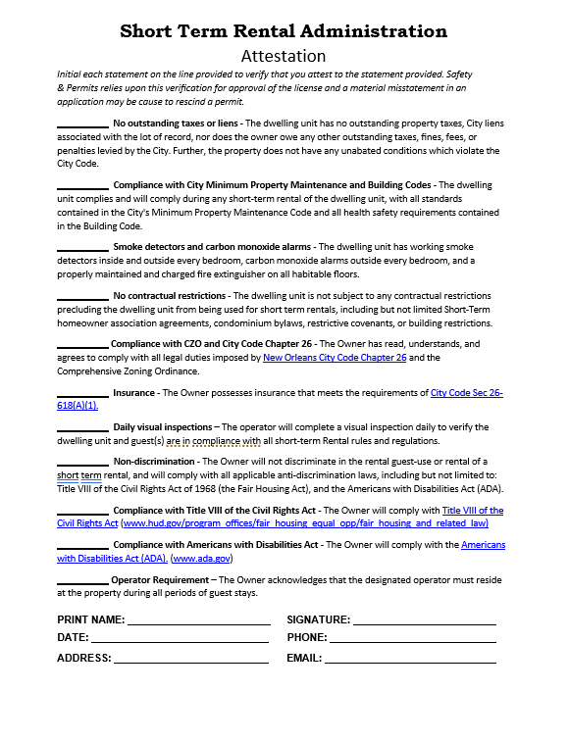
New attestation
Please complete form in its entirety.

Slide 20


  The Healthy Homes ordinance requires that all rental dwelling units must be registered, including Short-Term Rentals.
  You must register to obtain a Certificate of Compliance to rent long-term and short-term. A Certificate of Compliance is NOT an STR license.
  Registration is available online via the OneStopApp or in-person at 1340 Poydras St, Suite 800.
  All information about the program is available on the city’s website:nola.gov/healthyhomes
  Owners of properties with four or more dwelling units were required to have applied by August 15, 2024.
  Owners of properties with 1-3 dwelling units were required to have applied by June 15, 2025. Late applications are still being accepted for a $50 late fee.
  Allowing occupancy of a rental dwelling without a certificate of compliance is a violation of city code and subject to enforcement.

Slide 21
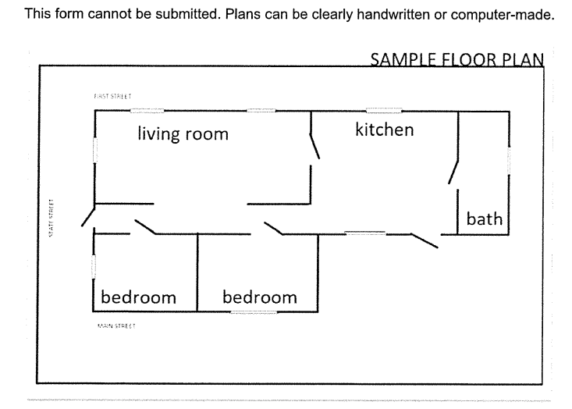
Sample Floor Plan - You MUST label your floor plan. If property is single-family, guests MUST have access to the kitchen.
*Please be sure to label
the operator bedroom
OPERATOR

Slide 22
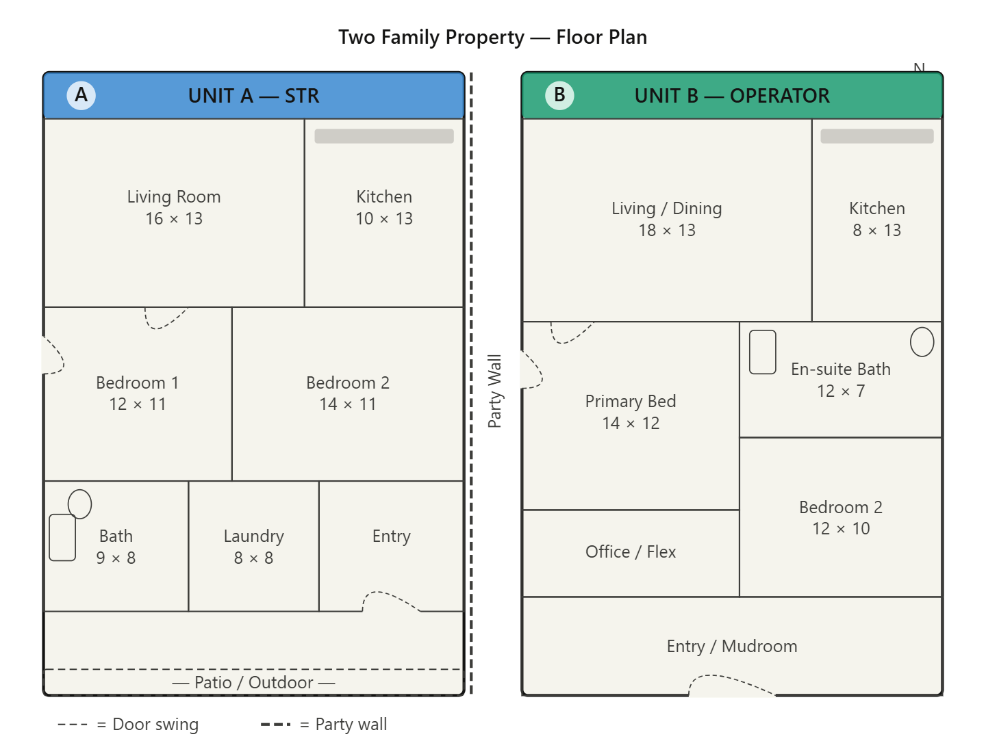
Sample Floor Plan – If multifamily property you must show all units on the parcel and indicate which unit is occupied by the operator
UNIT A - STR
UNIT B - OPERATOR

Slide 23
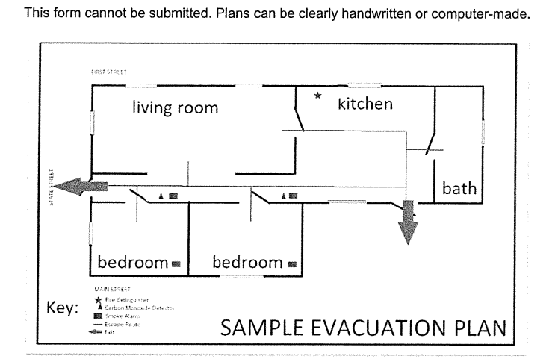
Sample Evac Plan - you must label the emergency devices (fire extinguisher, smoke/carbon monoxide detectors)
*Please be sure to label
the operator bedroom
*Please emphasize the
locations of emergency
equipment.
OPERATOR

Slide 24
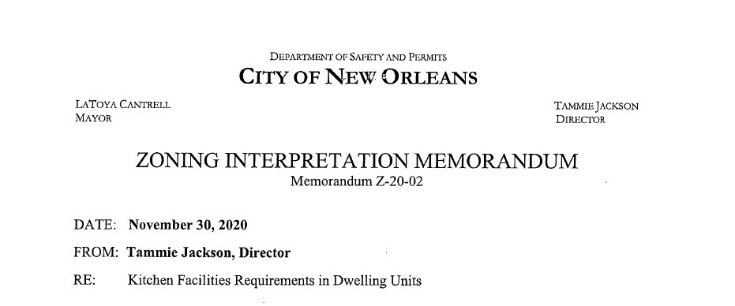
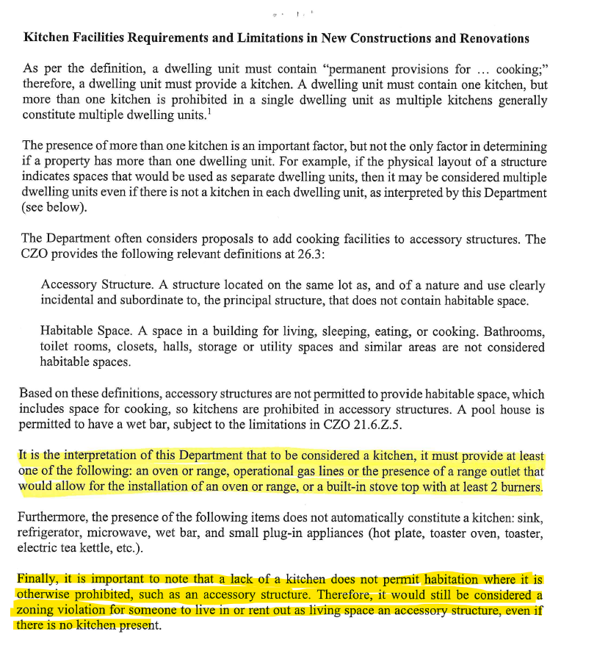
Important Info Re: Kitchens & Bedrooms

Slide 25
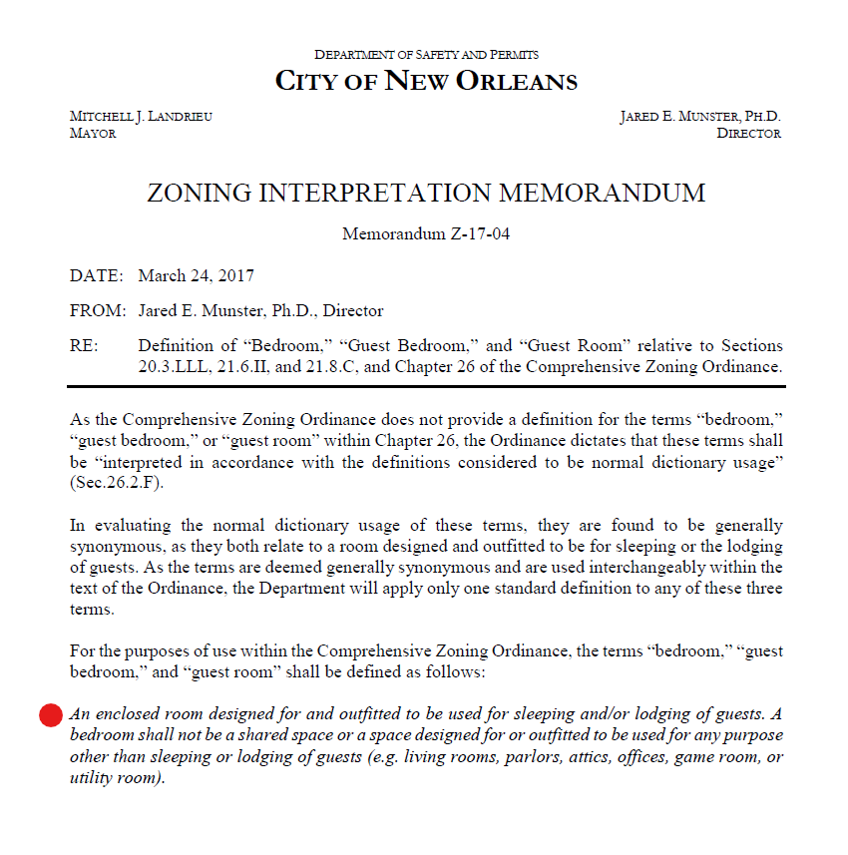

Slide 26
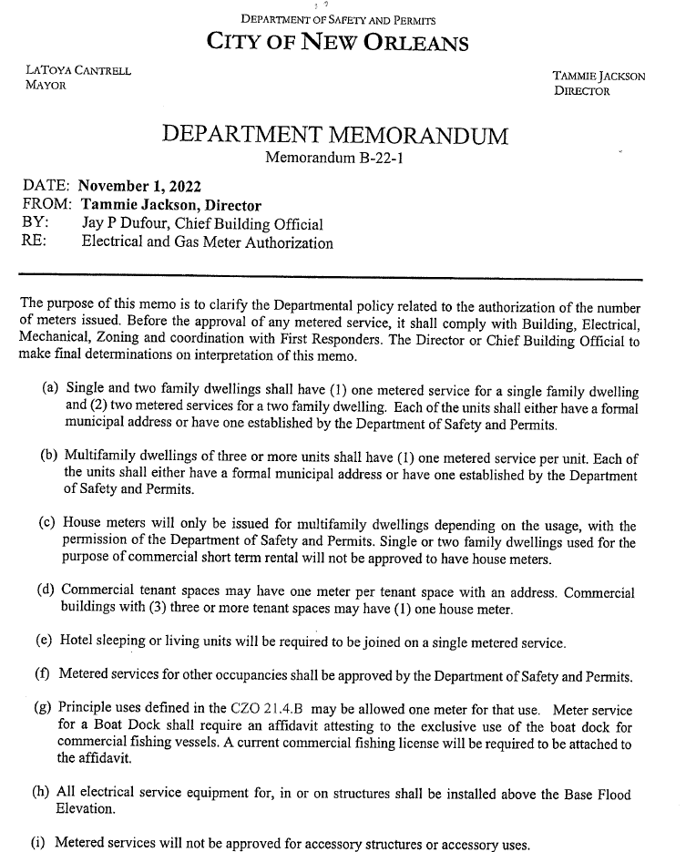

Slide 27
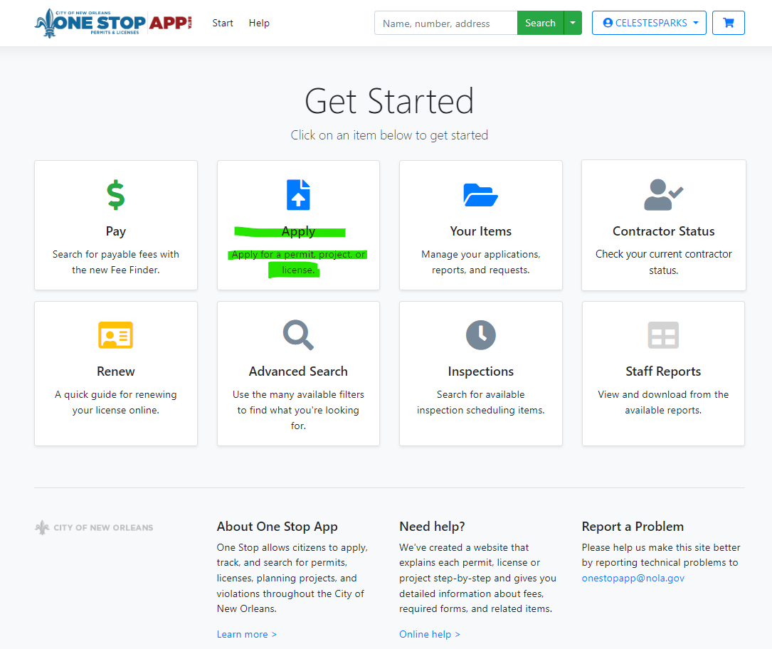
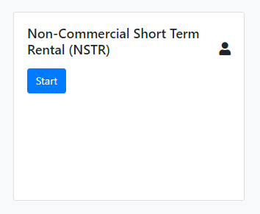
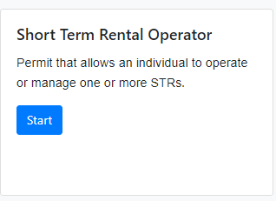
ONESTOPAPP.NOLA.GOV
Available 8am, Sept 16th to 8am, Sept 22nd
Available now
SUBMIT SECOND
SUBMIT FIRST

Slide 28
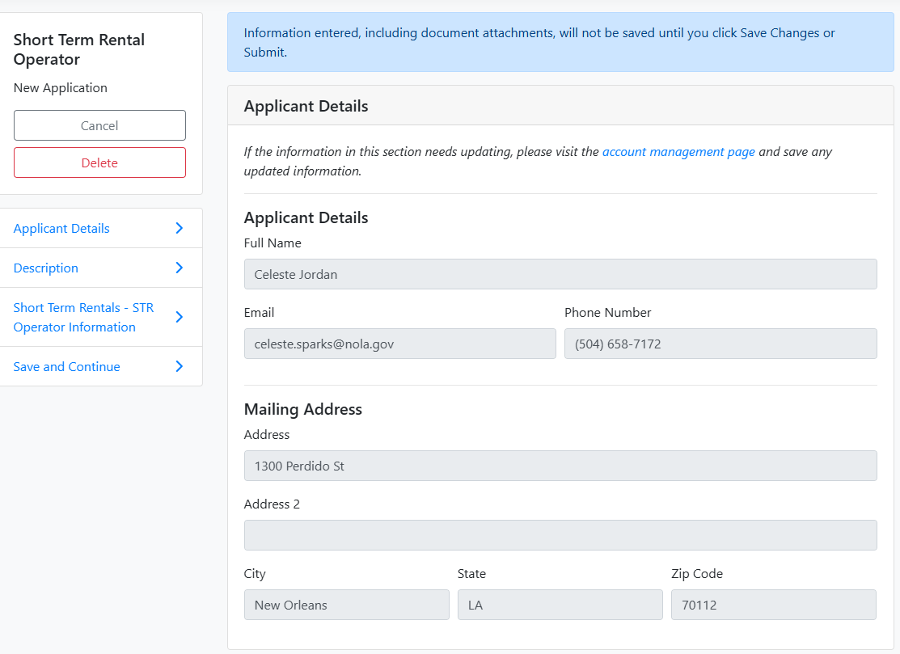
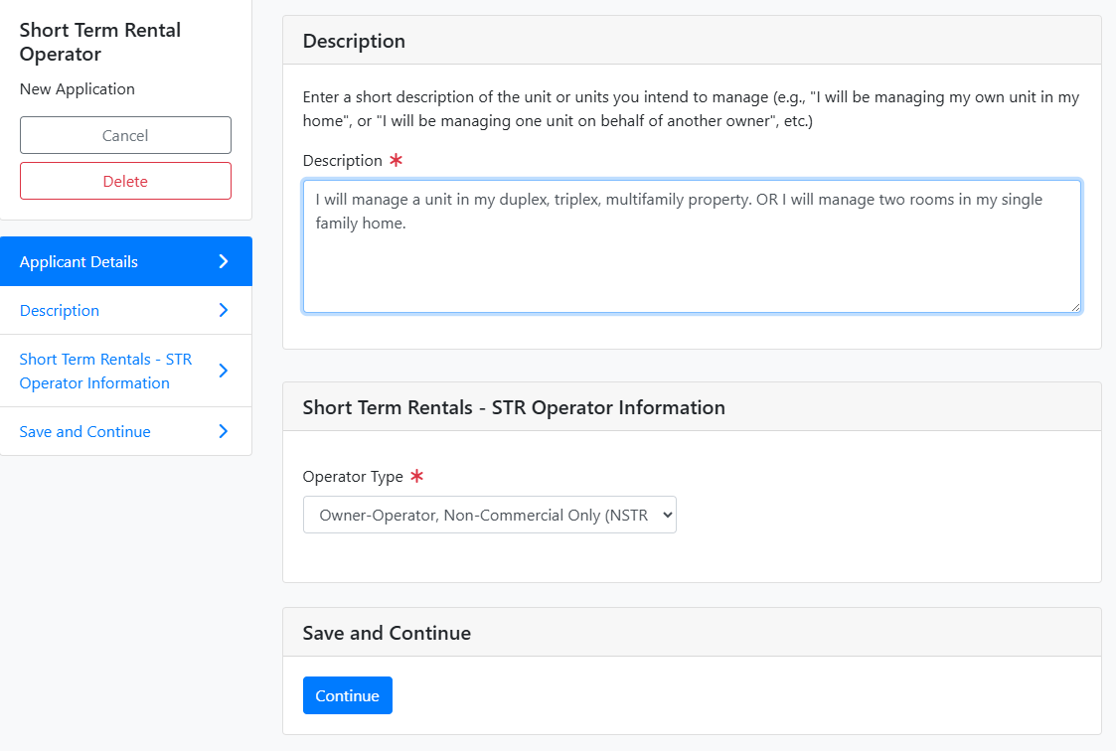

Slide 29
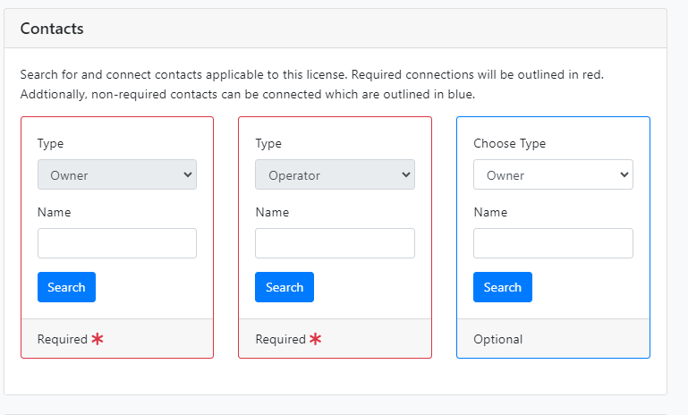
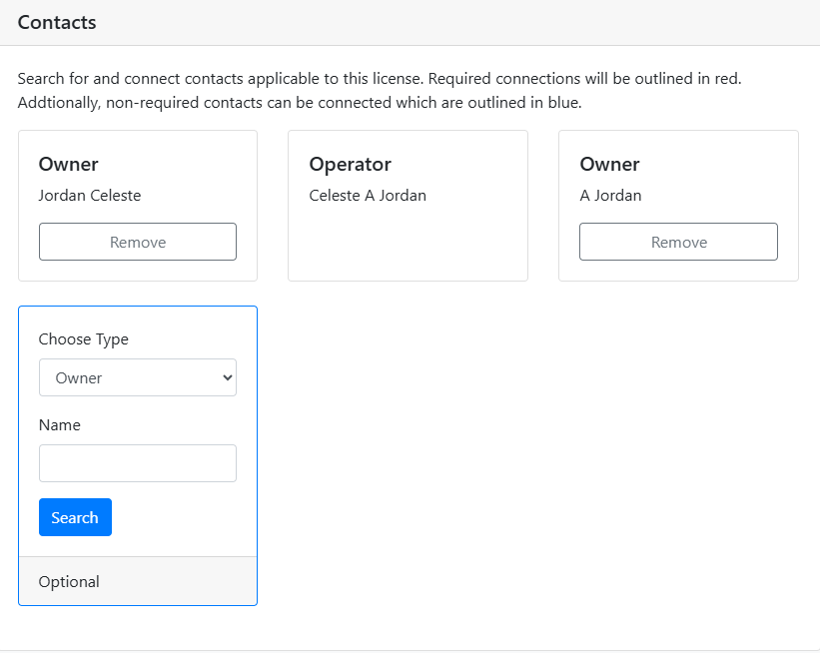

Slide 30
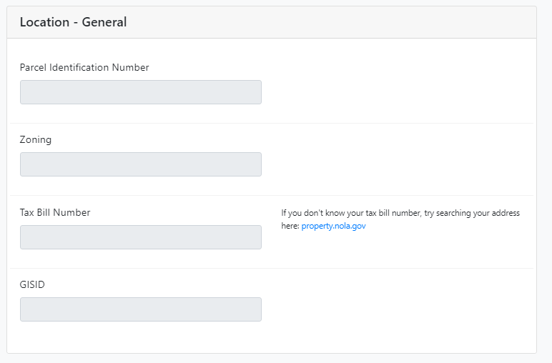
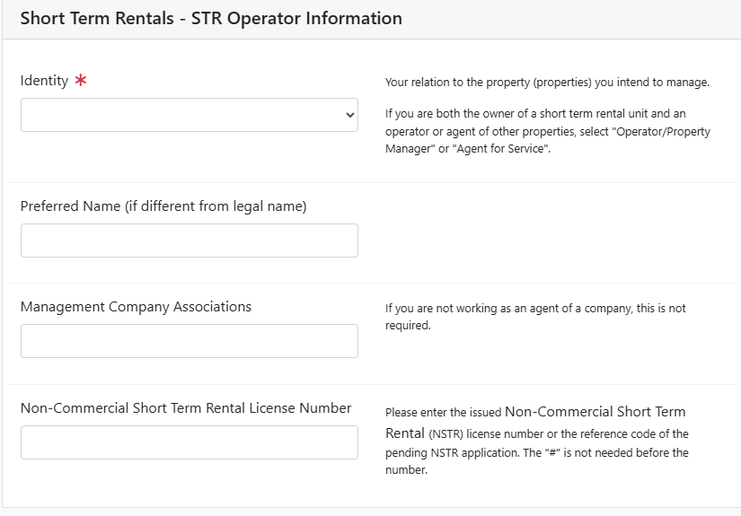
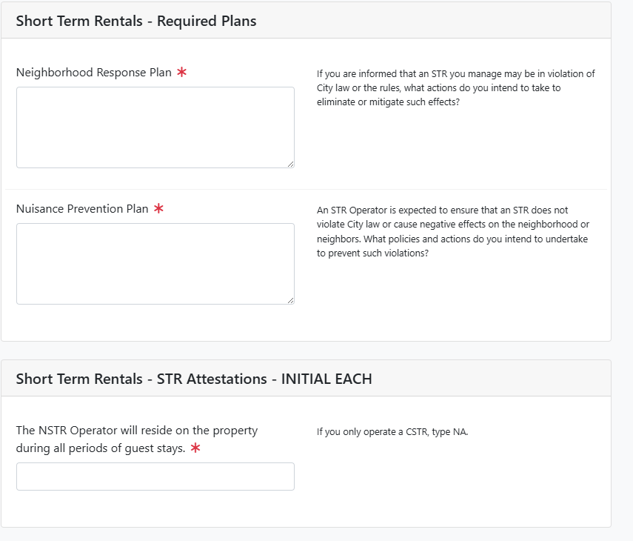

Slide 31
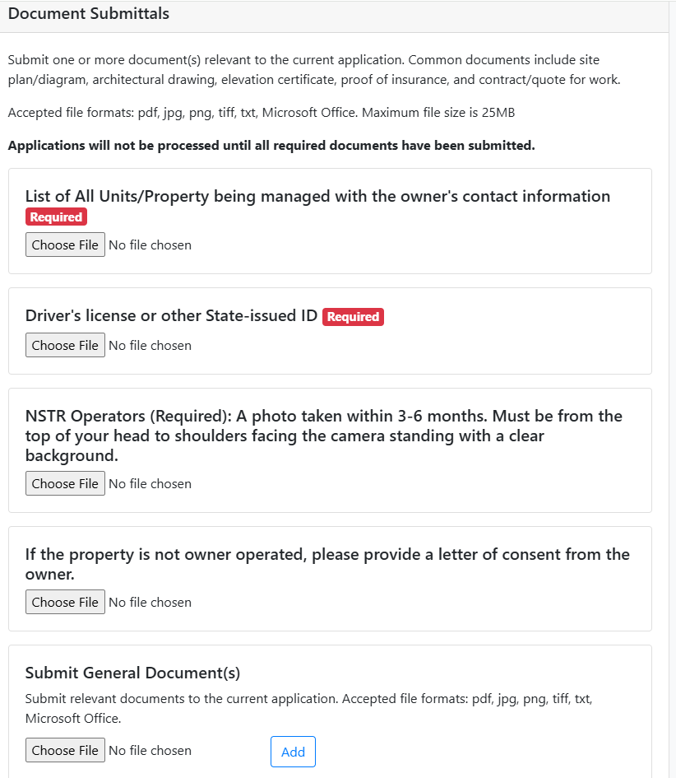
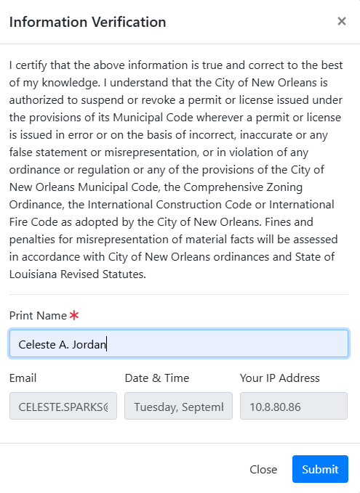
Required upload

Slide 32
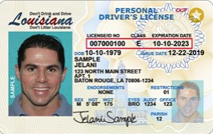
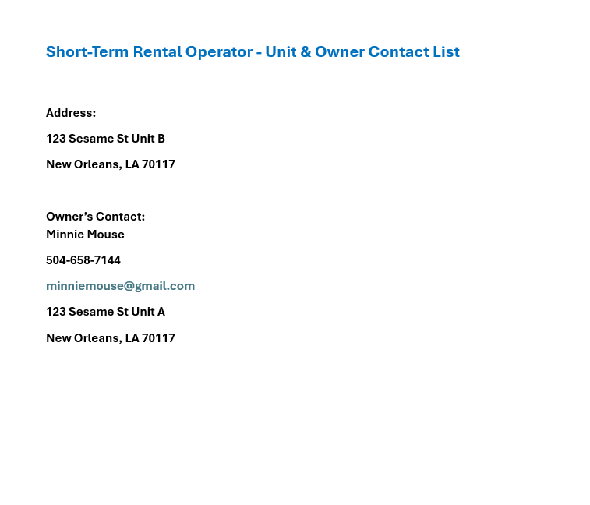
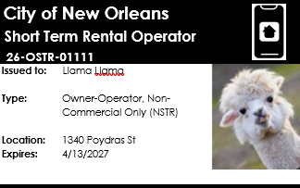
Document Submittals –
List of units - you must provide owner’s contact information
State issued ID
Photo for OSTR card
Letter of consent if not the owner

Slide 33
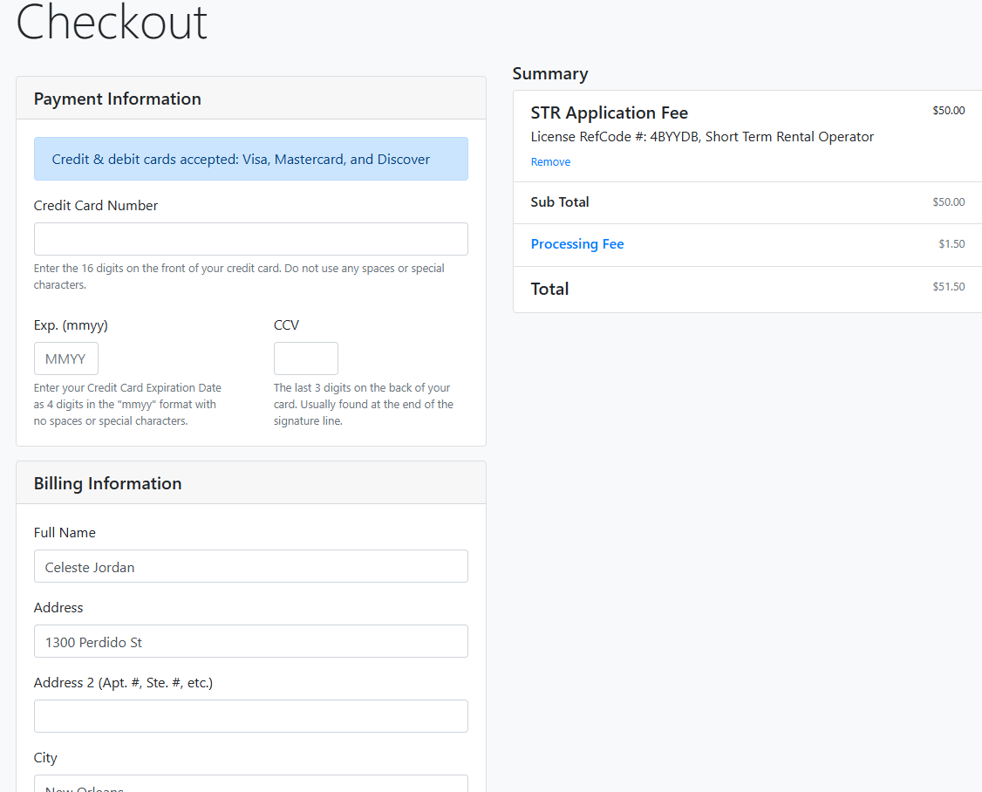

Slide 34
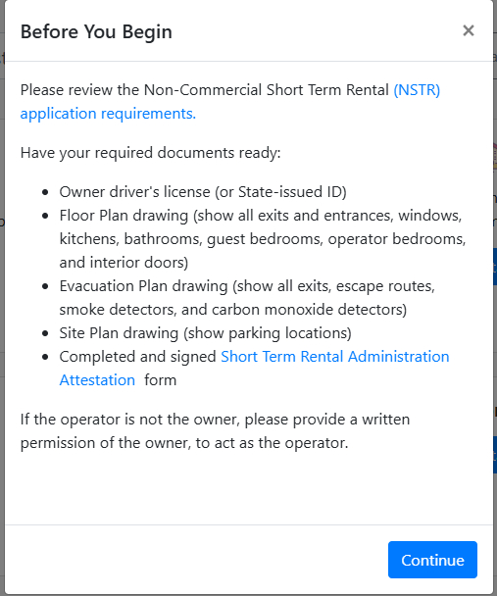
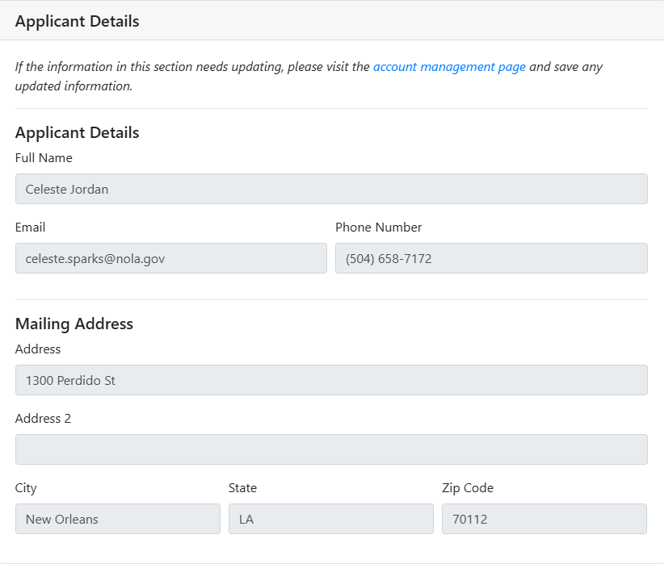
ONESTOPAPP.NOLA.GOV
Please DO NOT edit & submit an old application.

Slide 35
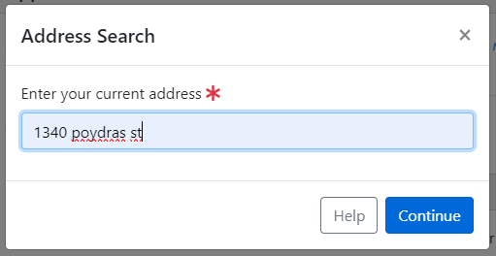
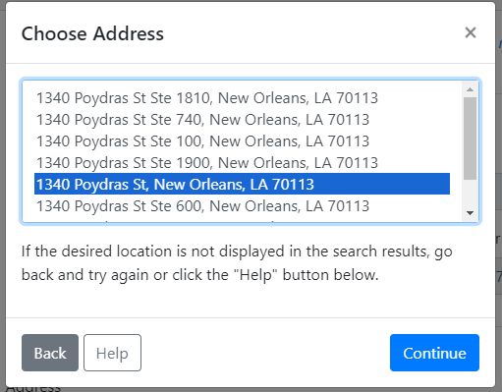
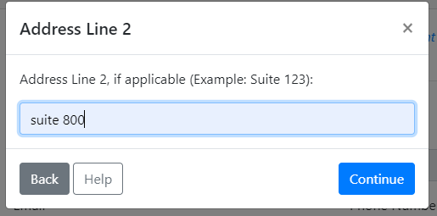
ONESTOPAPP.NOLA.GOV

Slide 36
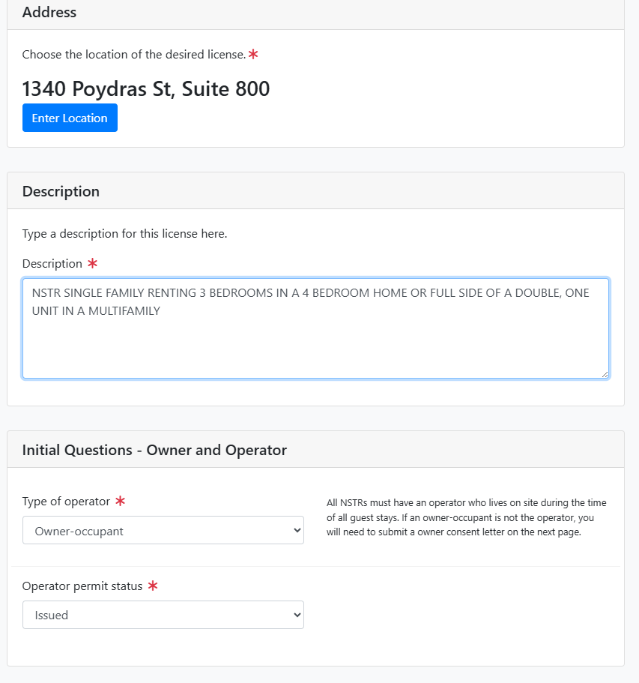
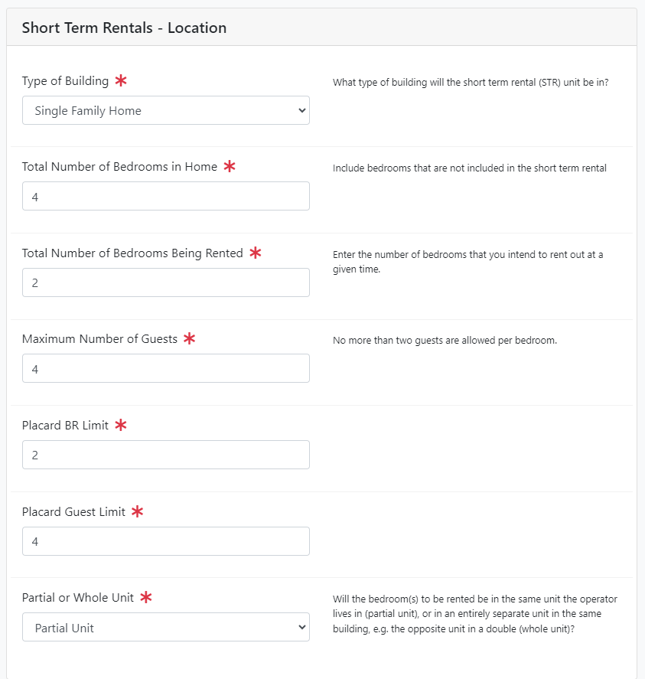
ONESTOPAPP.NOLA.GOV

Slide 37
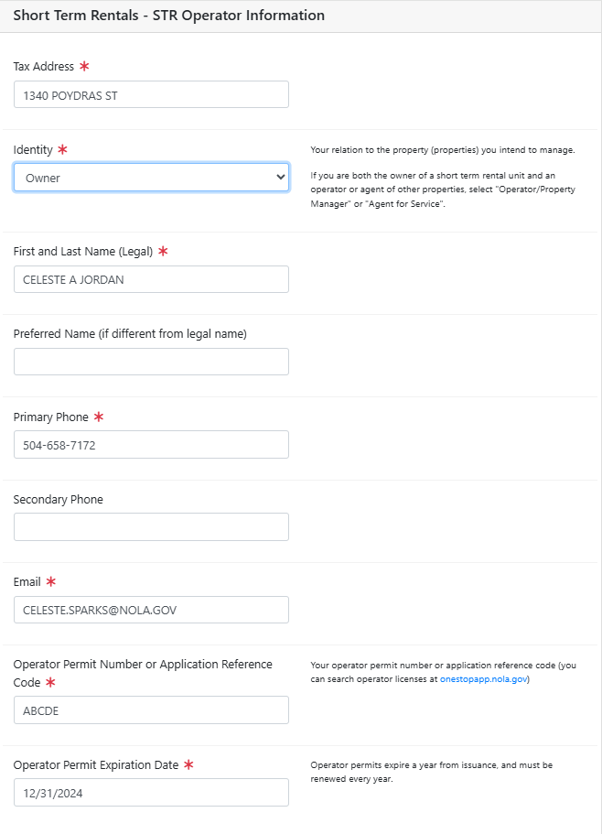
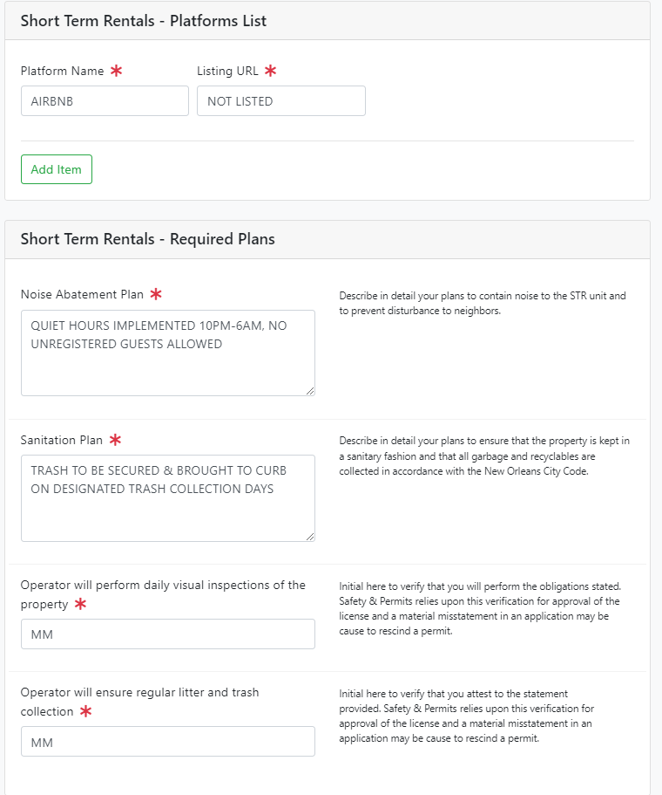
ONESTOPAPP.NOLA.GOV

Slide 38
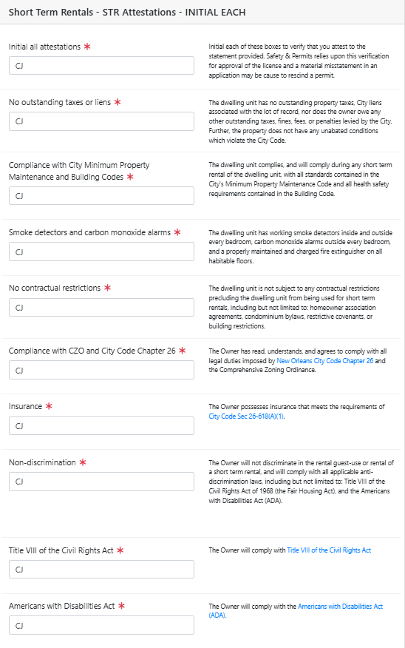

ONESTOPAPP.NOLA.GOV
10/06/2026
RENEWAPRIL2027

Slide 39


ONESTOPAPP.NOLA.GOV

Slide 40


ONESTOPAPP.NOLA.GOV

Slide 41

ONESTOPAPP@NOLA.GOV
ONE STOP APP HELP DESK

Slide 42
Please double check your application for completion. We WILL NOT send review comments & you CANNOT make changes after your application review has been completed. If there are errors or documents missing, your application WILL BE denied. NO EXCEPTIONS! Only complete applications, including payment of the application fee, will be eligible for the lottery process.

Slide 43
If you fail to submit your complete application timely, your application WILL BE denied. NO EXCEPTIONS! Applicants are responsible for ensuring all documents are properly attached & submitted. Denied applications will not be reopened for any reason, even if the request to reopen is accompanied by an email from your Councilperson. Please utilize the office hours to ensure you receive any assistance you need to submit your complete application by September 22 @ 11:59pm.

Slide 44
Please save noreply@nola.gov to your email address book so your decision email does not go to the spam folder.

Slide 45

NSTR LOTTERY

Slide 46

LOTTERY FREQUENCY
Lottery Frequency.
Lotteries will be held quarterly. The Department will annually publish a calendar with application period, lottery, and renewal period dates.

Slide 47
LOTTERY PROCEDURES
Lottery Procedures.
Lotteries will be live streamed via Teams. Lotteries will utilize a bingo or another comparable machine, to ensure fairness. Permit numbers will be drawn in order, so that if there are three applicants for a square, there will be a “first”, “second” and “third.” This order will only apply if there is non-payment of the permit fees. If the permit is lost for any other reason—forfeiture (a permittee sells, moves, or doesn’t want to continue to short term rent the property), non-renewal, revocation, or rescission—unsuccessful permittees may apply for the next quarterly lottery.
Permittees selected in the lottery will be issued a permit upon payment of all fees. All fees must be paid within five (5) calendar days, or the selected permittee forfeits their right to the permit. If the first selected permittee forfeits their right, the second selected permittee will have five days to pay their fees (and so on). Unsuccessful permittees may reapply for the following lottery if the block is reopened for any reason or may apply to the City Planning Commission to participate in the special exception process. An overview of this process is included in Exhibit B of these Rules and Regulations.

Slide 48

PERMIT DURATION
Permit Duration.
Permits will be valid until June 30 of the following year, regardless of which lottery they are issued during. Permit fees for the permit year will be prorated as follows:
  July lottery winners: Full fees ($500)
  September lottery winners: 75% fees ($375)
  January lottery winners: 50% fees ($250)
  April lottery winners: 25% fees ($125)

Slide 49
RENEWALS – Please note that renewal season will begin in April 2027 to ensure all licenses are renewed prior to the expiration date.
Renewals.
Permitholders who remain in good standing with the Department of Safety and Permits will be eligible to apply for renewal of their permits. This requires:
A complete application that includes all required documentation to be resubmitted;
Permittees to apply within the designated renewal period provided in the annual calendar;
Payment of permit fees within five (5) calendar days of application approval;
A valid operator license;
Proof of completion of a short-term rental course to be provided by the Department;
Satisfaction of all judgments, liens, fines, and fees related to the property;
Resolution of any electrical, mechanical, or work without permit violations; and
Closure of all open building permits or written approval of the Chief Building Official for renewal despite the open permit.
Permitholders whose permits have been revoked or rescinded are not eligible for renewal.
If a permitholder fails to renew timely, the square will be eligible for participation in the next quarterly lottery.

Slide 50
LEGAL DUTIES & PROHIBITED ACTS - OWNER
Additional insurance policy not required if listing on Airbnb
Short-term rental advertisements. The owner shall ensure that the following information be provided in connection with any short-term rental advertisement and shall ensure, in any event, that each short-term rental listing advertises only licensed properties, with each listing containing:
  The short-term rental owner permit number;
  The short-term rental operator permit number of the designated operator;
  Whether the dwelling unit is wheelchair accessible or otherwise compliant with the Americans with Disabilities Act; put in listing if it applies to your property;
  The number of available guest bedrooms as indicated on the owner permit;
  The maximum available occupancy of the dwelling unit as indicated on the owner permit.

Slide 51
Adhere to dwelling and occupancy limits. Short-term rentals shall be subject to, and may not exceed, the dwelling-unit-per-lot-of-record, guest bedroom, guest occupancy, and density limitations set forth in the Comprehensive Zoning Ordinance.
Ensure the owner permit is displayed in a location clearly visible from the street and guests & neighbors.
Ensure evacuation diagram identifying fire escapes and all means of egress from the dwelling unit and the building in which the dwelling unit is located must be displayed in a location clearly visible and legible to guests.
Each dwelling unit must have a working fire extinguisher, smoke alarms & carbon monoxide detectors & shall comply with applicable fire codes.
Short-term rental guest use limitations. The owner shall ensure that no dwelling unit used as a short-term rental is used as a reception facility, or any other commercial use defined by the Comprehensive Zoning Ordinance, during guest use of the short-term rental.
Criminal activity. The owner shall timely report any known or suspected criminal activity by a guest to the New Orleans Police Department.
Owner/operator availability. The owner shall:
  Ensure the permitted operator is available during all periods of guest occupancy including nights and weekends, to facilitate compliance with this article. Availability requires, at a minimum that the operator accessible by telephone, able to resolve complaints within one hour of being contacted by neighbors, guests & the city.
  Serve as the point of contact for guests, in addition to the operator, and be able to resolve complaints within one hour of being contacted by guests.

Slide 52
LEGAL DUTIES & PROHIBITED ACTS - OPERATOR
  Natural person, age 18 or over, with proof
  Permit valid for one year from date of issuance, renewed annually
  Operator availability. The operator shall:
    Ensure they are available during all periods of guest occupancy including nights and weekends. Availability requires, at a minimum that the operator accessible by telephone, able to resolve complaints within one hour of being contacted by neighbors, guests & the city.
    Must reside at the property during all scheduled stays
    Short-term rental advertisements. The operator shall be responsible with the owner for ensuring full compliance with the advertising requirements set forth in section 26-618(a)(3).
    Required postings at the short-term rental. The operator shall be responsible with the owner for ensuring full compliance with the posting requirements set forth in section 26-618(a)(5).
    Criminal activity. The operator shall be responsible with the owner for reporting any known or suspected criminal activity by a short-term rental guest to the New Orleans Police Department as set forth in section 26-618(a)(8).

Slide 53
  Short-term rental use that generates (i) excessive loud sound, (ii) offensive odors, (iii)
  public drunkenness, (iv) unlawful loitering, (v) litter, (vi) lewd conduct by guests or (vii) any effect that otherwise unreasonably interferes with neighbors' quiet enjoyment of their properties. For purposes of this paragraph, excessive loud sound means any noise generated from within the dwelling unit or having a nexus to the dwelling unit that is louder than a conversational level, or any music that is plainly audible from the property line of the lot containing the dwelling unit, between the hours of 10:00 p.m. and 8:00 a.m. Each instance and type of unreasonable interference defined in this paragraph shall constitute a separate violation of this section and may be cited separately in any enforcement action.
  Failure to reside on the premises during guest stays as required by law.
  Failure of the operator to be available as required by law.
  The licensed operator is personally responsible for fulfilling these duties and may not delegate them to any other person or entity.

Slide 54
Violation of the Legal Duties and/or Prohibited Acts May Be Grounds For Suspension or Revocation of a Short-Term Rental Owner and/or Operator License.

Slide 55
STAY UP TO DATE

Slide 56



Slide 57


STR@NOLA.GOV

Slide 58
QUESTIONS?
RENEWAPRIL2027

